Slide 1
Copper in health and disease
Talk: Srinivas Sankaranarayanan
Chairpersons: Bela Verma, Parag Tamhankar

Slide 2
Copper in Health and Disease
Dr. Srinivas s
Consultant pediatric gastroenterologist
Apollo childrens hospital
Kanchi kamakoti childs trust hospital

Slide 3
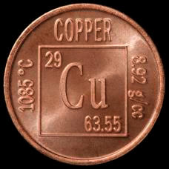
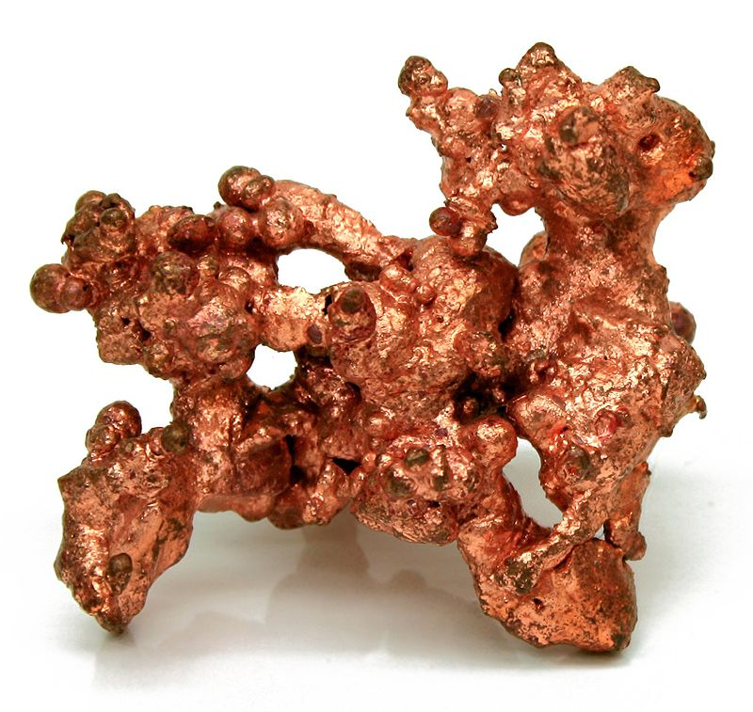
COPPER
Copper is a chemical element with symbol Cu and atomic number 29.
It is a soft, malleable, and ductile metal with very high thermal and electrical conductivity.
A freshly exposed surface of pure copper has a reddish-orange color.

Slide 4
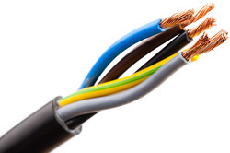
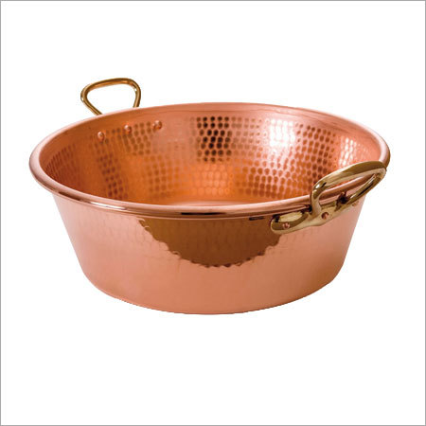
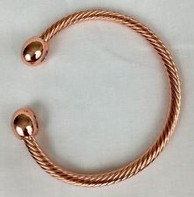
COPPER IS A USEFUL METAL
Copper is used as a conductor of heat and electricity, as a building material, and as a constituent of various metal alloys

Slide 5
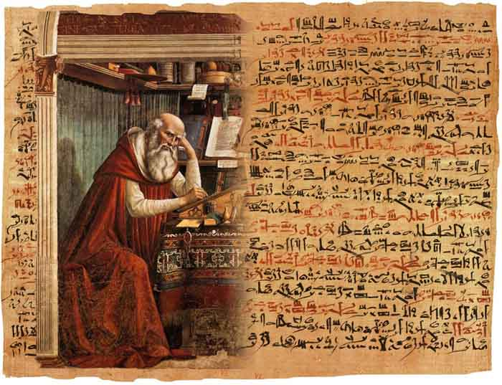
A BIT OF HISTORY
EDWIN SMITH SURGICAL PAPYRUS
The oldest surgical treatise on trauma – Egyptian dating back to 1600 BC reports the antiseptic use of Cu application to prevent wound infections

Slide 6
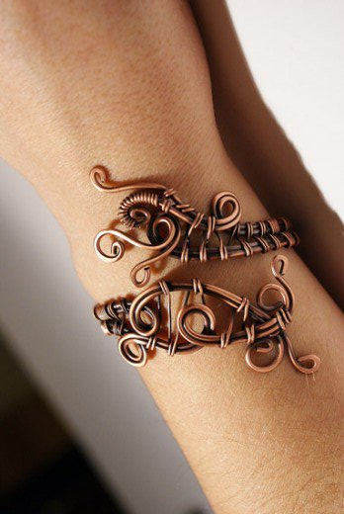
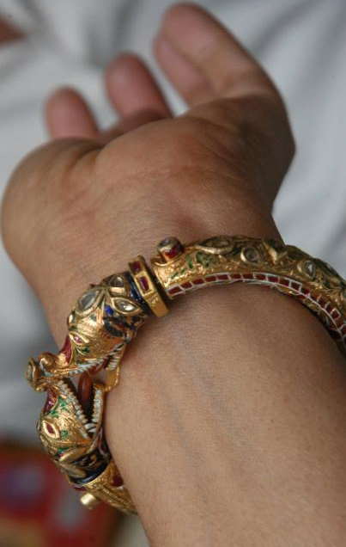
COPPER BRACELETS – Medicinal benefits?
The earliest use of copper bracelets dates back to 800 BC
Copper bracelets were so popular in 1970s for arthritis
Antimicrobial Copper touch surfaces are a new weapon in the fight against healthcare-associated infections and the spread of antimicrobial resistance.

Slide 7
Copper helps fight super bugs
Antimicrobial activity of copper surfaces against carbapenemase-producing contemporary Gram-negative clinical isolates. M Souli, I Galani, D Plachouras, T Panagea, G Petrikkos and H Giamarellou. Journal of Antimicrobial Chemotherapy, April 2013, 68(4), p. 852-7.
Sustained Reduction of Microbial Burden on Common Hospital Surfaces through Introduction of Copper. MG Schmidt, HH Attaway, PA Sharpe, JF John, KA Sepkowitz, A Morgan, SE Fairey, S Singh, LL Steede, JR Cantey, KD Freeman, H Michels and CD Salgado. Journal of Clinical Microbiology 2012, Vol. 50 No. 7 2217-2223.
Copper Surfaces Reduce the Rate of Healthcare-Acquired Infections in the Intensive Care Unit. CD Salgado, KA Sepkowitz, JF John, JR Cantey, HH Attaway, KD Freeman, MG Schmidt. Infection Control and Hospital Epidemiology 2013, 34(5), 479–486.

Slide 8
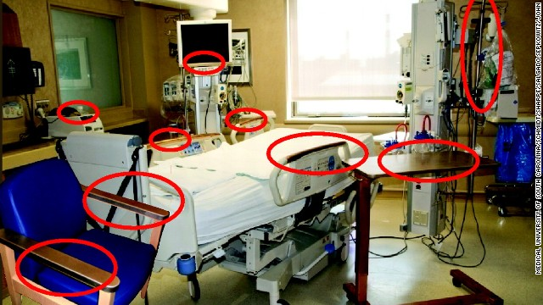
Cu Surfaces Reduce Infections in ICU.

Slide 9
Cu is an essential trace element
Cu is a cofactor of proteins and enzymes (called cuproenzymes) involved in fundamental mechanisms, such as energy generation, oxygen transportation, hematopoiesis, cellular metabolism and signal transduction

Slide 10
COPPER IN NEUROLOGY
Copper is a critical element for major neuronal functions, and the central nervous system is a major target of disorders of copper metabolism.
Both the accumulation of Cu (eg. Wilsons disease) and Cu deficiency (eg. Menke’s disease) are associated with brain dysfunction !!

Slide 11
Cu STORES IN THE BODY
TOTAL Cu IN ADULT HUMAN BODY | 90-110 g
Bones | 47%
Skeletal muscles | 27%
Liver and brain | 8-11%
Highest concentrations in liver, brain, kidney and heart

Slide 12
Cu METABOLISM
In blood, about 65%-90% of the copper Cu2+ is bound to ceruloplasmin.
The remaining 10-35 % participate in exchanges with albumin, transcuprein, alpha 2 macroglobulin.

Slide 13
Cu METABOLISM
Most copper in the human body is present as Cu+ (cuprous) and oxidized Cu2+ (cupric) compounds
Copper is mainly absorbed in the duodenum and proximal jejunum.
The current recommended dietary intake in the USA is 0.9 mg/day.
The average daily intake of copper is between 0.5 and 1.5 mg.

Slide 15
Cu EXCRETION
Copper is excreted endogenously in the saliva, the gastric fluids and intestinal liquids.
Copper is excreted from the body either in a non-absorbed form or via the bile.
The estimated amount of copper in feces is 1–1.5 mg/day.

Slide 16
COPPER HOMEOSTASIS
The intra-cellular and extra-cellular metabolism of copper is under tight control, in order to maintain free copper concentrations at very low levels.
The redox capacities of free copper, its ability to trigger the production of reactive oxygen species and the close relationships with the regulation of iron and zinc are remarkable features.
Bulk of evidence in the role of copper in neurodegenerative diseases - Wilsons, Alzheimer, Parkinson

Slide 17
Cu METABOLISM
The human copper transport protein 1 (hCTR1), located at the level of enterocytes, transfers the ion following the reduction of dietary Cu2+ into Cu+.
In hepatocytes, copper binds to metallothioneins (MTs), to reduced glutathione (GSH) or to one of the copper chaperones regulating the traffic of intracellular copper

Slide 18
Regulates Cu influx

Slide 19
CHAPERONE ?

Slide 20
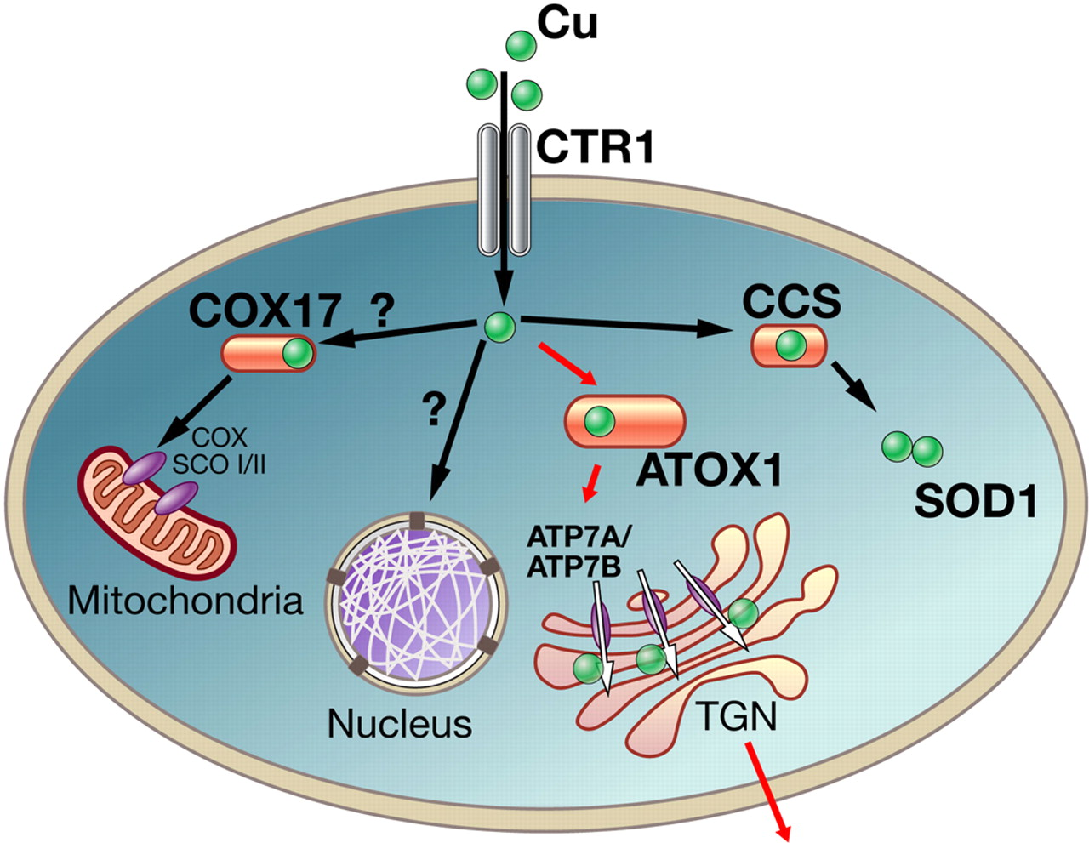
Cu CHAPERONE?
They act like a shuttle. Without chaperones, copper would be directly scavenged by MTs, GSH and mitochondria.

Slide 21
Free Cu crosses the blood-brain barrier BBB.
CTR1 and ATP7A contribute to the net influx of Cu towards the CNS.
As mentioned earlier, this Cu is potentially toxic, being available for the Haber–Weiss and Fenton reactions.
Nevertheless, Cu is rapidly sequestrated by GSH, a mechanism of protection against the toxic effects of free copper

Slide 22
ATP7A
ATP7A is an intra-cellular pump transferring Cu into the Golgi apparatus. This is required to incorporate the ion into cuproenzymes, such as the dopamine-beta-hydroxylase.
ATP7A is essential not only for the CNS, but also for peripheral nerves

Slide 23
MENKE’S DISEASE - Cu deficiency
Mutation in ATP7A gene
X linked disease
MD presents in infants bet 6 wks and 1 yr
MD is characterized by mental retardation, seizures, abnormal lightly pigmented hair, bone fragility and aortic aneurysms.
Cu deficiency state: Cu accumulates in the intestine and cannot be absorbed in blood. A similar process occurs at the level of the BBB, causing a lack of ions within the CNS.

Slide 24
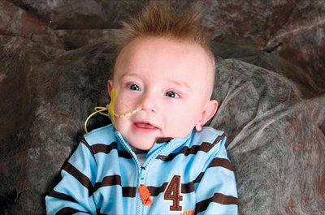
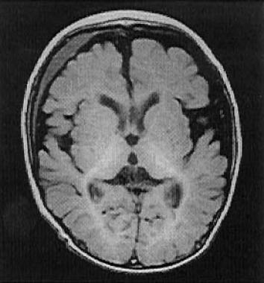
Low serum Cu < 70 mg/dL (ref 80-160)
Low serum ceruloplasmin level < 20 mg/dL (ref 20-60)
High DOPA and DHPG ratio

Slide 25
Parenteral Copper therapy
Gene therapy using adeno associated viral vectors

Slide 26
Other Cu deficiency states
Occipital horn syndrome
ATP7A related isolated distal motor neuropathy
Zinc induced myeloneuropathy

Slide 27
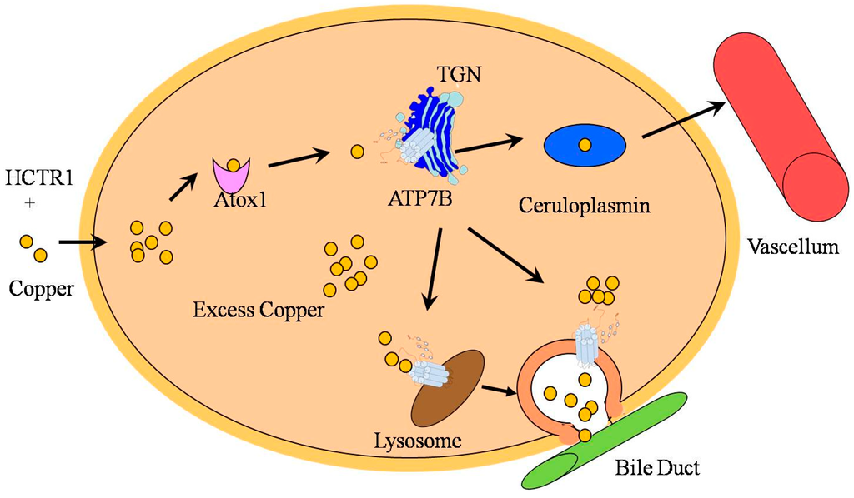
WILSONS DISEASE - ATP7B gene
This causes deficits not only for the excretion of Cu into the bile, but also in terms of the binding of Cu to ceruloplasmin.

Slide 28
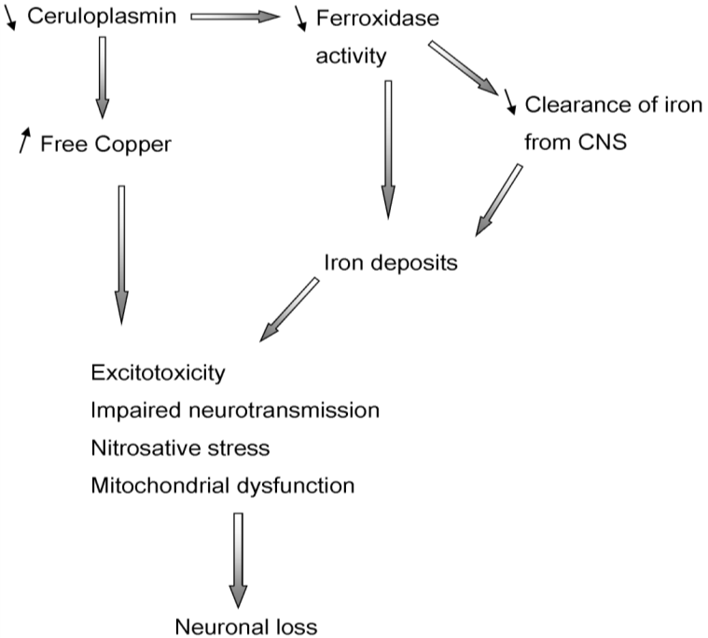
Cascade of events triggered by low cerruloplasmin

Slide 29
THERAPY OF WILSONS DISEASE
Chelating agents
D penicillamine
Tetrathiomolybdate
Trientine
Zinc: competes with intestinal Cu intake and also induces intestinal metallothionien

Slide 30
Acerruloplasminemia
This causes the accumulation of iron in the CNS, especially in basal ganglia, in retina, liver and pancreas.
Clinically, patients exhibit diabetes mellitus, retinal degeneration and a progressive neurological syndrome combining extrapyramidal signs, cerebellar ataxia and dementia, usually between the age of 25 and 60 years
Low serum Cu
Low serum iron, high ferritin, microcytic hypochromic anemia
Rx: iron chelators, antioxidants, zinc

Slide 31
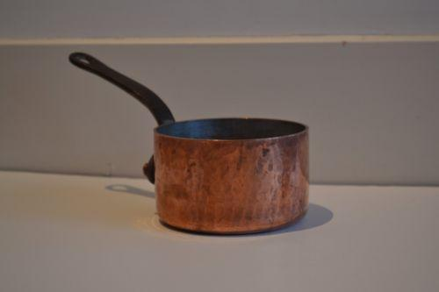
INDIAN CHILDHOOD CIRRHOSIS - MYTH OR ERSTWHILE REALITY ?
A unique disease thought to be due to exogenous Cu overload !!
1887: Boyle Chunder Sen described the first account of this disease in Calcutta - infantile biliary cirrhosis
Charecteristics
Micronodular cirrhosis
Mallory hyaline
Orcein stainable Cu positivity

Slide 32
1950s: Reports of ICC started raining in
from several regions of the country, particularly Chennai and Vellore in the south, Delhi and Chandigarh in the north, Bombay (now Mumbai) and Gujarat in the west and Gwalior and Uttar Pradesh in central India.
The first major breakthrough: Mallory hyaline
Tanner and Pune associates suggested that the hepatic copper overload and liver injury in ICC resulted from early top feeding of animal milk containing high levels of Cu from storage in brass utensils.

Slide 33
Tyrolean childhood cirrhosis

Slide 34
Few reports of ICC like illness
Reports of ICC like illness from
Austria: Tyrolean childhood cirrhosis
Japan
Australia
Germany
They justified the term ‘Idiopathic copper toxicity’ adding that the exogenous copper causes disease only in genetically predisposed children with an autosomal recessive inheritance.

Slide 35
ICC was conquered by a decade long campaign against Cu
Gradually Cu and brass utensils - lost favour
Replaced by aluminium and stainless steel
As the use of Cu disappeared; ICC disappeared too !!
Only rare sporadic reports nowadays

Slide 36
Recent multicentre study - ICMR
The notion that excessive copper intake in infancy through food or water contaminated by the metal from copper yielding utensils or copper tubing seems ill founded.
The evidence on which this concept was based was inadequate and largely circumstantial.
Epidemiologic, clinical and morphological data from large, well controlled studies have failed to incriminate exogenous copper in causing a toxic injury or the copper overloading of liver in ICC.

Slide 37
ALZHEIMER’S DISEASE
Commonest dementia worldwide with major histopathological findings: Senile plaques and neurofibrillary tangles
AD is due to an abnormal processing of the APP (amyloid precursor protein) by β- and γ-secretases
Copper not bound to ceruloplasmin, rather than absolute serum copper levels, is a key-concept for the understanding of the pathogenesis of AD.
The role of copper related oxidative stress in the initiation and propagation of an inflammatory cascade within the aging brain has been suggested

Slide 38
ALZHEIMER’S DISEASE
ATP7B loss-of-function variants in transmembrane domains increase disease risk of Alzheimer’s and Parkinson disease
Clinical trials with metal modulators are in progress, in order to assess the effects of therapies redistributing copper amongst the different compartments.
Chelating agents improve cognitive symptoms in animal models of AD

Slide 39
TAKE HOME POINTS
Cu is an essential trace element
Important co-factor for cupro enzymes
It has antimicrobial properties
Cu deficiency as well as Cu toxicity can cause disease
ATP7 B gene mutations cause Wilsons disease
Free Cu levels are tightly regulated
Free Cu is toxic above a certain level - increasing evidence of Cu in neurodegenerative diseases
ICC has almost disappeared

Slide 40
THANK YOU FOR A PATIENT LISTENING

