Slide 1
Panel Discussion
Genetics: Is there a role in clinical practice?
Moderator: Seema Alam
Panelists: Ashish Bavdekar, Malathi Sathiyasekaran,
Parag Tamhankar

Slide 2
Role of Genetic Testing in Wilson Disease

Slide 3
Case 1

Slide 4
7 year old boy
Chronic hepatitis
Investigations
Ceruloplasmin 4mg/dl
24 hour urinary copper 458 mcg/day,
KF Ring positive
Diagnosis: Wilsons disease
Is genetic analysis needed???

Slide 5
Is genetic analysis needed???
As per AASLD 2009 guidelines, diagnosis of WD is confirmed in this child
Genetic test will not aid any further for this child

Slide 6
Same child - 5 common mutations negative Is it not Wilson Disease ???

Slide 7
Is it not Wilson Disease ???
>500 ATP7B mutations - reported in WD
Apart from mutations in the exons, mutations in regulatory elements as well
A NEGATIVE GENETIC TEST DOES NOT RULE OUT WD
Indian J Gastroenterol (November–December 2012)

Slide 8
Case 2

Slide 9
10 year Boy - Acute-on-chronic liver failure
Acute: Hepatitis E
Chronic: Wilson Disease
Coombs –ve hemolysis
Grade 3 Hepatic Encephalopathy
PELD: 27, NWI: 16
Diagnosis: Acute Fulminant Wilson Disease
Role of genetics in such a scenario??

Slide 10
Role of genetics in such a scenario??
Important for the screening of other family members
If mutation not possible or no known mutation detected → Preserve DNA of the patient for linkage/haplotype analysis

Slide 11
Case 3

Slide 12
Asymptomatic 4 year old Sibling of Wilson disease
Liver Function tests , USG normal
Ceruloplasmin: 18 mg/dl
24 hour urinary copper: 40 mcg/day
No K-F ring
Would genetic testing help in diagnosis??

Slide 13
Genetic testing method of choice for screening in first degree family relatives
If mutation for proband is positive, direct gene testing in famliy
If mutation is negative or unknown then haplotype analysis
AASLD Class I, Level B

Slide 14
Case 4

Slide 15
8 year old female
Chronic hepatitis
Investigations
Ceruloplasmin 7mg/dl
24 hour urinary copper 228 mcg/day,
KF Ring negative
Diagnosis: Suspected Wilsons disease
Does genetic analysis obviate the need for liver biopsy??

Slide 16
Genetic testing is not cost effective
Liver biopsy - provides additional information about the liver status
Genetic testing maybe offered in inconclusive report

Slide 17
Case 5

Slide 18
10 year old diagnosed as Wilson Disease Mutation detected
Asymptomatic sibling
Same homozygous mutation present and started on chelation
Biochemical tests not done
Is it appropriate to start treatment on the basis of just presence of genetic mutations without evidence of abnormal biochemical parameters?

Slide 19
Biochemical tests v/s Genetic Studies
Biochemical tests help in diagnosis as well as monitoring patients on treatment
Biochemical tests cannot be replaced by genetic studies.
Phenotypic and genotypic heterogeneity is known with Wilson Disease
Not enough data to prove genotype – phenotype correlation

Slide 20
Case 6

Slide 21
Master S / 7 year / Boy
Acute Fulminant Wilson Disease
PELD- 30, NWI 12
Planned for liver transplant
Probable donors-
18 year old elder sibling
Parent
What is the role of genetic studies in donor evaluation for Liver Transplant?

Slide 22
Role of Genetic testing in donor evaluation
In the 18 year old sibling:
Genetic mutations may be helpful in patients with low normal ceruloplasmin levels and normal phenotype
Genetic tests would help to identify specific gene mutations (homozygous/ heterozygous)
In the asymptomatic parent:
Identify homozygous and heterozygous mutation
DNA linkage analysis and haplotype studies in places where direct gene studies are not available.

Slide 23
Case 7

Slide 24
25 year old
Chronic Liver Disease - Wilson Disease
Compliant to diet and treatment
Plans to start a family
What genetic counseling would you give to this patient?
Is prenatal diagnosis possible?

Slide 25
Autosomal Recessive
In a consanguineous marriage:
Both parents heterozygous: 25% affected & 50% would be carriers.
One parent diseased and the other is heterozygous: 50% affected
Asymptomatic partner can be heterozygous for the mutation. Genetic testing should be advised.
Prenatal diagnosis can help in early diagnosis and treatment with good long term outcome.

Slide 26
Case 8

Slide 27
15 year old boy
Neurological Wilson Disease
Role of genetic testing in Neurological Wilson Disease??
Any specific gene mutation associated with Neurological Wilson Disease??

Slide 28
Genotype- Phenotype correlation
Correlation with age and neurological presentation
NO correlation with age and neurological presentation

Slide 29
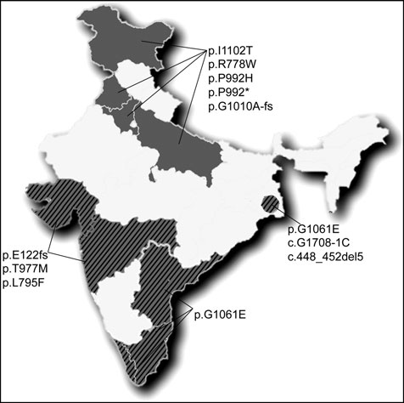
Indian mutations in Wilson Disease
Different centers screen for different allele panels
No consistent results from the available studies
Large population with genetic heterogeneity
High rates of consanguineous marriages in some parts of the country
No caste based/ community based studies to identify common mutations in a particular group.
Aggarwal A, et al. Ann Hum Genet. 2010

Slide 30
Study | Place | Sample size | Common mutation | Phenotype
S. Mukherjee | Kolkota and Pune | 199 | p.C271X (24%) p.G1101R (23%)
Aggarwal A | Mumbai | 53 | p.C271X (20.2%) p.E122fs (10.6%) | Hepatic: 30% Neuro: 66%
Kumar S. | Chandigarh | 41 | T33053 (6 %) C2975A (6 %) 2977insA (6 %) | Hepatic: 60% Neuro: 21%
Gupta A. | Kolkota | 62 | C813A (19 %)
Santhosh S. | Vellore | 27 | G3182A (16 %) C813A (12 %)
@ ILBS | New Delhi | 16 | G3182A (50%) C813A (30%) | Hepatic : 11/16 Neuro: 01/03

Slide 31
Key Messages
Definite role of genetic studies especially with negative/ inconclusive biochemical tests.
Screening for genetic mutations is more effective with known mutation in the proband.
Genotype – Phenotype correlation is not consistent
Lack of consistent data for mutations in India due to no uniformity in allele testing.

Slide 32
Thank You

