Slide 1




Panel Discussion
Developmental, speech, psychiatric and counseling issues
Moderator: Sanjib Sinha
Panelists: John Matthai, N Shivashankar,
Prashanth LK, Samir Dalwai,
Sohini Chatterjee

Slide 2

Wilson’s Disease: Developmental, Speech, Psychiatric & Counselling Issues
Sanjib Sinha
Panelists :
John Mathai
N. Shivshankar
Prashanth LK
Samir Dalwai
Sohini Chatterjee

Slide 3
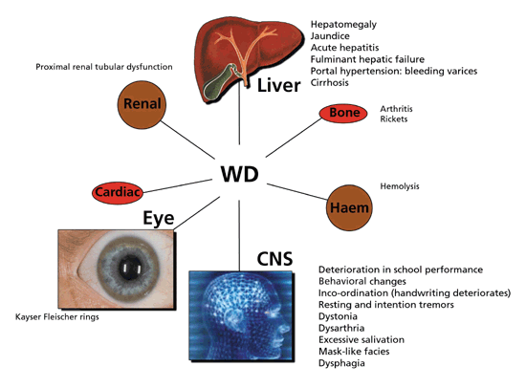
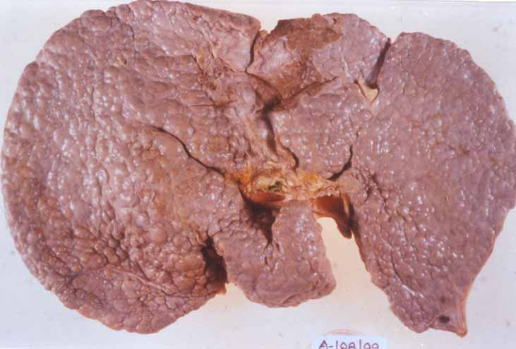
Multisystem Involvement
Liver
Genitourinary
Fracture
Autonomic
Hypersplenism
Sunflower cataract
seizures

Slide 4
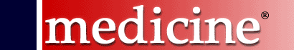
Phenotypic Characteristics
 | n | % | Age | Duration of illness (months) | H/o jaundice
Hepatic | 42 | 14.9 | 10.9±3 .9 | 13.3±18.7 | 41/42 (97.6 %)
Hepato-neurological | 10 | 3.5 | 18.8±7.5 | 35.1±36.4 | 9/10 (97.5 %)
Neurological | 195 | 69.1 | 16.8±8.3 | 29.3±33.2 | 59/189 * (31.2 %)
Pure psychiatric | 7 | 2.4 | 24.1±4.9 | 43.0±25.4 | 1/6 *(16.6 %)
Osseomuscular | 6 | 2.1 | 23.0±9.1 | 103.7±104.4 | 1/5 *(20.0 %)
Presymptomatic | 15 | 6.0 | 10.2±6.1 | ---- | ----*
Others | 7 | 2.4 | ---- | ---- | ----*
M:F 196:86
Duration of Illness 841.6±1098.7 days (0 to 7300 days)
Taly AB, Meenakshi-Sundaram S, Sinha S, et al. Medicine 2007;82 (2): 112-119

Slide 5
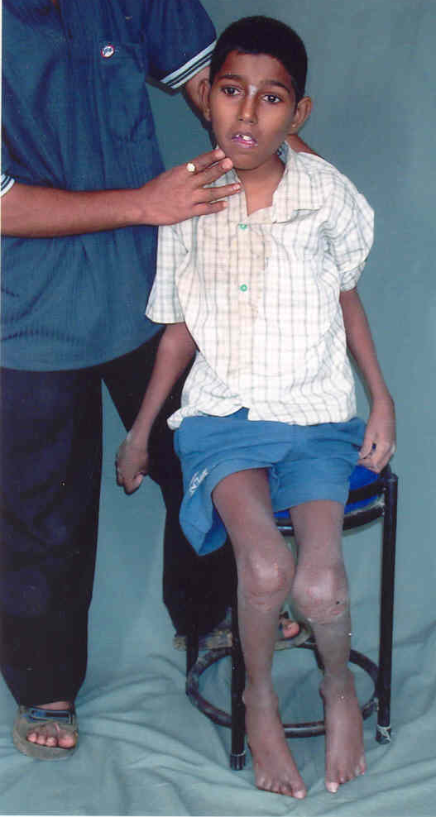
Neurological Manifestations in Wilson’s disease
(n=282)
Three movement disorder syndromes
Parkinsonism (tremor/slowing) 167
Dystonia / Dysarthria 95
“Ataxia” (Pseudo-sclerotic) 79
Dysarthria Universal
Other observations
Mental subnormality 62
Dominant behavioral abn. 43
Pyramidal signs 43
Chorea 24
Seizures 20
Myoclonus 9
Athetosis 6
Taly AB, Meenakshi-Sundaram S, Sinha S, et al. Medicine 2007;82 (2): 112-119

Slide 6
Family History in Wilson’s Disease (n=262)
910 sibs in 262 families : 3.5 sibs/family
Positive family history : 127 (47.4%)
Consanguineous parentage : 144/262 (53.7%)
Siblings born of consanguineous vs Non-consanguineous parents
  Higher frequency of family history (p=0.042)
  Shorter duration of illness at presentation (p=0.017)
  Significantly younger (p=0.002)
  Need for Genetic Studies in our Cohort
  High consanguinity
  Intra-familial variation
  Sibling screening/diagnosis
  Vertical Transmission
Clue to Diagnosis!
Taly AB, Meenakshi-Sundaram S, Sinha S, et al. Medicine 2007;82 (2): 112-119

Slide 7
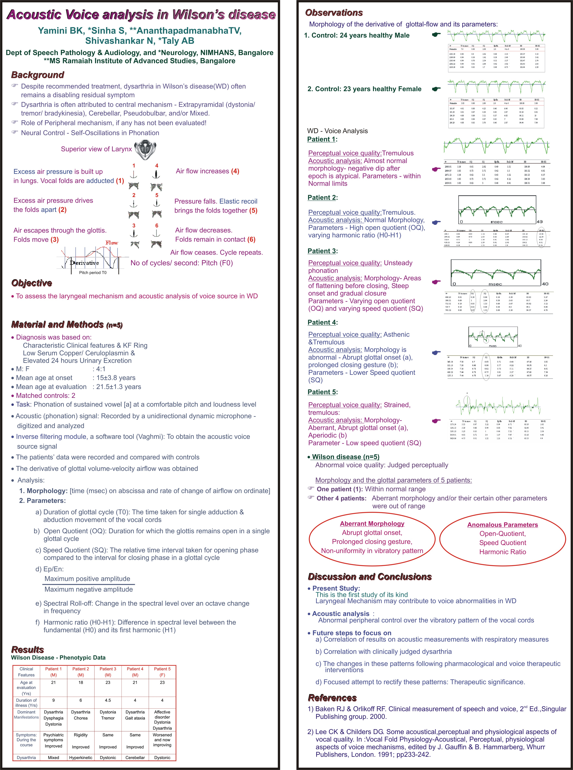
Voice Analysis in Wilson’s Disease (n=5)
Dysarthria Universal with poor therapeutic response
Patterns of Dysarthria Hypokinetic
Hyperkinetic or dystonic
Pseudobulbar
Anarthria
Ataxic
Control
Patient
Conclusion: Acoustic analysis revealed altered laryngeal control over the
vibratory pattern of the vocal cord
Yamini BK, Sinha S, Ananthapadmanabha TV et al. IANCON 2006 at Bangalore

Slide 8
Behavioral disorder in Wilson’s disease:
An Interesting story!
“This 19 year old man, a bright pre-university student, was first evaluated in 1993
for absent mindedness, social withdrawal, anxiety, reduced attention and
concentration and declining academic performance of one year duration. He was
diagnosed to have schizophrenia with affective features and had received
fluphenazine, chlorpromazine and trihexiphenidyl. Following this he had mild
improvement but a year later, he developed severe extrapyramidal symptoms and
stopped medications. He was suspected to have drug induced extrapyramidal
symptoms and prescribed propranalol, trihexiphenidyl and olanzapine. In 1995, he
was reviewed for progressive worsening of behavior, visual and auditory
hallucination, tremor, sialorrhea and gait disturbance. Five cycles of ECTs
were given and he was advised clozapine. There was minimal improvement until
May 1996, when patient’s mother reported worsening of tremors, difficulty in talking
and walking. During the case review, he was detected to have bilateral KF ring. Low
serum ceruloplasmin of 4mg/dl (Normal >15mg/dl) and low serum copper of 44µg/dl
(Normal > 75µg/dl) confirmed the diagnosis. With de-coppering therapy he
improved markedly and eventually got employed in a software firm”

Slide 9
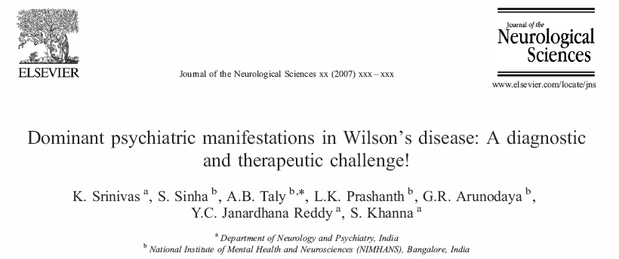
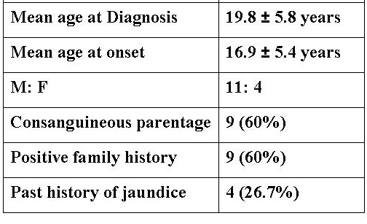
Retrospective analysis of 15 patients with dominant behavioral abnormalities posing diagnostic & therapeutic challenges
The final diagnosis of psychiatric symptoms was: Bipolar affective disorder (n-9), schizophrenia (n-5) and cognitive decline (n-1).

Slide 10
Dominant Psychiatric Manifestation in Wilson’s disease
(n=15)
  Consider WD in all young patients presenting with
  Family & past h/o jaundice, neuropsychiatric disorder & premature deaths
  Recent onset behavioral & personality changes, & extrapyramidal features
  Sensitivity to neuroleptics
  Poor therapeutic response to symptomatic therapy including ECTs!
  Undiagnosed bleeding symptoms
  Recurrent or pathological fractures
Sreenivas K, Sinha S, Taly AB et al. J Neurol Sci; 2007 Sep 26; [Epub ahead of print]

Slide 11

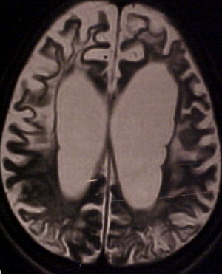
J Neuropsychiatry Clin Neurosci 2008; 20(1)
Prospective study: 50 patients
Tools: SCID Frequency: 12 (24%)
Psychopathology BPAD : 9
Depression : 2
Dysthymia : 1

Slide 12
Seizures in Wilson’s disease
Prevalence: 6-7% (8 to 10 fold higher than in
general population)
Pathophysiology:
Unknown
Deafferentation of White matter Fiber Tracts
Metabolic Dysfunction of Cortex
  - Copper Deposition in Brain (Peteras, 1965)
Drug Induced (Denning, 1988; Gibbs, 1968)
  Pyridoxine Deficiency
Prashanth LK, Sinha , Taly AB. Seizures in Wilson’s Disease. J Neurol Sci 2010; 291:44-51

Slide 13
Neuropsychiatric aspects
Cognitive & behavioral changes may be initial and dominant symptom and frequently pose diagnostic
& therapeutic challenges
Affective Symptoms are common
Precise structural correlate needs exploration
While patient often have clues to diagnosis, a high Index of suspicion is necessary

Slide 14
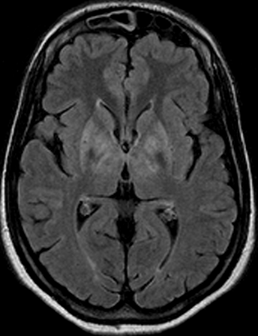
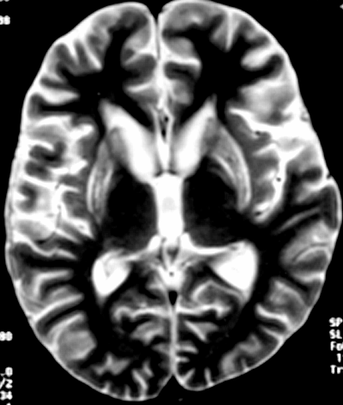
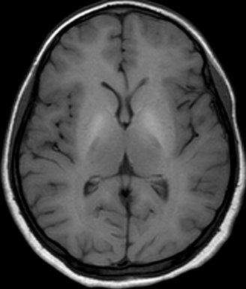
Neuropsychological Profile in Wilson’s Disease
(n=12)
Tools
NIMHANS Neuropsychology Battery (2004): Administered with norms considering age, education & gender
Observations
Universal and variable deficits in domains of motor speed, sustained attention, executive functions- in working memory, verbal fluency, set-shifting ability, verbal learning & visual memory, information processing & encoding
Putative Substrate
Frontal-subcortical & Frontal lobe involvement
Temporal lobe involvement: Rare
Hegde S, Sinha S, Rao S, Taly AB. Cognitive evaluation in Wilson’s disease. Neurology India 2010; 58(5): 708-713

Slide 15

Rehabilitation
Rehabilitation and psychological support is required for the patients as the treatment is life long
Rehabilitation includes physiotherapy, vocational rehabilitation for the disabled persons
Speech therapy
Psychological support is not only required for the patient but also for the family members who are the caretakers of the patient

Slide 16
QoL & Wilson’s disease
(n=30)
Background: Assessment of Quality of life (QoL) is fast assuming significant as a measure of
health in many disorders.
Aim: To correlate clinical severity and QoL in patients with Wilson’s disease (WD).
Subjects and Methods: We evaluated patients of WD on regular follow up for at least two years and aged
over 18 years, using Neurological Symptom Score (NSS) for clinical severity and WHO-BREF for QoL at a
university teaching hospital. Patients with inability to respond to questionnaire due to behavioral problems, low
IQ or other disease related factors were excluded. These 30 patients (M: F:: 23:7) had mean age of
27.97±11.16 years and mean duration of treatment of 9.2±6.4 years.
Results: All four domains of WHO-QoL-BREF viz, Physical, Psychological, Social
and Environmental correlated well with each other (p<0.01). The NSS correlated
inversely with physical domain (p<0.02) while duration of treatment had a positive
correlation with physical domain (p<0.01). None of the other features of QoL showed
any significant correlation with age, NSS or duration of treatment.
Conclusion: QoL is complementary to formal neurological assessment & should be
routinely incorporated in the evaluation of outcome of patients with WD
Komalkumar RN, Taly AB, Nair S, Sinha S et al, AIAN 2008; 11(1): 37-40

Slide 17
Child has come with new onset Neuro-behavioral syndrome – What to suspect Wilson’s Disease ?
Patient of WD on Treatment develops behavioral disturbances – What to do?

Slide 18
Patients with Dysarthria – Never improves completely – Role of Speech Evaluation & Therapy

Slide 19

NATIONAL INSTITUTE OF MENTAL HEALTH AND NEUROSCIENCES
N. Shivashankar, Professor, Department of Speech Pathology & Audiology
Wilson’s Disease Seminar-Mumbai, 25th March 2017
Dysarthria is a Motor Speech Disorder (MSD). It results from impairment in the neuromuscular control systems.
Dysarthria is the most common neurologic manifestation in 85-90% patients with Wilson’s disease.
Wilson’s Dysarthria is most frequently of the mixed type with varying spastic, ataxic, hypokinetic, and dystonic components.
Besides speech being affected in MSD, other oral movements for swallowing or smiling may be impaired.

Slide 20
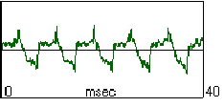

NIMHANS Study on acoustic analysis
Speech (voice quality) universally affected in these patients.
Acoustic analysis revealed that the neuromuscular control over the vibratory pattern of the vocal cords is altered.
Control, Male,24yrs
Case N, Male
Abnormal morphology-Abrupt glottal onset (a), prolonged closing gesture (b); Lower Speed quotient

Slide 21
Objective of Speech Intervention (Therapy)
Reacquiring and generalization of the skills.
Effective social participation.
Focus of Speech Intervention
Targeting simple to complex oro-motor activities
Targeting speech sub systems
Respiratory
Phonatory
Resonatory
Articulatory
Prosody

Slide 22
Respiratory
Phonatory and Resonatory
Articulatory
Respiratory support – postural adjustments
Duration Increase
Deep inhalation and exhalation
Prolongation of vowel during exhalation
Respiratory flexibility – Use of breath support to produce various stress patterns on words
Improving Voice Quality: Postural adjustment and relaxation therapy
optimizing the function of vocal chords: Improve on voiced vs voiceless components (voice vs whisper) to
Prolongation of vowel during exhalation
Velo-pharyngeal competency – nasal vs oral air flow pattern; nasal vs non-nasal sound production
Voice modulation training
Accuracy, direction and range of speech movements
Modelling speech production
Cueing techniques for placement
Perceptual judgement training
Speech pacing – syllabication
Pitch and loudness processing

Slide 23


C1: 18 Y/M
Speech Status: Baseline
Dysarthria profile:
Prosodic insufficiency
Articulatory – resonatory incompetence
Greater component of hyperkinetic dysarthria

Slide 24
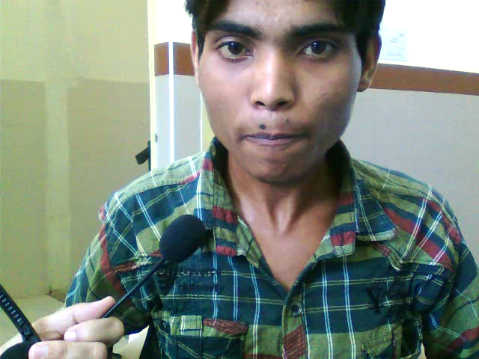

Speech Status with Management
C1: 18 Y/M
Auditory and visual feed back

Slide 25
When Speech is difficult to produce
AAC
Traditional
Gadget based

Slide 26
What is Role of Child Psychologist in WD?

Slide 27
A Survey of Knowledge & Understanding of the Disease

Slide 28
Children has motor disability – Role of Rehabilitative Measures

Slide 29
Wilson Disease:
A Survey from Mumbai
Children’s Liver Foundation,
New Horizons Health and Research Foundation,
Indian Academy of Pediatrics, Mumbai
March 2017
Aabha Nagral, Samir Dalwai, Rashid Merchant, Ameya Bondre, Krittika Malhotra, Sohini Chatterjee

Slide 30
Survey
Respondents: Caregivers of individuals with Wilson disease or the patients themselves
Total sample size: 21 (10 boys, 11 girls)
Average current age of the individual with Wilson disease: 17 years 3 months
Age range: 7 to 39 years
Question-wise analysis and graphical data (further slides)

Slide 31
Notes:
No one symptom, except jaundice, has been substantially reported. Coordination problems and uncontrolled muscle movements were also noticeable.

Slide 32
Notes:
Most concerns pertain to routine activities

Slide 33
Notes:
All four plots are roughly concurrent
Children diagnosed at widely varying ages
Diagnosed children tend to promptly receive intervention
The time-span is wide i.e. From 5 to 18 years!

Slide 35
Table of milestones
Number of respondents who achieved specific milestones at specific ages
Milestone delay marked in red.

Slide 36
Age ranges | Neck holding | Rolling over | Sitting without support | Standing without support | Walking without support | Babbling | One meaningful word | Two meaningful word phrase
2 months | 3
3 months | 1
4 months | 2 | 1 |  |  |  | 1
5 months |  | 4 | 1 |  |  | 4
6 months | 1 | 6 | 4 |  |  | 8
7 months |  | 5 | 6 |  |  | 2
8 months |  |  | 3 | 2
9 months |  |  | 1 | 2 |  |  | 1
10 months | 1 |  | 1 | 5 |  |  | 3
11 months |  |  |  | 3 |  |  | 8
12 months |  |  |  | 2 | 9 |  | 3 | 2
13 months |  |  |  |  | 4
14 months |  |  |  |  | 1
18 months |  |  |  |  | 1 |  |  | 4
20 months |  |  |  |  | 1
24 months |  |  |  |  |  |  |  | 5
5 years |  |  |  |  |  | 1
Total respondents | 8 | 16 | 16 | 14 | 16 | 17 | 16 | 11

Slide 37
Conclusion
Multi Disciplinary Evaluation
Early Intervention
Awareness among Pediatricians, Teachers.

Slide 38
Life Long Medications / Compliance – Importance?
Issues Related to Cost & Side effects of Therapy

Slide 39
Hepatic Wilson’s Disease diagnosed by Pediatrician – What Next?

Slide 40
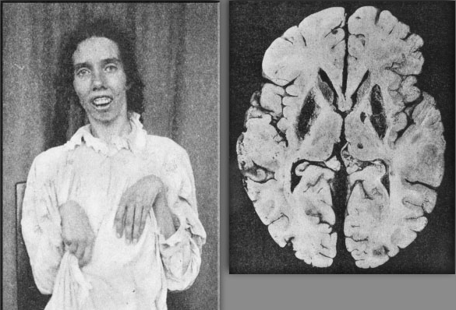
Wilson’s Disease: Challenges faced !!
High diagnostic errors & delays: Implications ----
Sibling screening: Gap
Compliance with special reference to gender
Life long treatment & Financial Issues
Lack of support from Pharmaceutical sectors
Involvement of NGO!
Impairment, Disability, QOL
Lack of facility even at tertiary care (Medical colleges level)
Mutations are many: what do they mean!
Let us pledge that we shall not see an autopsied brain of WD again!

