Slide 1




Role of MRI in Wilson disease
Chairpersons: Aabha Nagral, Prashanth LK,SK Yachha
Talk: Sanjib Sinha

Slide 2

Wilson’s Disease:
Role of MR imaging
Sanjib Sinha
Dept of Neurology
NIMHANS, Bangalore, India

Slide 3
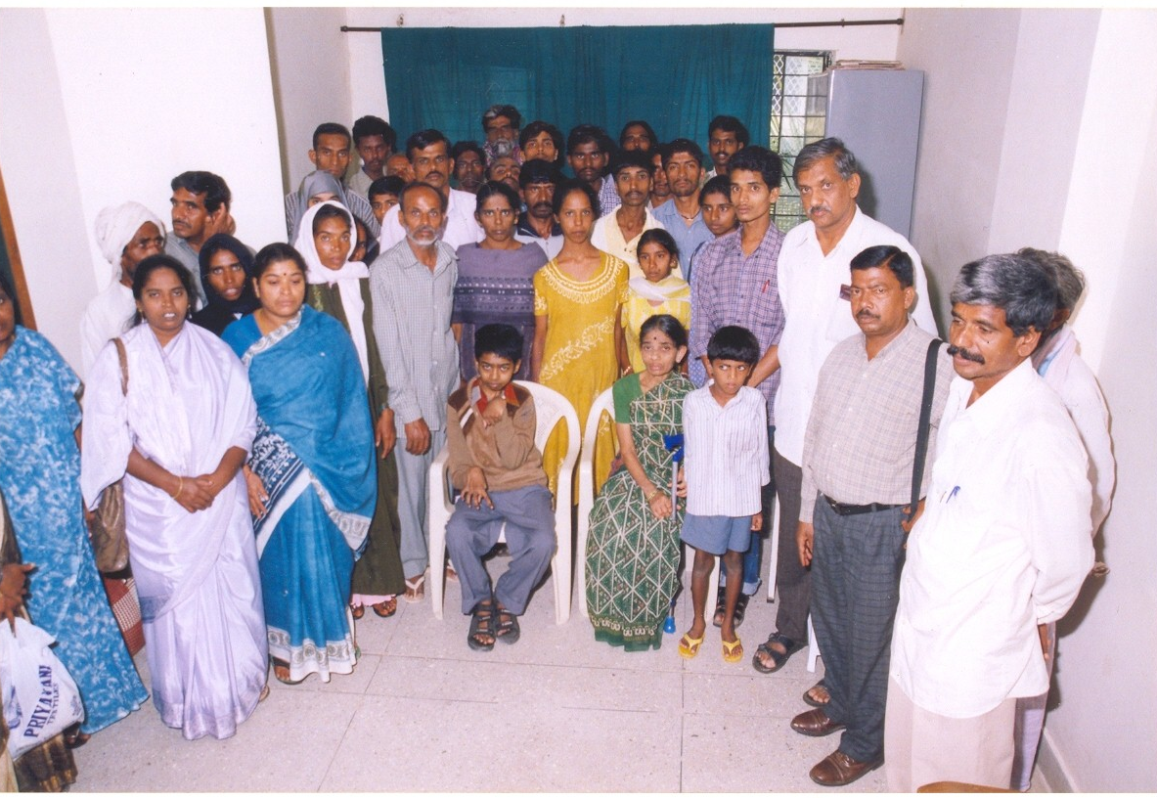
Wilson’s disease at NIMHANS
Prof HS Swamy : Initiated in late 1970
Specialized WD clinic: Every Wednesday
Neurologist, Social worker
Free care
Funded & Non-funded Research Projects
    Dissertation : 16
    Presentation : 30
    Peer- reviewed Publications: 34
Corpus fund
Registry of >700 patients with
125 – 150 on regular follow up

Slide 4
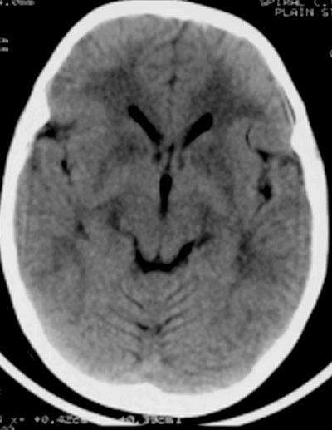
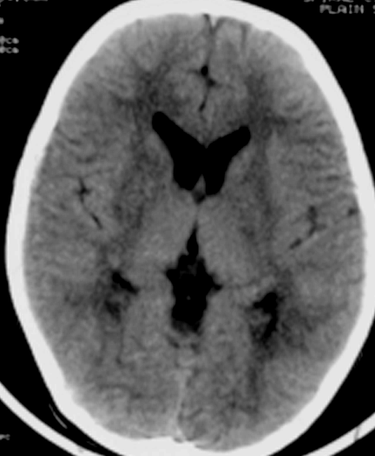
CT Scan Observations in Wilson’s Disease
(n=116)
 | Williams and Walshe, 1981 (n=60) % | Jha et al, 1998 (n=21) % | Present report, 2006 (n=116) %
Cortical atrophy | 63 | 9.5 | 44.8
Ventricular dilatation | 73 | 19.0 | 44.0
Caudate atrophy | NA | 9.5 | 25.0
Brainstem atrophy | 55 | NA | 31.9
Cerebellar atrophy | 10 | 9.5 | 19.0
Hemispheric hypodensity | NA | 9.5 | 29.3
Basal ganglionic hypodensities | NA | NA | 19.8
Thalamic hypodensities | NA | NA | 10.3
Brainstem hypodensity | NA | 28.6 | NA
Normal | 18 | 14.3 | NA
Taly AB, Meenakshi-Sundaram S, Sinha S, et al. Medicine 2007;82 (2): 112-119
Putaminal, Pallidal &
White matter hypodenisty
D Bhattacharya. Follow up study of CT scan brain and clinical correlation in Wilson’s disease.
Thesis submitted towards partial fulfillment for DM degree in Neurology, NIMHANS, Deemed University, (1997)

Slide 5
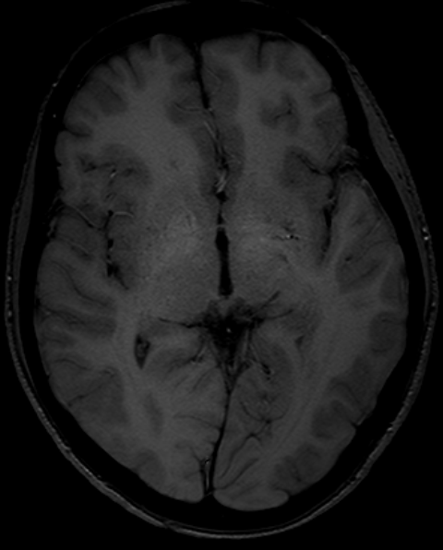
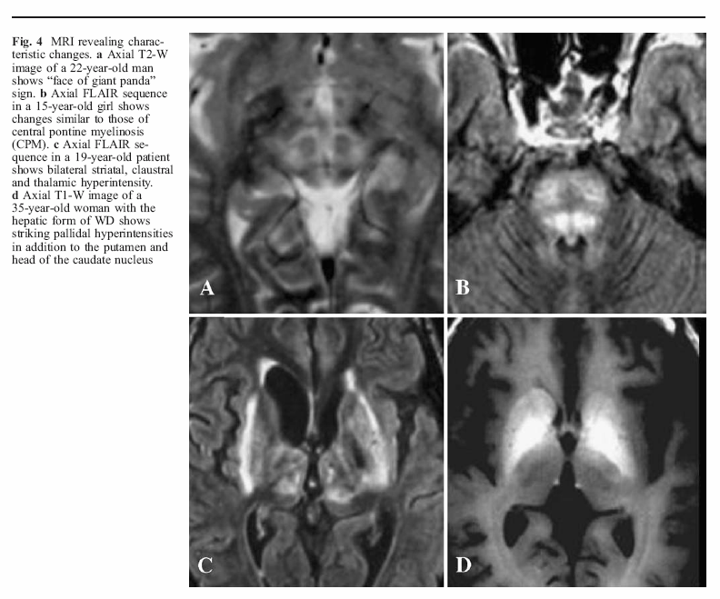
Brain MRI changes in hepatic Wilson’s disease

Slide 6
Brain MRI changes in Wilson’s disease
Globus Pallidum, S. Nigra causes T1 hyperintensity
Reason: ?Manganese
A combination of T2hyperIntensity & T1hyperintensity is highly suggestive of WD
This variable appearance is probably due to combination of necrosis, cystic changes, gliosis, and copper accumulation

Slide 7
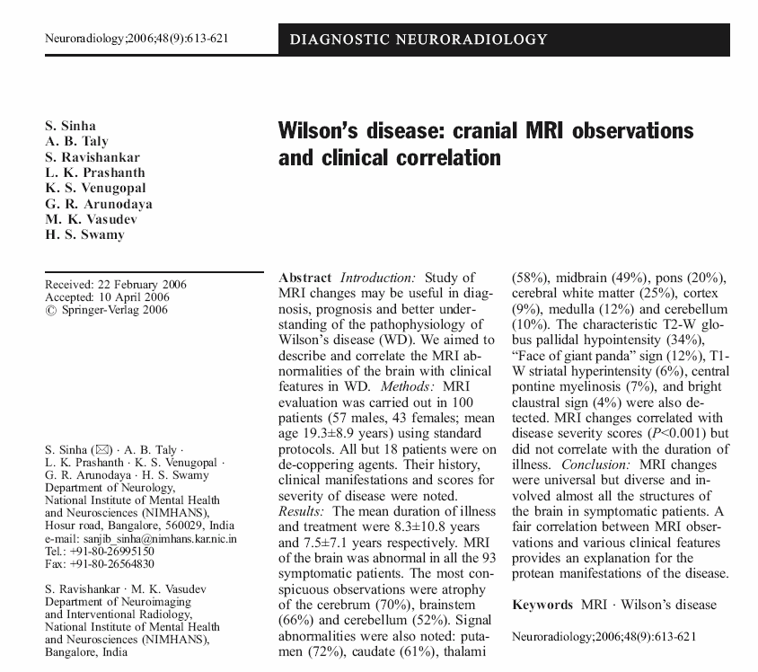
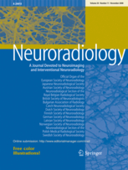
One hundred patients (M:F::57:43, Age: 19.3±8.9 years) underwent MRI evaluation
Atrophy: cerebrum (70%), brainstem (66%) and cerebellum (52%)
Signal Changes: putamen (70%), caudate (61%), thalami (58%), midbrain (49%), pons (20%), cerebral white matter (25%), cortex (9%), medulla (12%) and cerebellum (10%).
Characteristic features: T2W globus pallidal hypointensity (34%), ‘Face of Giant panda’ sign (12%), T1W striatal hyperintensity (6%), central pontine myelinosis (7%) and bright claustral sign (4%) were also detected.
Clinico-MRI correlation: MRI correlated with disease severity scores (p< 0.001) but did not correlate with the duration
MRI changes were diverse and universal in symptomatic patients and involved almost all the structures of the brain

Slide 8
MRI observations in WD
Parameter | Roh (1994) | Wassenaer (1996) | King (1996) | Saatci (1997) | Sinha et al (2006)
Number of Patients | 25 | 50 (49 MRI) | 25 | 30 | 100
Treatment status Drug naïve | 0(0%) | 3(6%) | 0(0%) | NA | 18(18%)
Abnormal MRI | All(100%) | NA | 22(88%) | 23(76.6%) | 93(93%)
Signal intensity changes (%)
Putamen | 68 | 36 | 86 | 85.7 | 72
Globus Pallidus | 20 | 22 | 41.1 | 88.8 | 40
Thalamus | 92 | 18 | 54 | 47.6 | 58
Caudate | NA | 8 | 45 | 42.8 | 61
White matter | 4 | 22 | 59 | NA | 25
Midbrain | 76 | 22 | 77 | 76.2 | 49
Pons | 68 | 18 | 82 | 85.7 | 20
Medulla | NA | NA | NA | NA | 12
Cerebellum | NA | 8 | 50 | NA | 10
Atrophy (%)
Diffuse/cerebral | 88 | 39 | 80 | 100 | 70
Brainstem | NA | NA | NA | NA | 66
Cerebellum | NA | NA | NA | NA | 52
Sinha S, Taly AB, Ravishankar S et al. Neuroradiology; 2006; 48 (9): 614-621

Slide 9
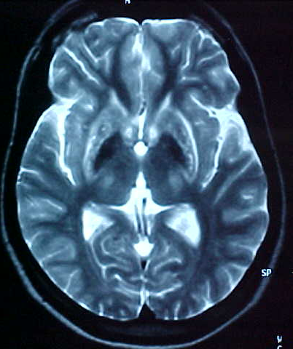
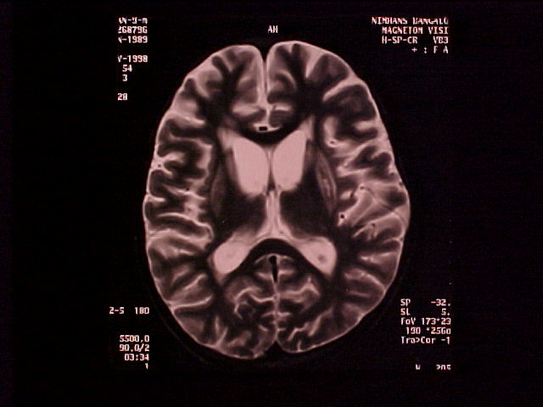
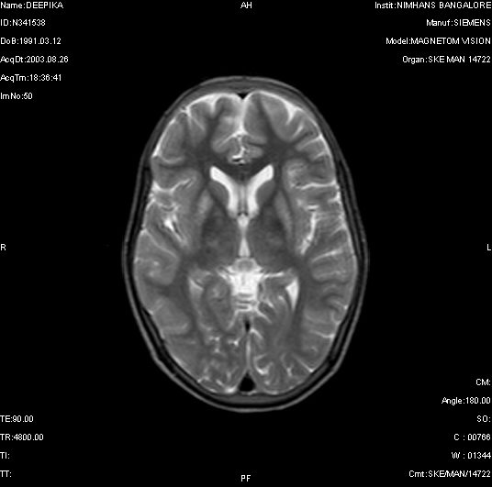
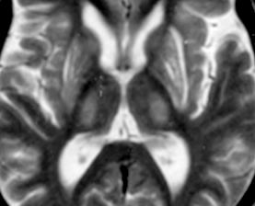
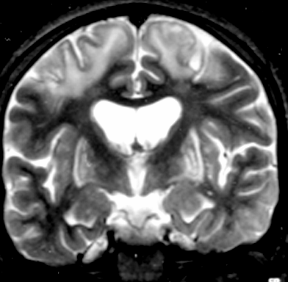
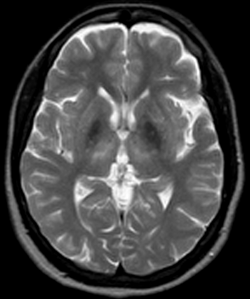
MRI observations in WD

Slide 10
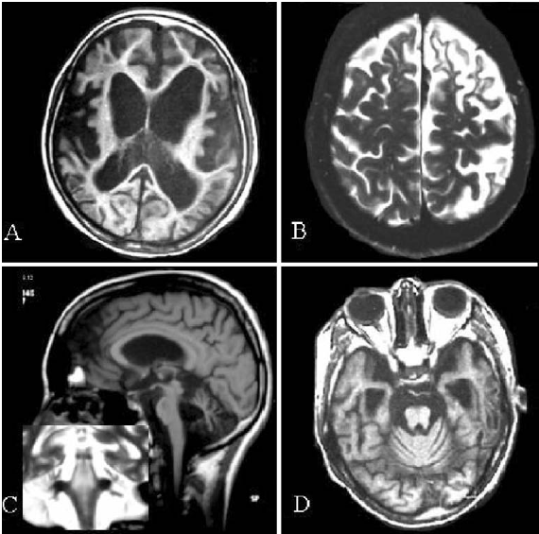
MRI and Wilson’s Disease
Focal
cerebral
atrophy
Diffuse atrophy
Brainstem
&
Cerebellar
atrophy
Brainstem
Signal changes
Sinha S, Taly AB, Ravishankar S et al. Neuroradiology; 2006; 48 (9): 614-621

Slide 11
MRI and Wilson’s Disease
Basal ganglionic
changes
Extensive
White matter
abnormalities
Basal ganglionic
Brainstem
&
White matter
changes
Midbrain
changes
Sinha S, Taly AB, Ravishankar S et al. Neuroradiology; 2006; 48 (9): 614-621

Slide 12
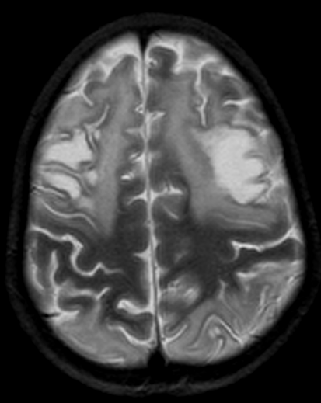
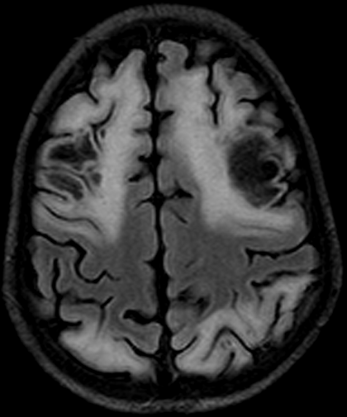
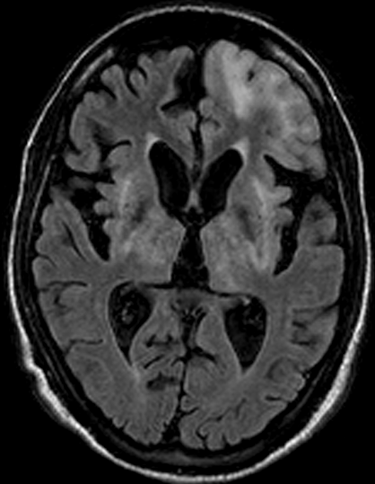
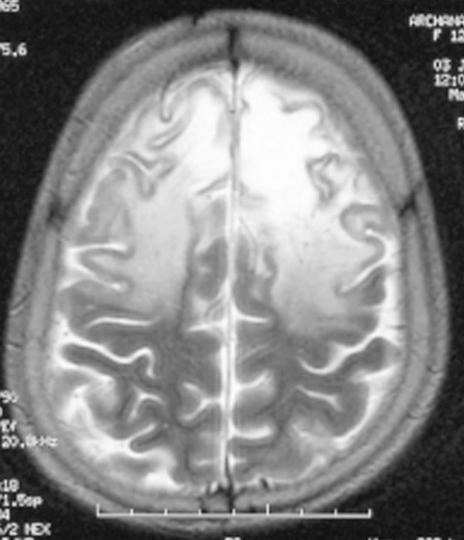
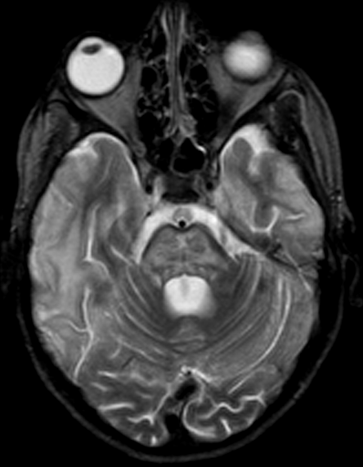
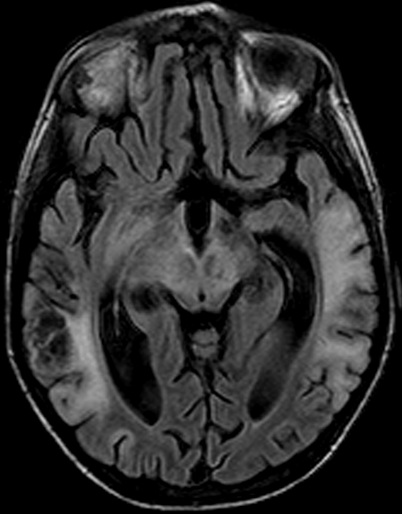
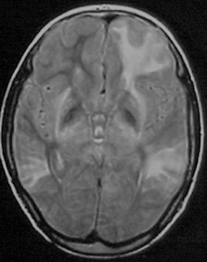
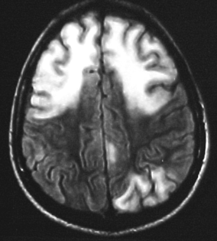
MRI observations in WD

Slide 13
White matter Changes in WD
WM changes: not uncommon
Frontal>other lobes
Subtle diffuse leucoencephalopathy
WM changes: gliosis/necrosis (cavitation)
Extensive changes: Poorer prognosis
Sometimes associated with seizures

Slide 14
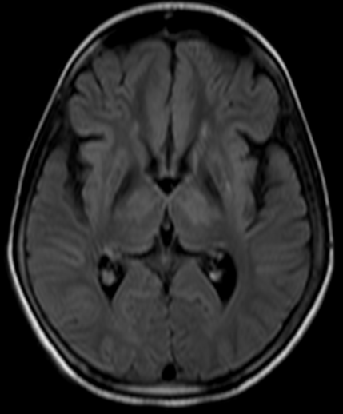
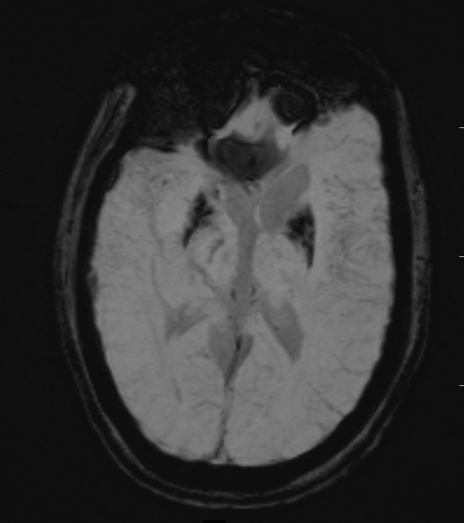
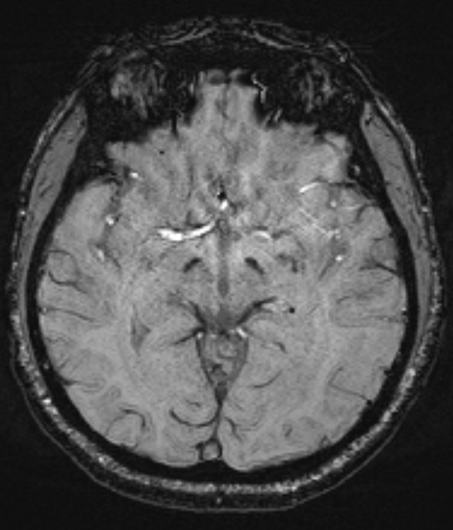
Iron in Copper
T2W hypointense lesions
Hypointensity of Putamen and Substantia Nigra

Slide 15
MRI and Wilson’s Disease
Face of
Giant Panda
CPM like
T1W
HyperIntensity
Bright
Claustrum
Sinha S, Taly AB, Ravishankar S et al. Neuroradiology; 2006; 48 (9): 614-621

Slide 16
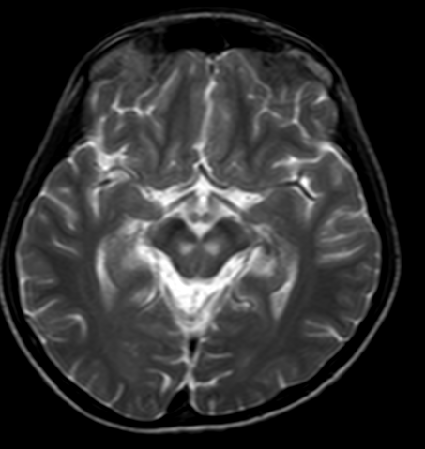
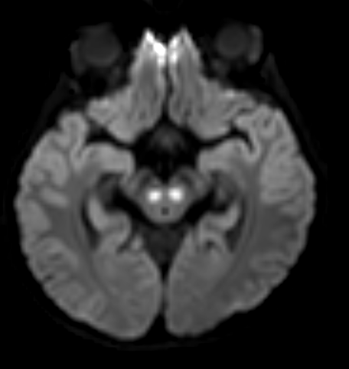
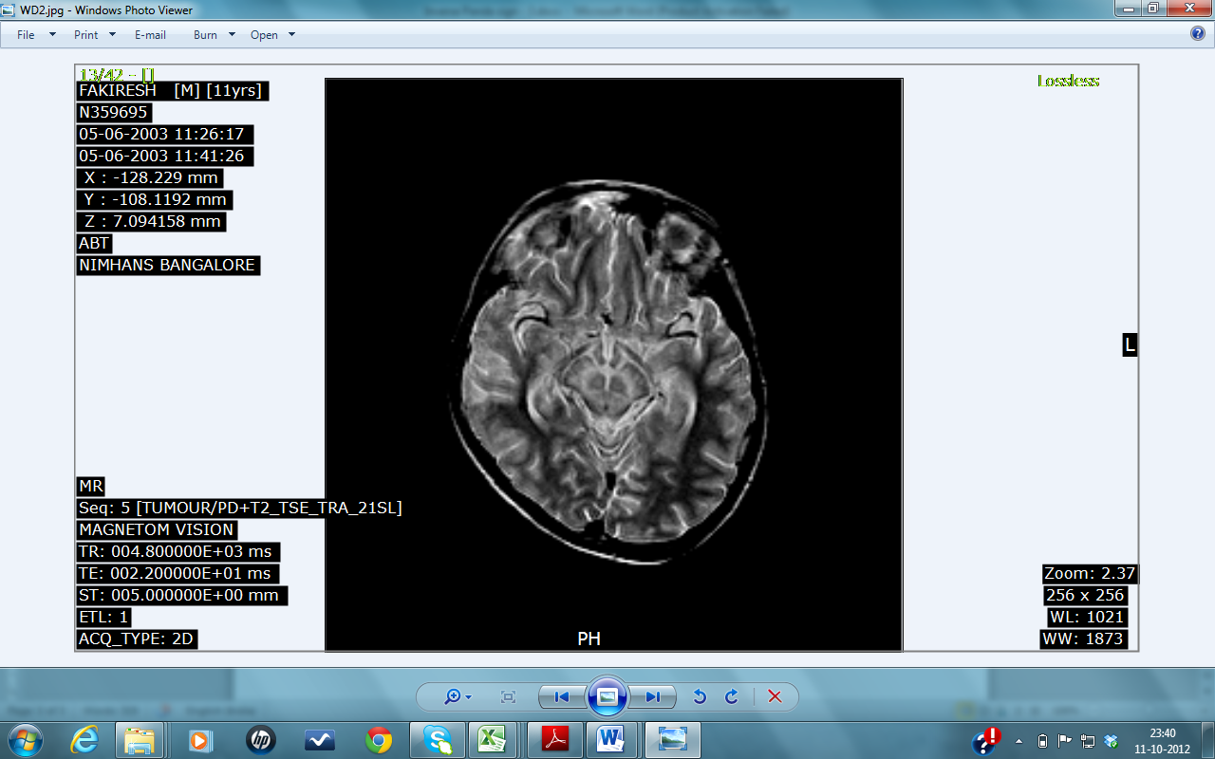
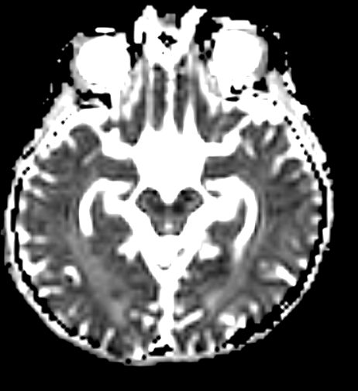

Slide 17
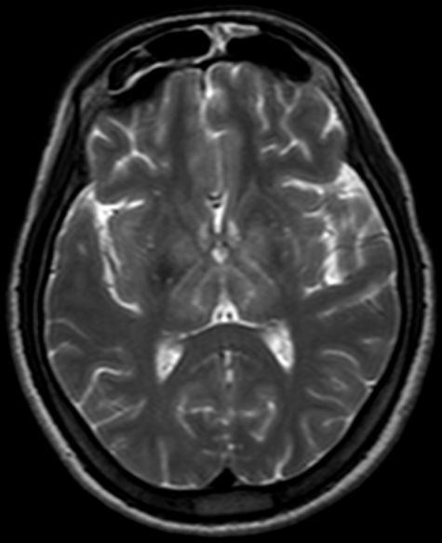
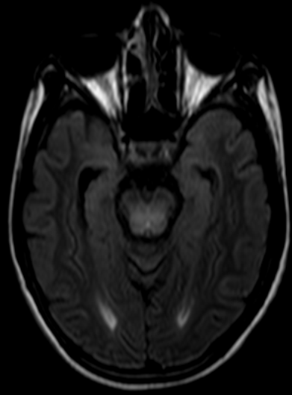
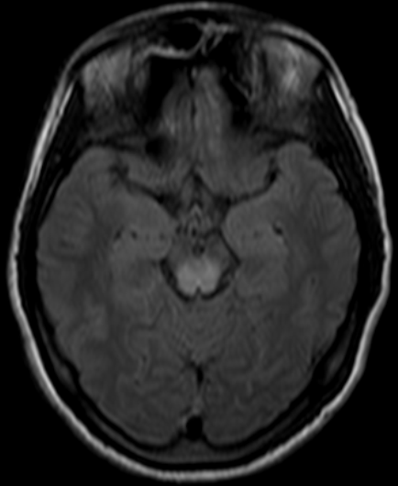
WD: Characteristic findings
Thalamic Layering
(Onion)
Minicub Sign
Dorsal Midbrain

Slide 18
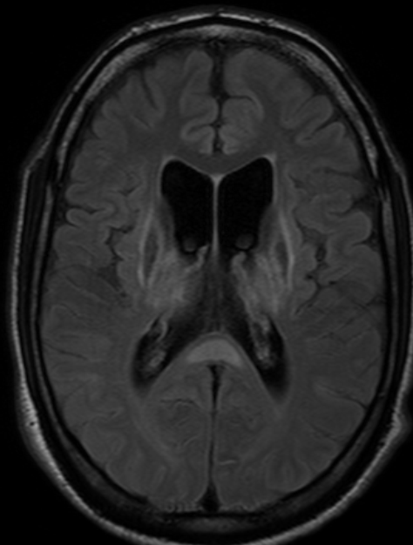
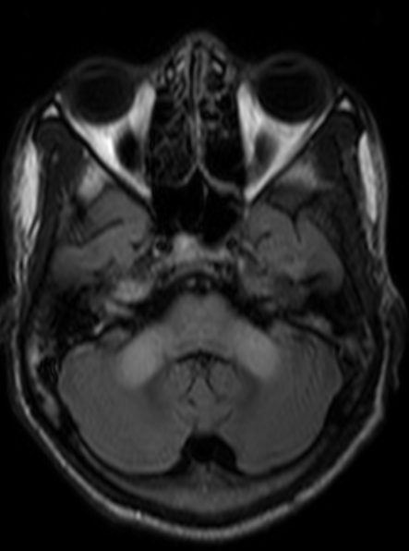
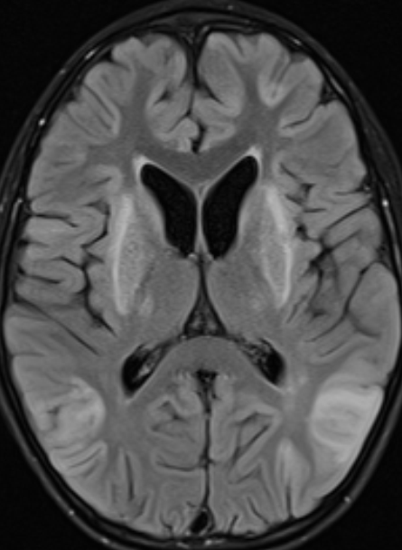
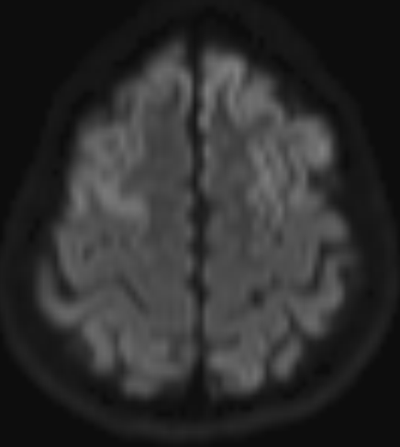
Uncommon findings
Splenium
MCP
U fibers
Cortex

Slide 19
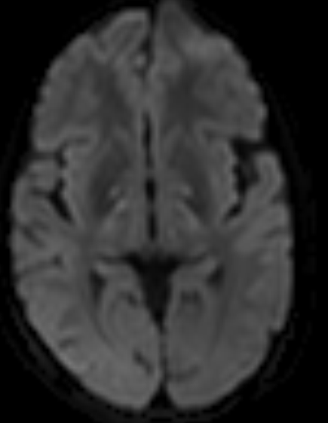
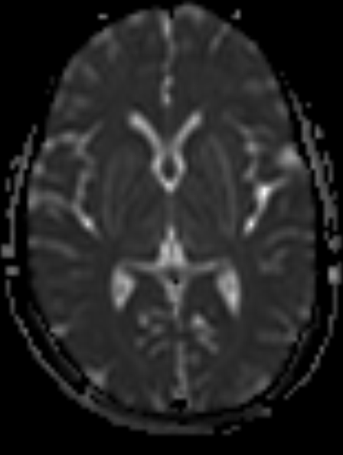
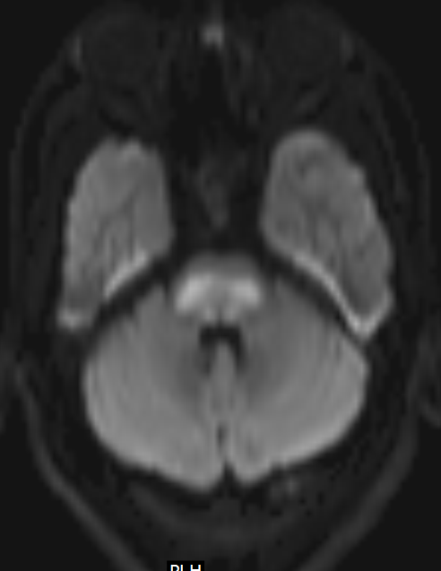
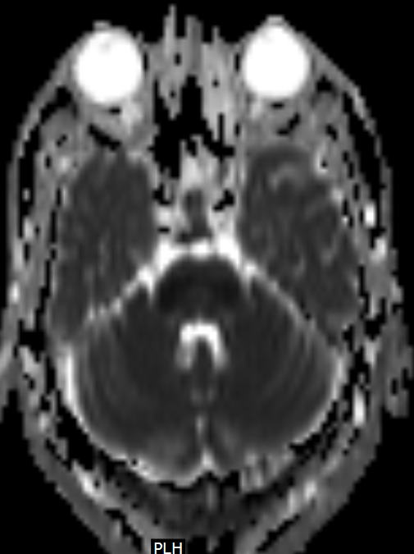
Diffusion Restriction in WD
Internal capsule, G. pallidus
Pons: CPM like
Restricted Diffusion: Correspond to restriction of mobility of water molecules and indicates the presence of cytotoxic edema (acute ischemia and infarct).
In WD: Excess copper causes cell injury leading to inflammation & cell death - represented cell swelling associated with inflammation, hence restriction of diffusion

Slide 20
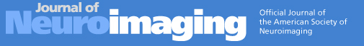

Slide 21

CPM-like changes in Wilson’s Disease
Sinha S, Taly AB, Ravishankar S et al. J Neuroimaging 2007; 17:286-291

Slide 22
CPM in osmotic demyelination Vs WD
CPM- like changes in WD share some similarity with CPM secondary to ‘osmotic demyelination’.
But, CPM- like changes in WD might differ in certain other aspects like
  a) occurs in the setting of a chronic disease without any obvious evidence of sodium imbalance,
  b) it is almost always contiguous with midbrain signal changes mainly of tectal region,
  c) has two additional but distinct ‘bisected’ and ‘trisected’ patterns,
  d) infrequent occurrence of EPM.

Slide 23
CPM-like changes in
Wilson’s Disease
Sinha S, Taly AB, Ravishankar S et al. J Neuroimaging 2007; 17:286-291

Slide 24
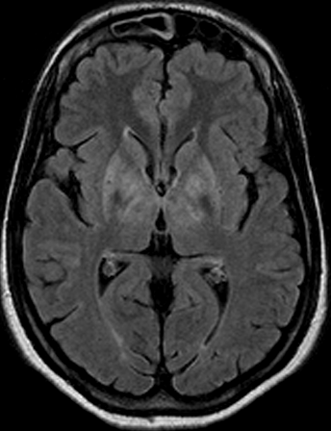
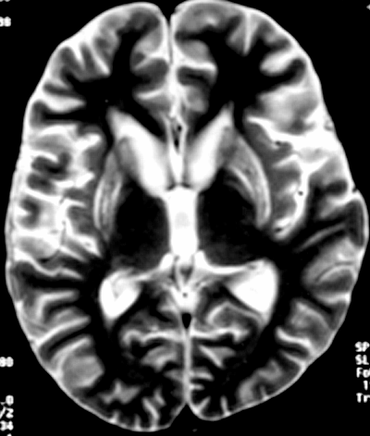
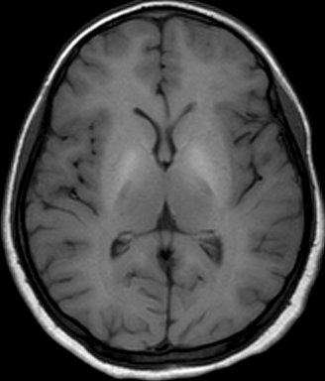
MRI correlates of Neuropsychological deficits in Wilson’s Disease
(n=12)
Tools
NIMHANS Neuropsychology Battery (2004): Administered with norms considering age, education & gender
Observations
Universal and variable deficits in domains of motor speed, sustained attention, executive functions- in working memory, verbal fluency, set-shifting ability, verbal learning & visual memory, information processing & encoding
Putative Substrate
Frontal-subcortical & Frontal lobe involvement
Temporal lobe involvement: Rare
Hegde S, Sinha S, Rao S, Taly AB. Cognitive evaluation in Wilson’s disease. Neurology India 2010; 58(5): 708-713

Slide 25
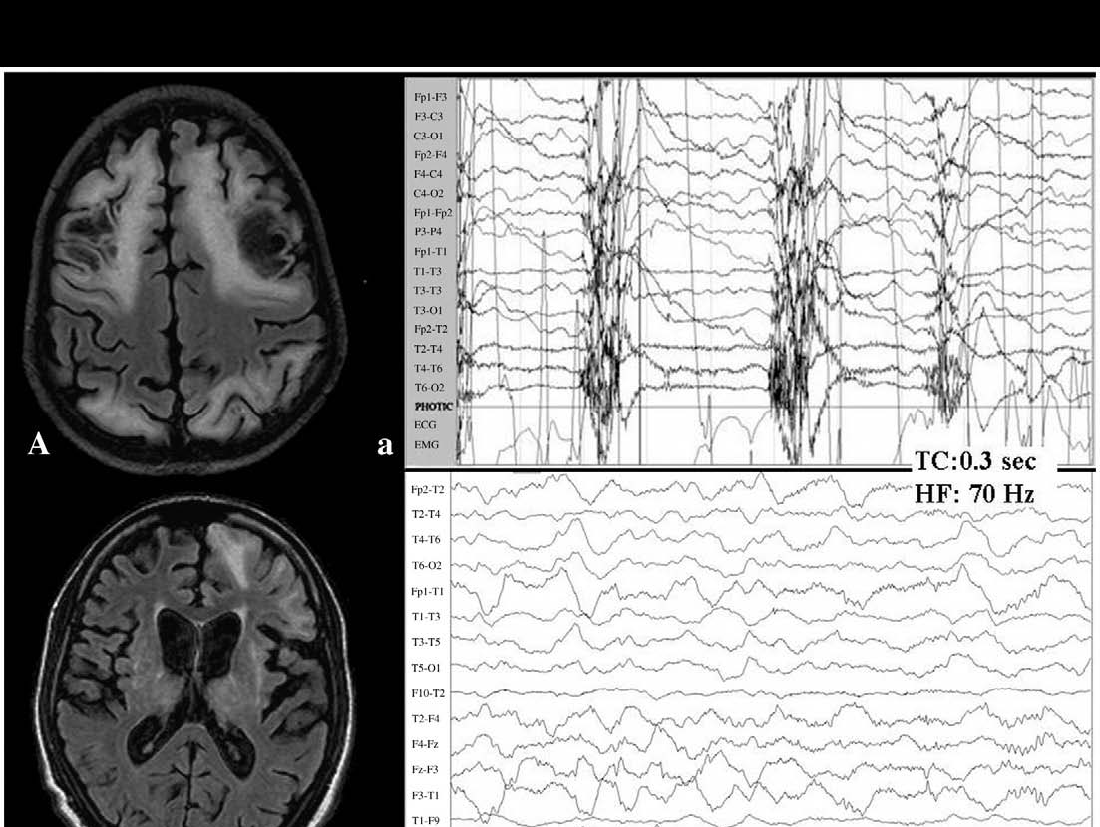
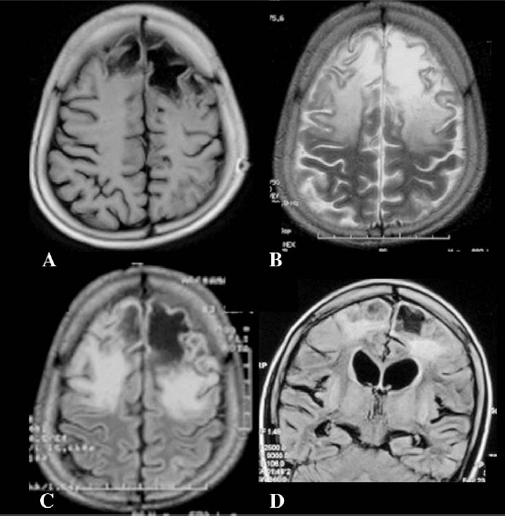
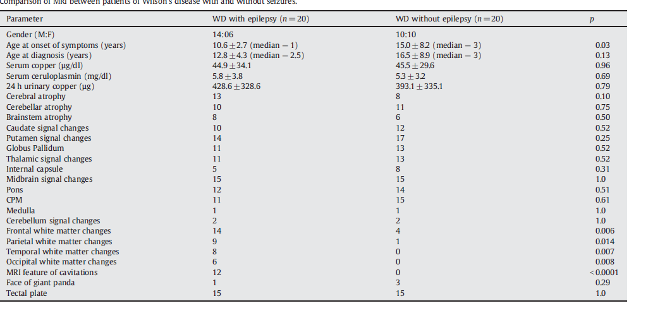
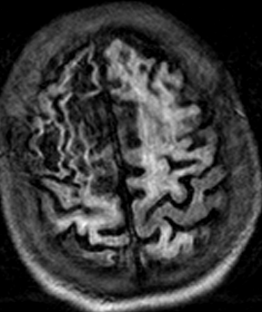
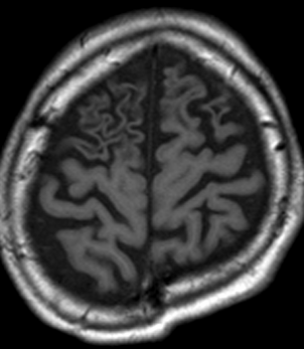
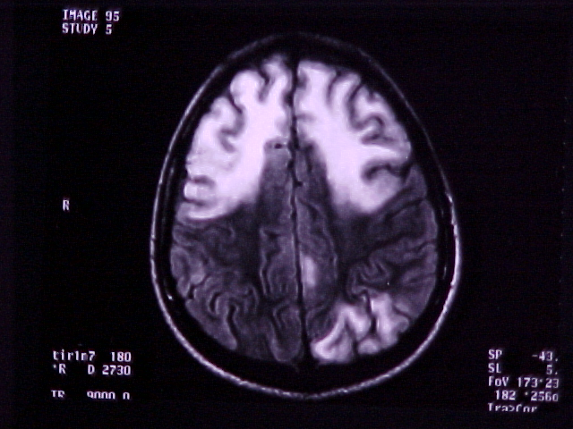
Seizures in Wilson’s disease: Magnetic Resonance Imaging
(n=11)
14 year girl with 2 years h/o WD: Recurrent seizures - response to de-coppering agents & AEDs unsatisfactory.
Prashanth LK, Sinha , Taly AB. Seizures in Wilson’s Disease. J Neurol Sci 2010; 291:44-51

Slide 26


Wilson’s disease: MR spectroscopy and Clinical correlation
Forty patients & 30 controls underwent in-vivo 2-D 31P and 1H MRS of basal-ganglia using an image-selected technique.
There was reduced breakdown and/or increased synthesis of membrane
phospholipids and increased neuronal damage in basal ganglia in patients with WD
H MRS
P MRS
Sinha S, Taly AB, Ravishankar S, et al. Wilson’s disease: ³¹P and ¹H MRS. Neuroradiology 2010;52(11):977-85

Slide 27
We evaluated white matter (WM) abnormalities in 15 patients with drug naïve Wilson's disease (WD) and 15 controls using the technique of diffusion tensor imaging (DTI).
Fractional anisotropy (FA) and mean diffusivity (MD) values were analyzed
Six patients showed lobar WM signal changes on T₂-Weighted (T2W)/ Fluid attenuation inversion recovery (FLAIR) images while remaining had normal appearing WM.
MD was significantly increased in the lobar WM, bilateral IC and midbrain of WD patients. FA was decreased in the frontal and occipital WM, bilateral IC, midbrain and pons.
Normal-appearing white matter on FLAIR images showed significantly increased MD and decreased FA values in both frontal and occipital lobar WM and IC compared with those in controls.
Correlation of clinical scores and DTI metrics revealed positive correlation between neurological symptom score (NSS) and MD of anterior limb of right internal capsule, Chu stage and MD of frontal and occipital WM.
Negative correlation was observed between the Modified Schwab and England Activities of Daily Living (MSEADL) score and MD of bilateral frontal and occipital WM and IC.
Conclusions: This is the probably the first study to reveal widespread alterations in WM by DTI metrics in drug naïve WD. DTI analysis revealed lobar WM abnormalities which is less frequently noted on conventional MRI and suggests widespread WM abnormalities in WD. It may be valuable in assessing the true extent of involvement and therefore the severity of the illness.

Slide 28



Diffusion weighted & tensor imaging (DWI / DTI) in WD
We evaluated the usefulness of Diffusion Tensor Imaging (DTI) metrics in confirmed patients with Wilson’s disease (WD) who are either drug naïve (n=15) or on de-coppering therapy (n=15) and healthy control (n=15).
Mean diffusivity (MD) maps (b=800 s/mm² images) shows ROI in cerebral white matter, basal ganglia, thalamus, midbrain, pontine and cerebellar white matter regions
FA maps (b=800 s/mm² images) shows ROI in white matter, basal ganglia, thalamus, and midbrain regions
First comprehensive report of DTI findings in patients with Wilson’s disease.
Abnormalities in DTI findings (high MD and FA) were noted in WD compared to controls and more so in drug-naïve patients
DTI showed additional tissue abnormalities in WD in various regions of brain where conventional MRI sequences were normal.
Differential involvement and variable degree of phenotypic-DTI correlation was noted
Jadav R, Saini J, Sinha S, et al Metabolic brain disease 2013; 28:455-62

Slide 29
Role of imaging in following patients
Clinical & MRI improvement pari-passu in most patients with neuropsychiatric form
Liver involvement: Additional clue
Newer tools - DTI metrics & MRS: improving understanding at microstructural levels
Extensive MRI (+WM) changes: Helps in prognostication
Sinha S, Taly AB, Prashanth LK et al. BJR 2007; 80:744-749
Lawrence et al, JIMD reports. 2016 vol 25: pp 31-38

Slide 30


Wilson’s disease (WD) is clinically & radiologically a dynamic disorder: 50 patients were recruited prospectively for this study to evaluate the serial MRI and clinical changes
Serial imaging: Improvement in MRI parameters - 35, No significant changes - 10, Worsening - 4 and An admixture of resolving and evolving changes - 1.
MRI score improved from 8.2±5.7 to 5.9±6.6.
Patients with extensive changes, white-matter involvement and severe diffuse atrophy had a poor prognosis
Conclusions: Majority of patients of WD on treatment showed variable improvement in clinical and MRI features

Slide 31

Serial MRI and Wilson’s Disease
Improvement
Improvement
Improvement
Improvement
Worsening
Differential
change
Sinha S, Taly AB, Prashanth LK et al. BJR 2007; 80:744-749

Slide 32
Objective: The purpose is to evaluate white matter (WM) abnormalities in 15 patients with Wilson's disease & 15 controls (WD) using the technique of diffusion tensor imaging (DTI).
Methods: DTI/conventional MRI was acquired (3T MRI): Fractional anisotropy (FA) and mean diffusivity (MD) values were extracted from regions of interest placed in pons, midbrain, bilateral frontal and occipital cerebral white matter, bilateral internal capsules (IC), middle cerebellar peduncles (MCP) and corpus callosum (CC).
Results: S
Six patients showed lobar WM signal changes on T₂-Weighted (T2W)/ Fluid attenuation inversion recovery (FLAIR) images while remaining had normal appearing WM. MD was significantly increased in the lobar WM, bilateral IC and midbrain of WD patients.
FA was decreased in the frontal and occipital WM, bilateral IC, midbrain and pons. Normal-appearing white matter on FLAIR images showed significantly increased MD and decreased FA values in both frontal and occipital lobar WM and IC compared with those in controls.
Correlation of clinical scores and DTI metrics revealed positive correlation between neurological symptom score (NSS) and MD of anterior limb of right internal capsule, Chu stage and MD of frontal and occipital WM. Negative correlation was observed between the Modified Schwab and England Activities of Daily Living (MSEADL) score and MD of bilateral frontal and occipital WM and IC.
Conclusions: This is the probably the first study to reveal widespread alterations in WM by DTI metrics in drug naïve WD. DTI analysis revealed lobar WM abnormalities which is less frequently noted on conventional MRI and suggests widespread WM abnormalities in WD. It may be valuable in assessing the true extent of involvement and therefore the severity of the illness.

Slide 33
WD (Neurological form) & DD:
How MRI can help?
Helps to exclude mimickers
Assists in deciding tests to exclude other DD
Some of the MRI findings: almost pathognomonic of WD

Slide 34
Non-Wilsonian Hepato-lenticular degeneration

Slide 35








A
B
C
D
E
F
G
H
Nagappa et al, JCoN 2016;27:91-94

Slide 36





Slide 37
Imaging: Important observations
CT scan: careful interpretation is essential and normal CT scan do not exclude WD
MRI: Definitely useful – often provide clue if not clinically suspected
  Hepatic form: T1W pallidal hyperintensity
  Always abnormal in neurologically involved patients
  Extent & severity of changes: Protean
  Clinically severe form=extensive MRI changes
  Common: Putamen, thalami, caudate, midbrain, pons, white matter
  Characteristics: Midbrain tectal change, CPM like changes, Face of giant panda

Slide 38
Imaging: Important observations
  T1W pallidal hyperintensity: Liver
  Frontal white matter & adjacent cortical atrophy: Seizures (SE)
  CPM: 3 subtypes –“Mercedes Benz” sign is a novel observation
  Serial MRI: improves variably with decoppering in majority
  CPM like changes: different that those of osmotic demyelination
  Simultaneous involvement of basal ganglia, thalamus and brainstem are virtually pathognomonic of WD.
  MR Spectroscopy: Evolving knowledge: Provide idea about metabolites
  Diffusion tensor imaging: Additional areas and might help in prognosis
  What is intriguing? Clinico-MRI discordance; Basis of topographic preference; & Genetic-MRI correlation

Slide 39



Wilson’s disease Clinic
(Late Dr. HS Swamy- 1970s)
HOPE
Acknowledgment: Prof AB Taly
& colleagues/residents
& all the patients
Thank you very much!

