Slide 1




Key publications on Wilson disease in last 3 years
Talk: Moinak Sen Sarma
Chairpersons: Harshad Devarbhavi, Seema Alam

Slide 2

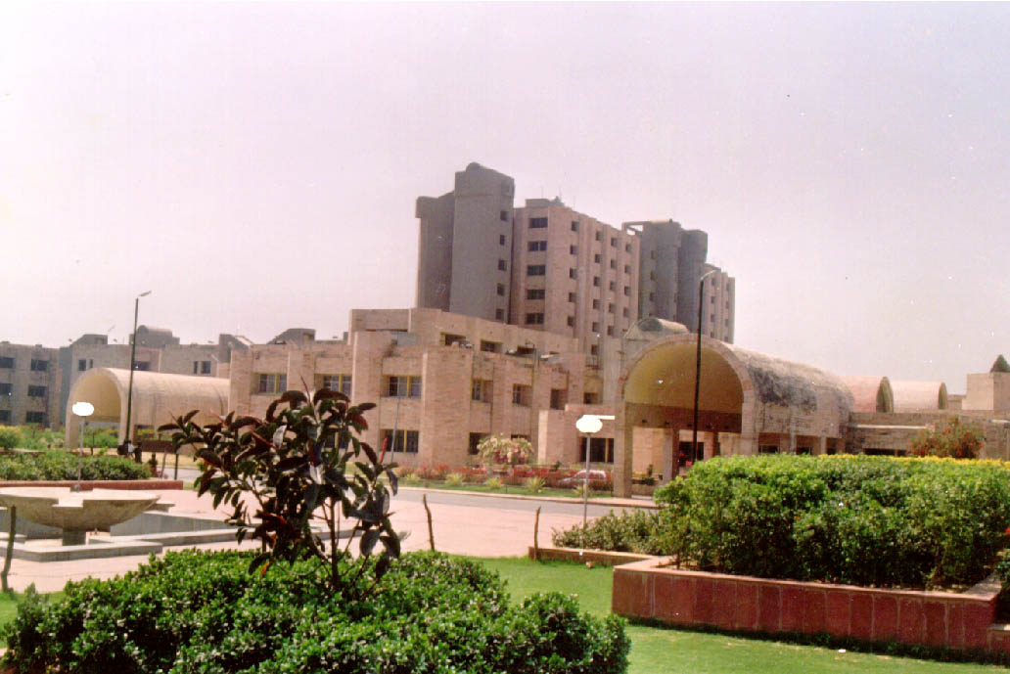
Key publications on
Wilson disease in last 3 years
Moinak Sen Sarma
Assistant Professor
Dept of Pediatric Gastroenterology
SGPGIMS, Lucknow

Slide 3
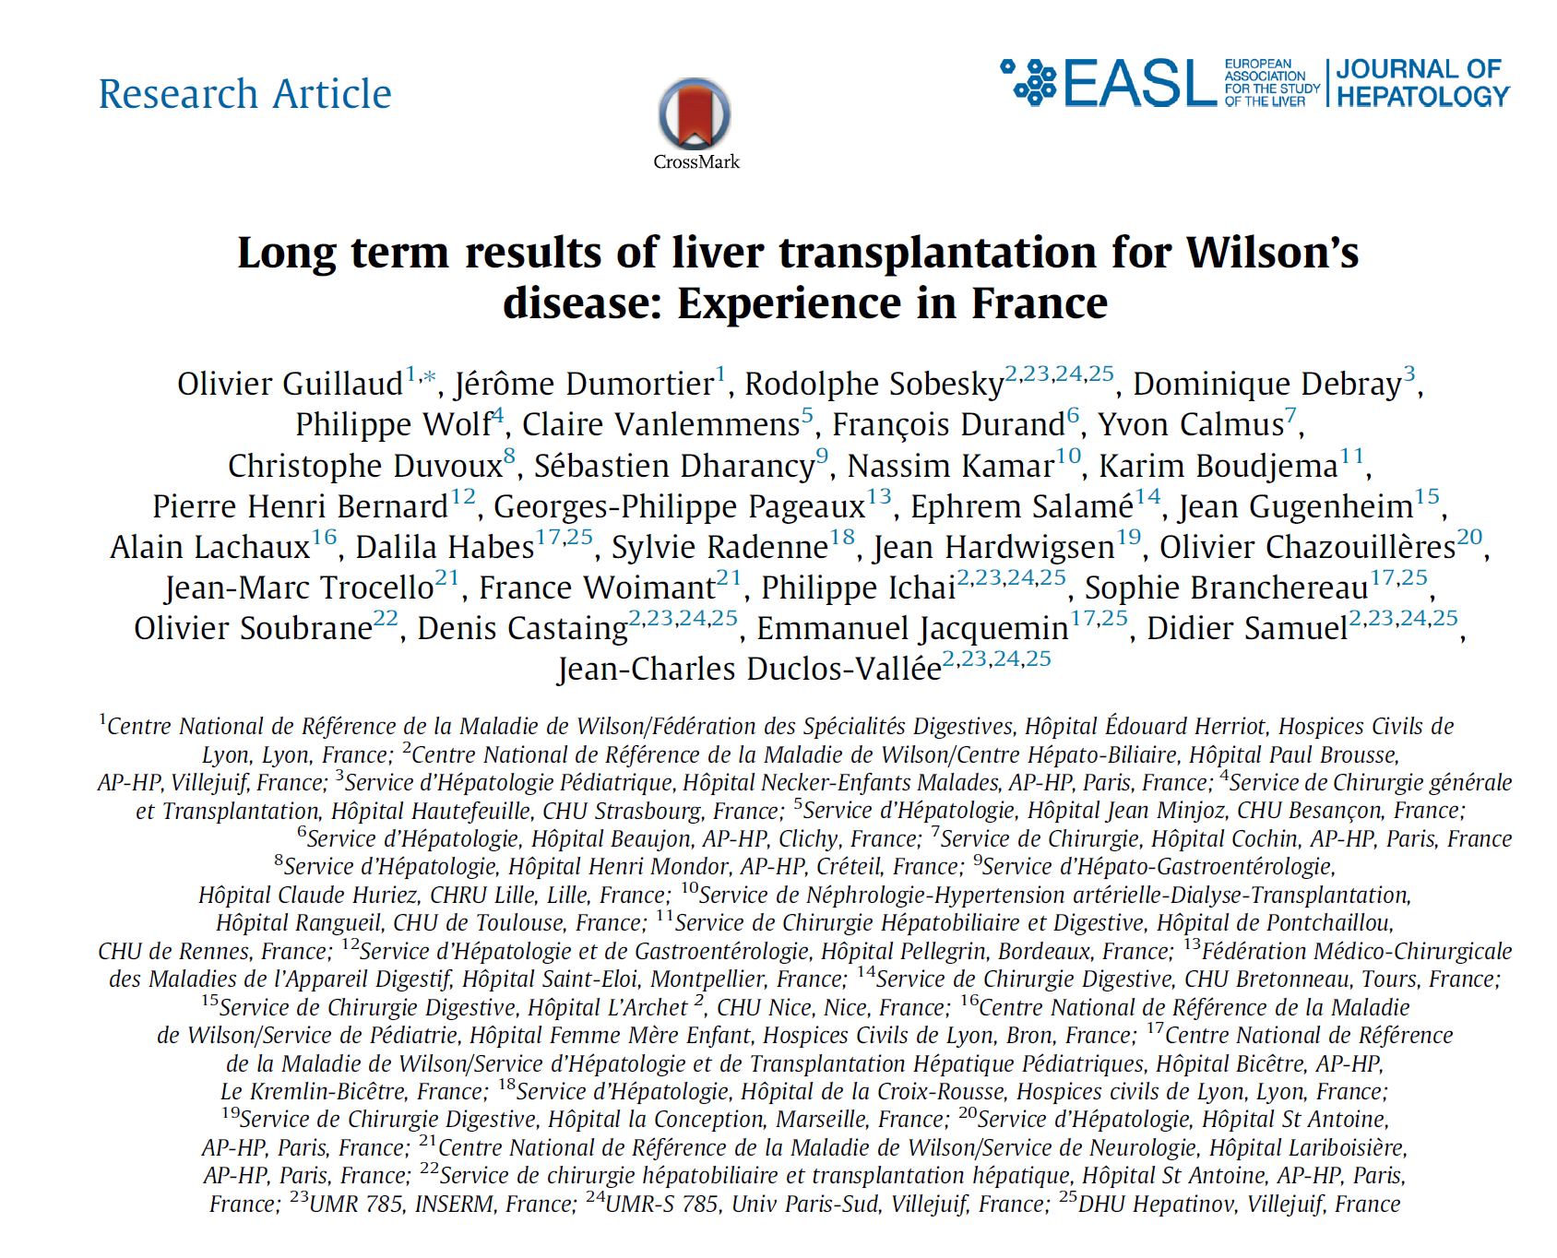
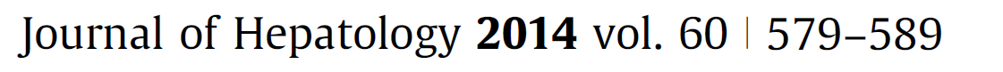

Slide 4
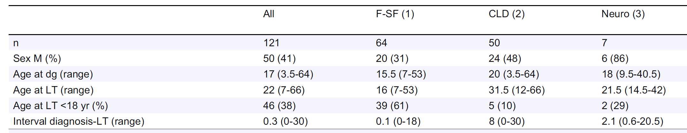
Baseline profile
Fulminant: liver failure < 2 weeks of symptoms; asymptomatic earlier
Sub-fulminant: liver failure 2-12 weeks of symptoms; asymptomatic earlier
CLD: unresponsive to medical therapy (± neurological involvement)
Neuro: unresponsive to medical therapy (without h/o liver failure)
N=121 patients
60% adults; 40% children
Median post-transplant f/u : 72 (1-23.5) mo
MELD 29 (6-40) 40 (20-50) 19 (6-34) 10 (7-11)

Slide 5
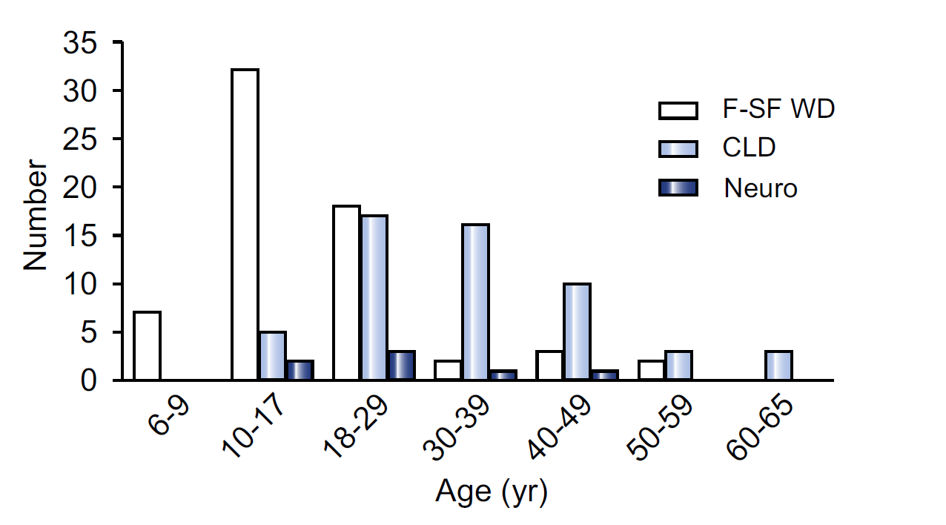
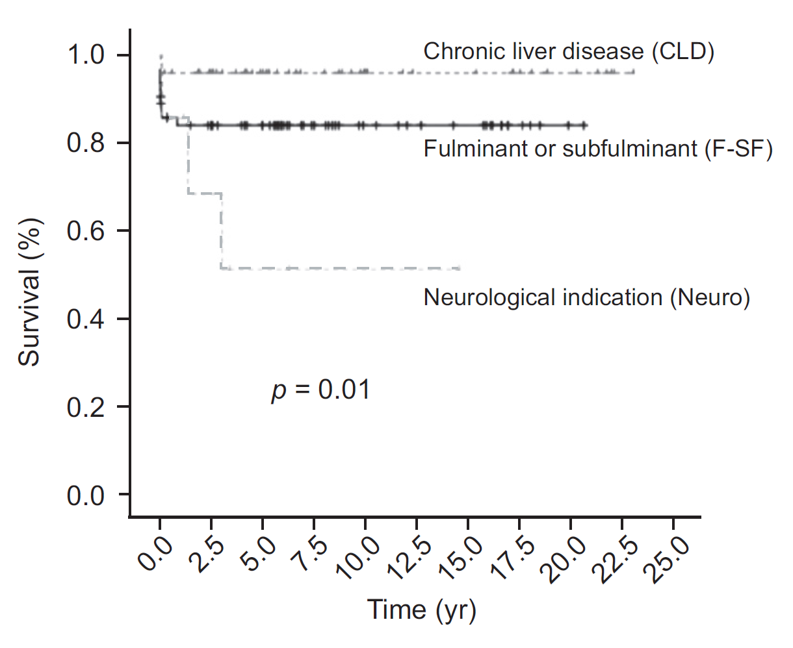
80% of FHF-SFHF had hemolytic anemia
Median duration of chelation prior to LT:
  FHF-SFHF: 18 days
  CLD: 7 years
Survival in CLD/F-SF:
80-90%

Slide 6
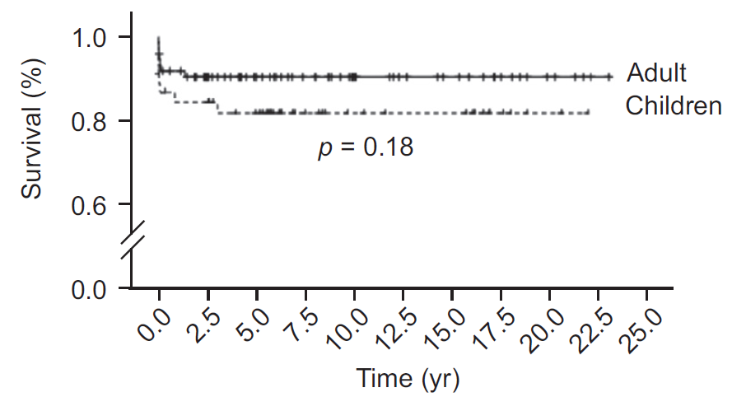
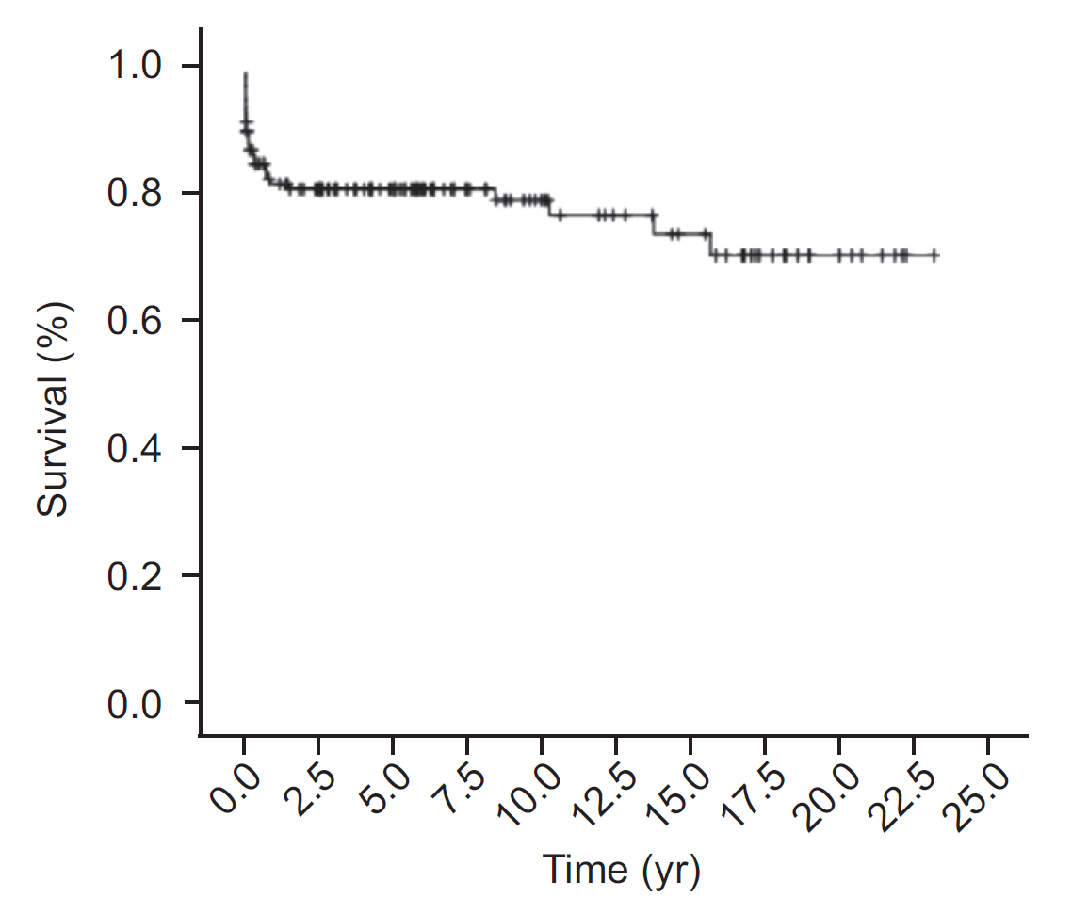
Patient Survival 5 y
Adults: 90%
Children: 82%
Poorer survival
Males
Pre-transplant renal issues
Non-elective LT
Neurological involvement
Graft Survival
80% at 5 y
70% at 20 y

Slide 7
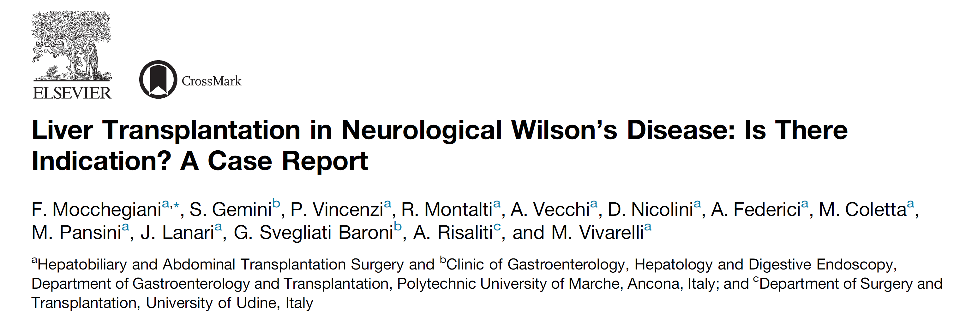
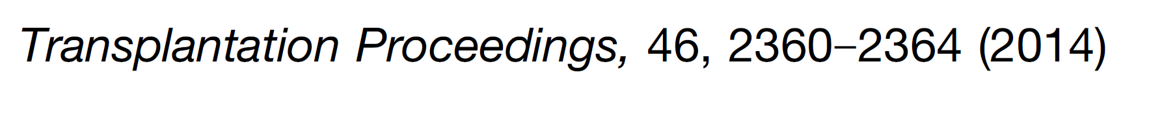

Slide 8
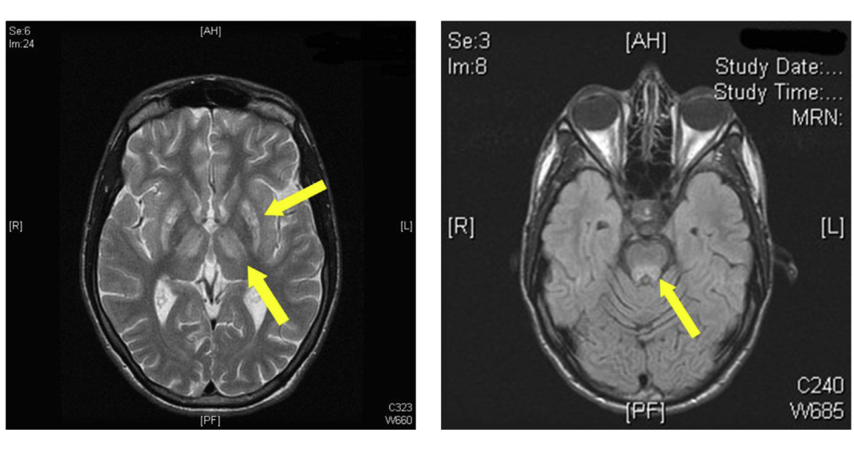
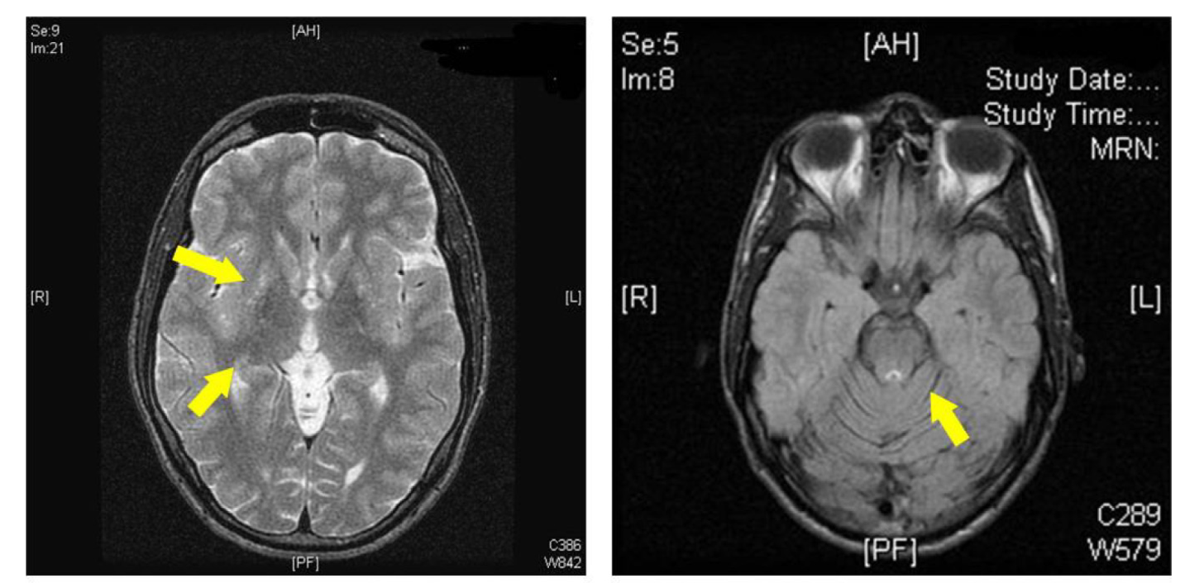
19 y boy with neurological symptoms for 10 y
Pre-transplant
Increased signal
(copper overload)
Supratentorial
(thalamus)
subtentorial (mesencephalon)
Post-transplant: 3 months
Reversal of
basal ganglia and
mesencephalon signal hyperintensity

Slide 9
Issues
Post-transplant
  Inability to tolerate tacrolimus (anxiety) and cyclosporine (worsening of mood)
  Replaced by everolimus + mycophenolate and responded
Considerable debate whether to perform LT
in severe neurological disease
Ideal immunosuppressive regimen in such
scenarios?

Slide 10
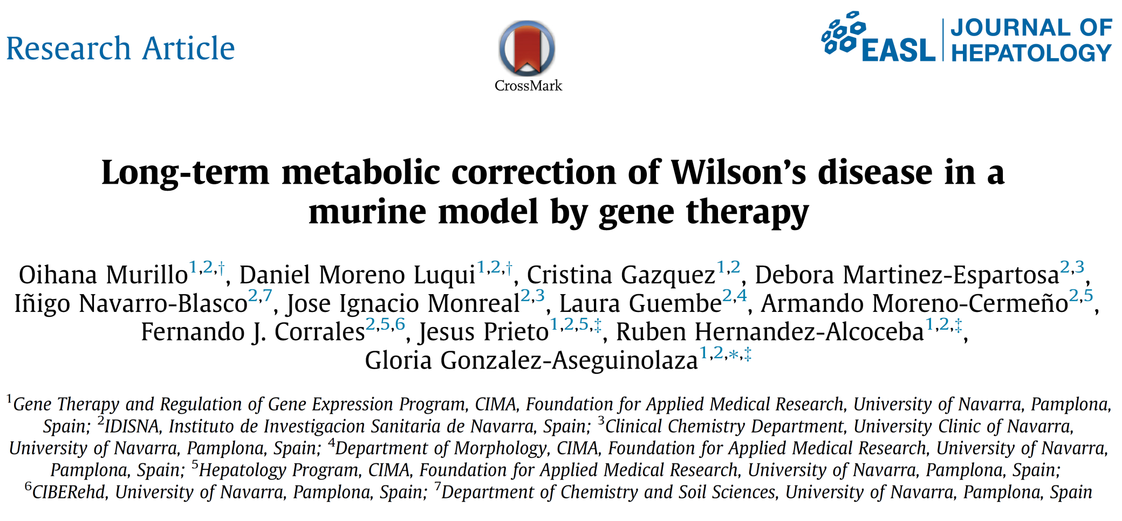

Slide 11

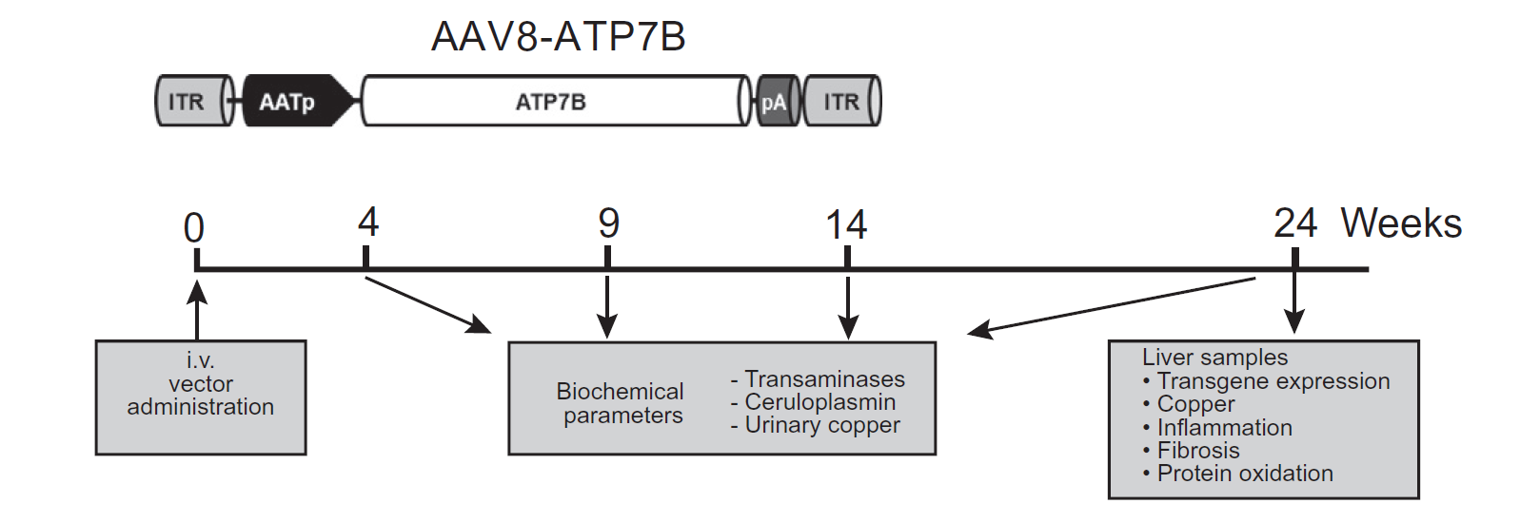
Adenoviral vector human ATP7B DNA
WD + Adenovirus 1x10¹⁰
WD + Adenovirus 3x10¹⁰
Control
WD

Slide 12
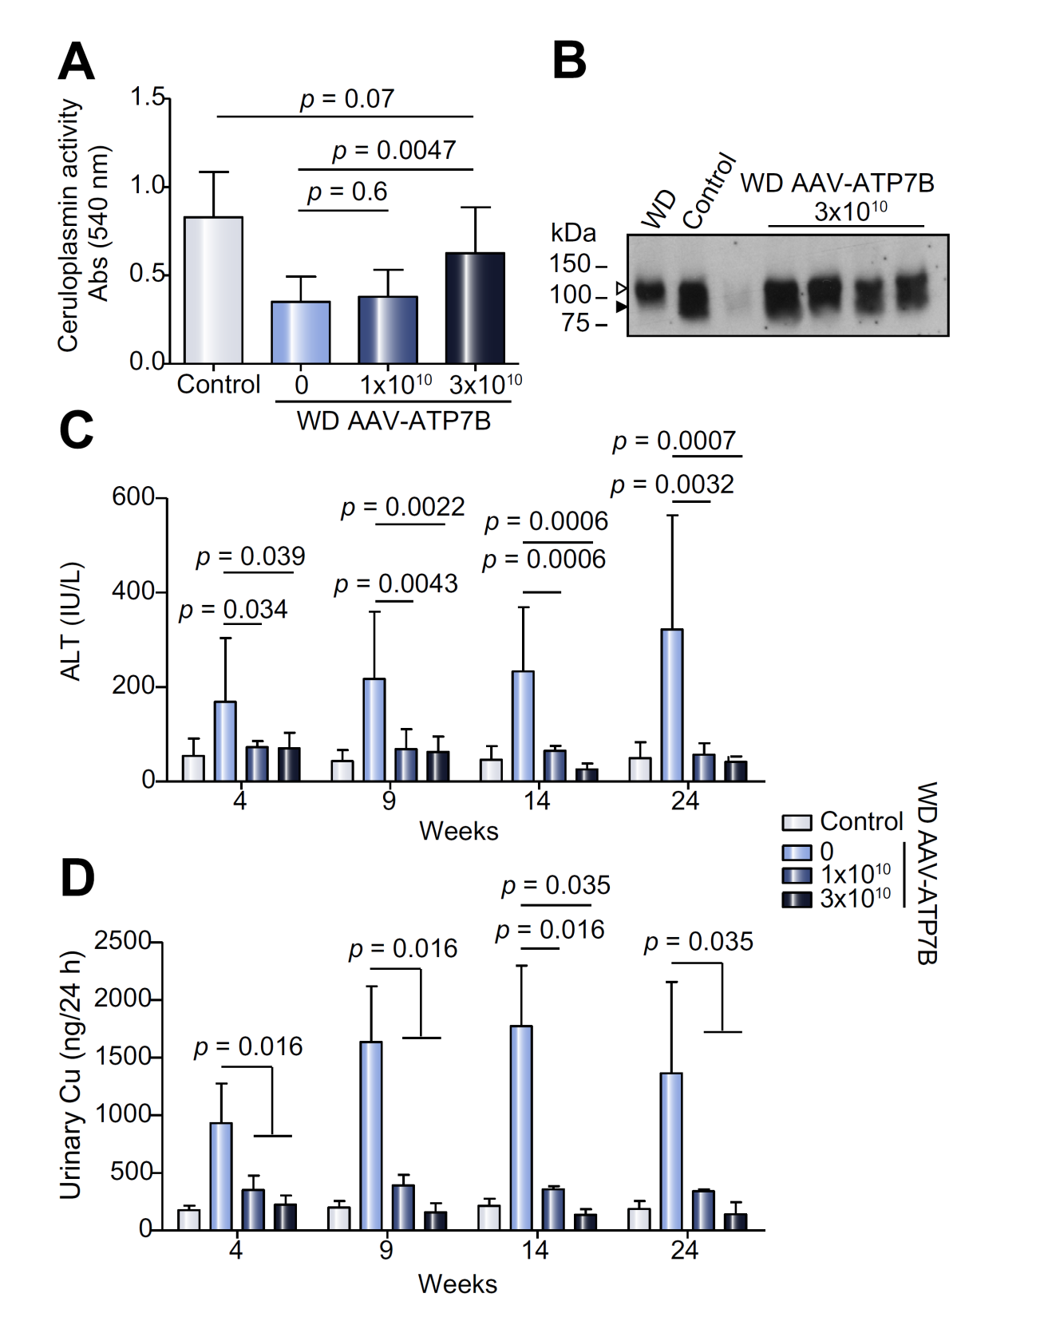
Response
Improvement in
S.Ceruloplasmin
ALT
Urinary Cu excretion

Slide 13
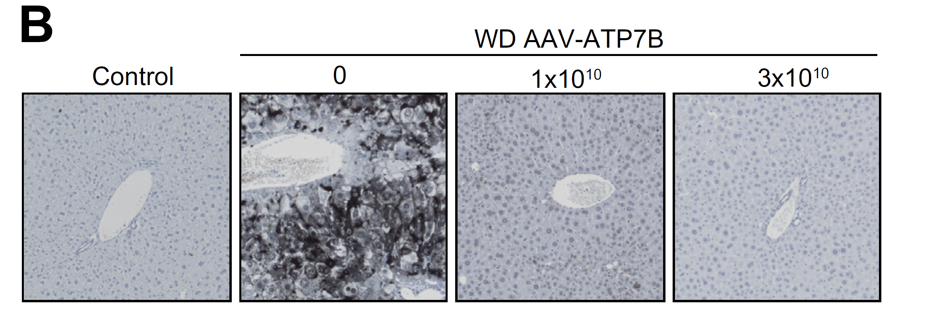
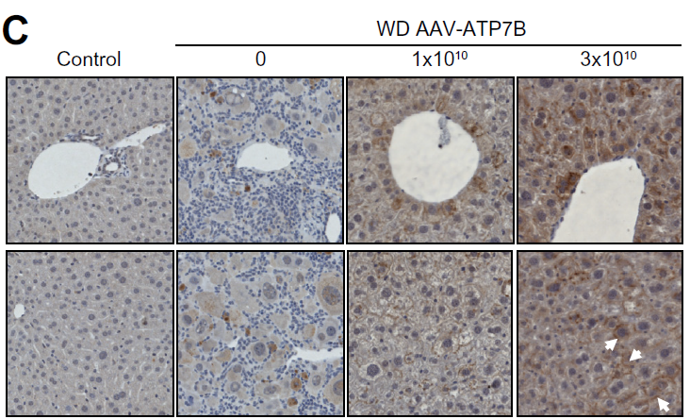
Hepatic copper content decreases
Hepatic ATP7B expression (immuno
staining)
increases

Slide 14
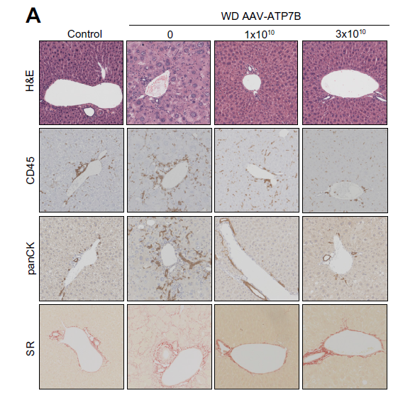
Liver injury decreases

Slide 15
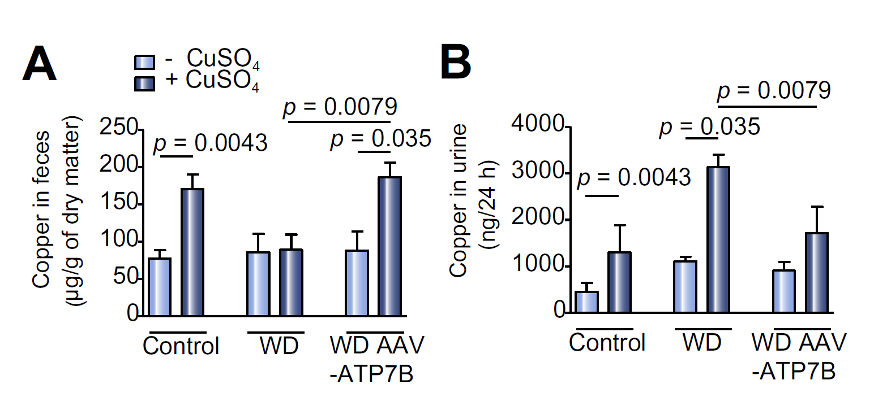
Restoration of physiological copper excretion
Intraperitoneal instillation of 100 g of copper sulphate

Slide 16
Conclusions
Adenoviral vector (AAV8-AAT-ATP7B) mediated gene therapy provides long-term correction of copper metabolism in a clinically relevant mouse model of WD

Slide 17
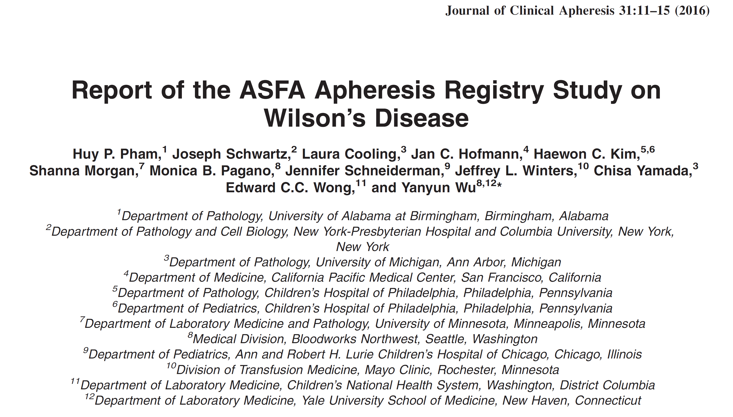

Slide 18
Bridge to liver transplantation
10 critically ill WD patients
Age : 17 (6-61) years
43 Total plasma exchange procedures
Multiple sessions over 1-13 days
Median: 3.5 (1-9) procedures
1st TPE to OLT: 4 (1-53) days
Last TPE to OLT: 1 (0-43) days
9/10 OLT survival at 6 month
Native liver survival (n=1)

Slide 19
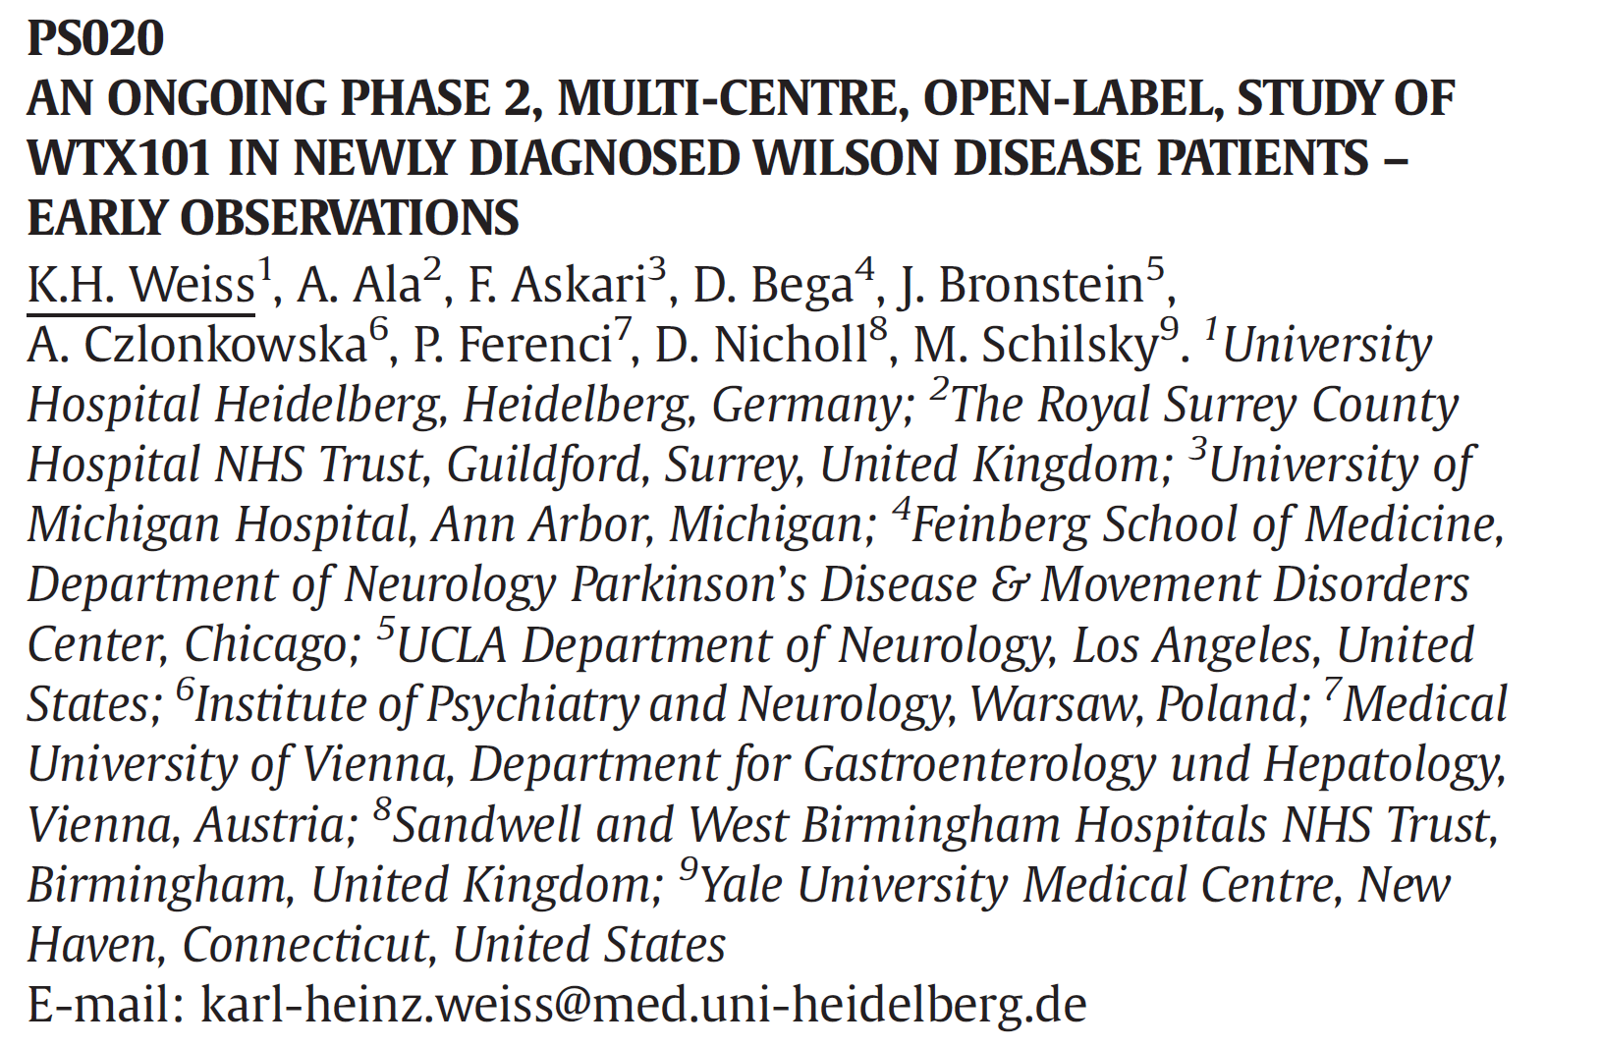
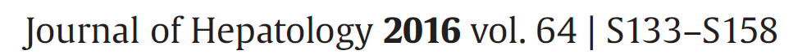
Oral presentation: EASL 2016

Slide 20
N=6, neuro-hepatic WD
Age : 18-53 years
Naïve patients or <28 days of D-Pen or trientine
60mg/day WTX101
(bis-choline tetrathiomolybdate)
8-36 weeks
Improvement in Nazer score/ LFT
Improvement in neurological score
Improvement in de-coppering
  Non-ceruloplasmin bound copper
  Total serum copper
  24 hour urine copper

Slide 21
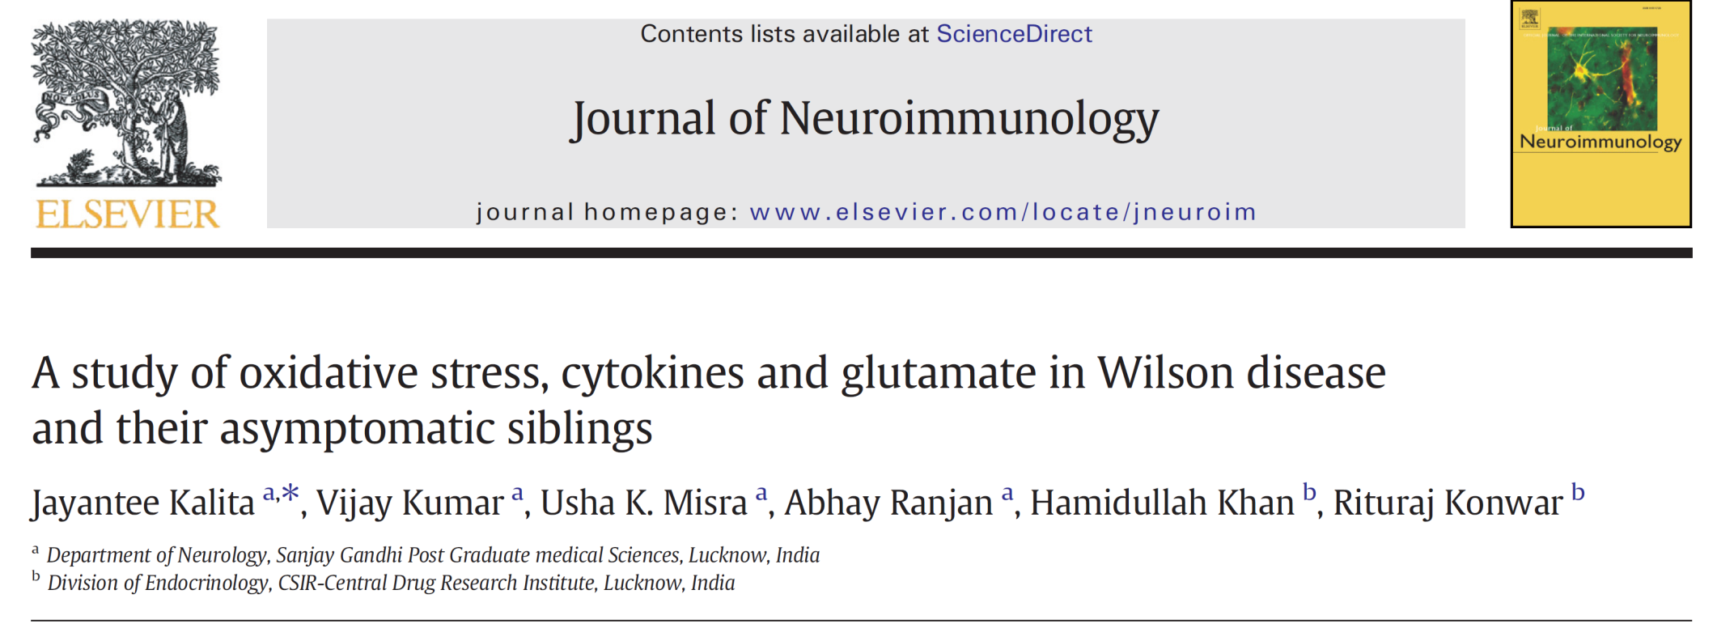
Free copper: Toxic
Reduced antioxidant levels
Increases oxidative stress
Increases cytokine levels
Potential to cause neuro-excitatory changes

Slide 22
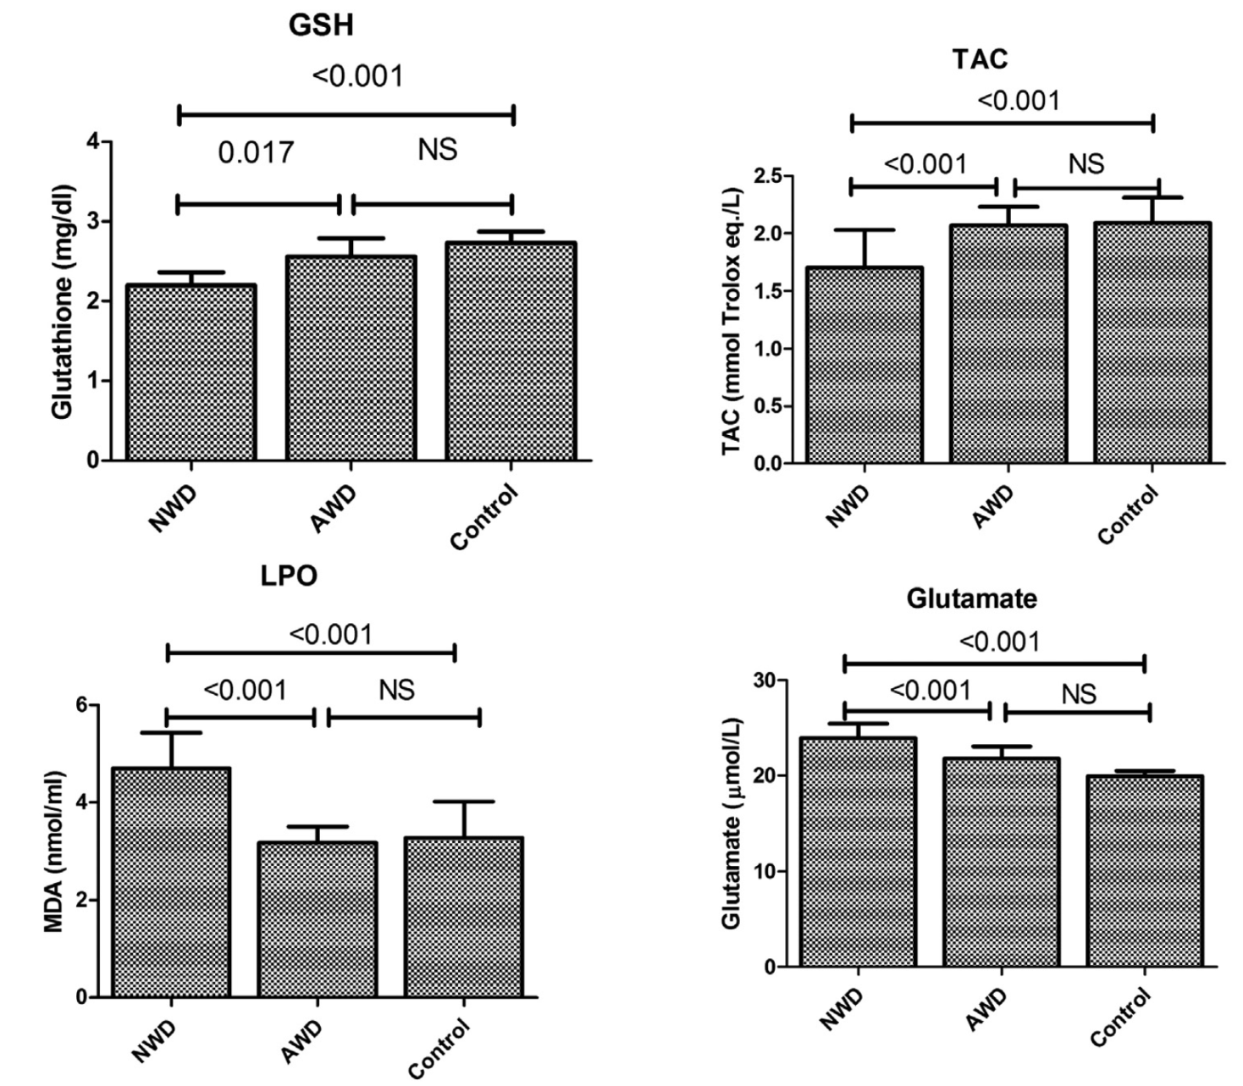
Wilson disease
29 neurological
9 asymptomatic
Age: 16 (4-31) y
Diseased
Low glutathione
Low total antioxidant
capacity
Diseased
High lipid peroxidation
High glutamate

Slide 23

Diseased patients: High cytokine activity

Slide 24
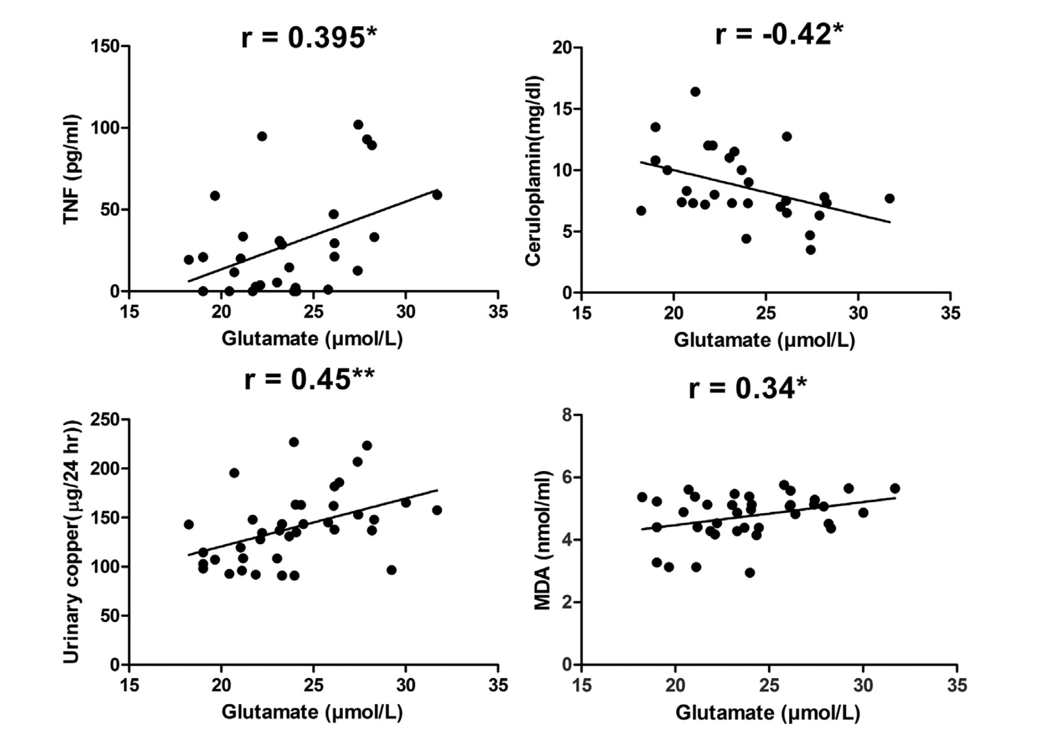
Good correlation of glutamate levels with
TNF, ceruloplasmin and urinary copper

Slide 25
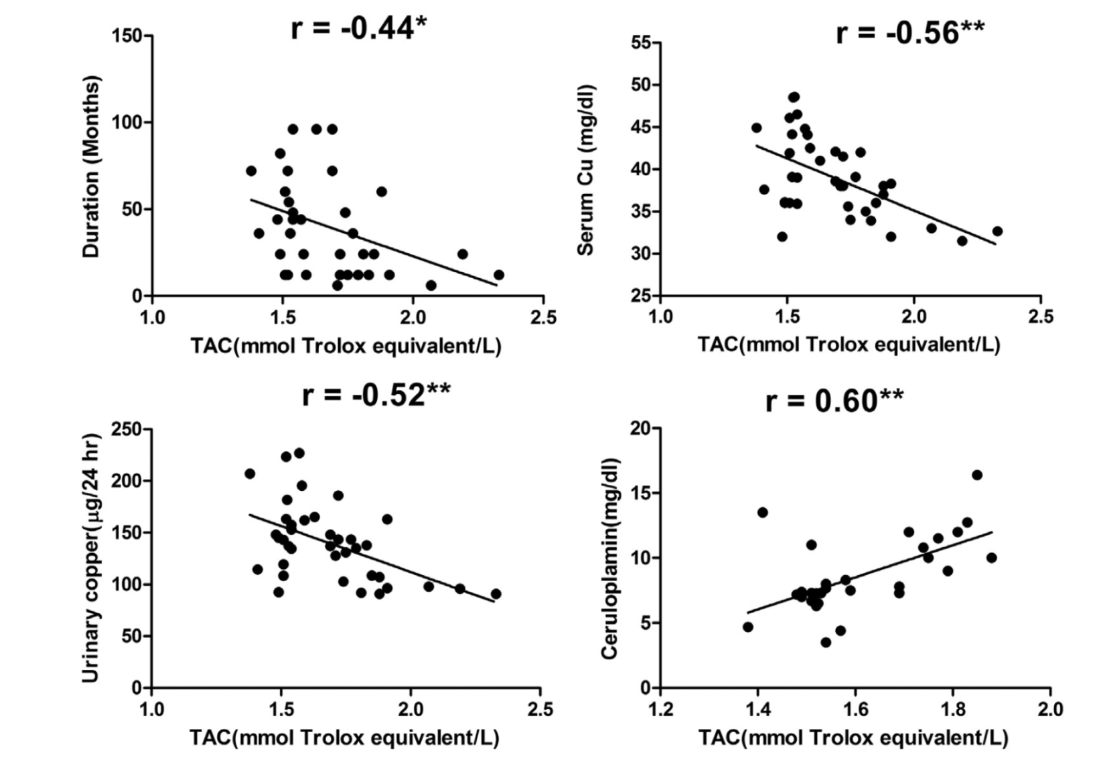
Good correlation of total antioxidant capacity (TAC) with
Duration of disease, serum copper, urinary copper and ceruloplasmin
Conclusion: Free copper is associated with oxidative stress

Slide 26
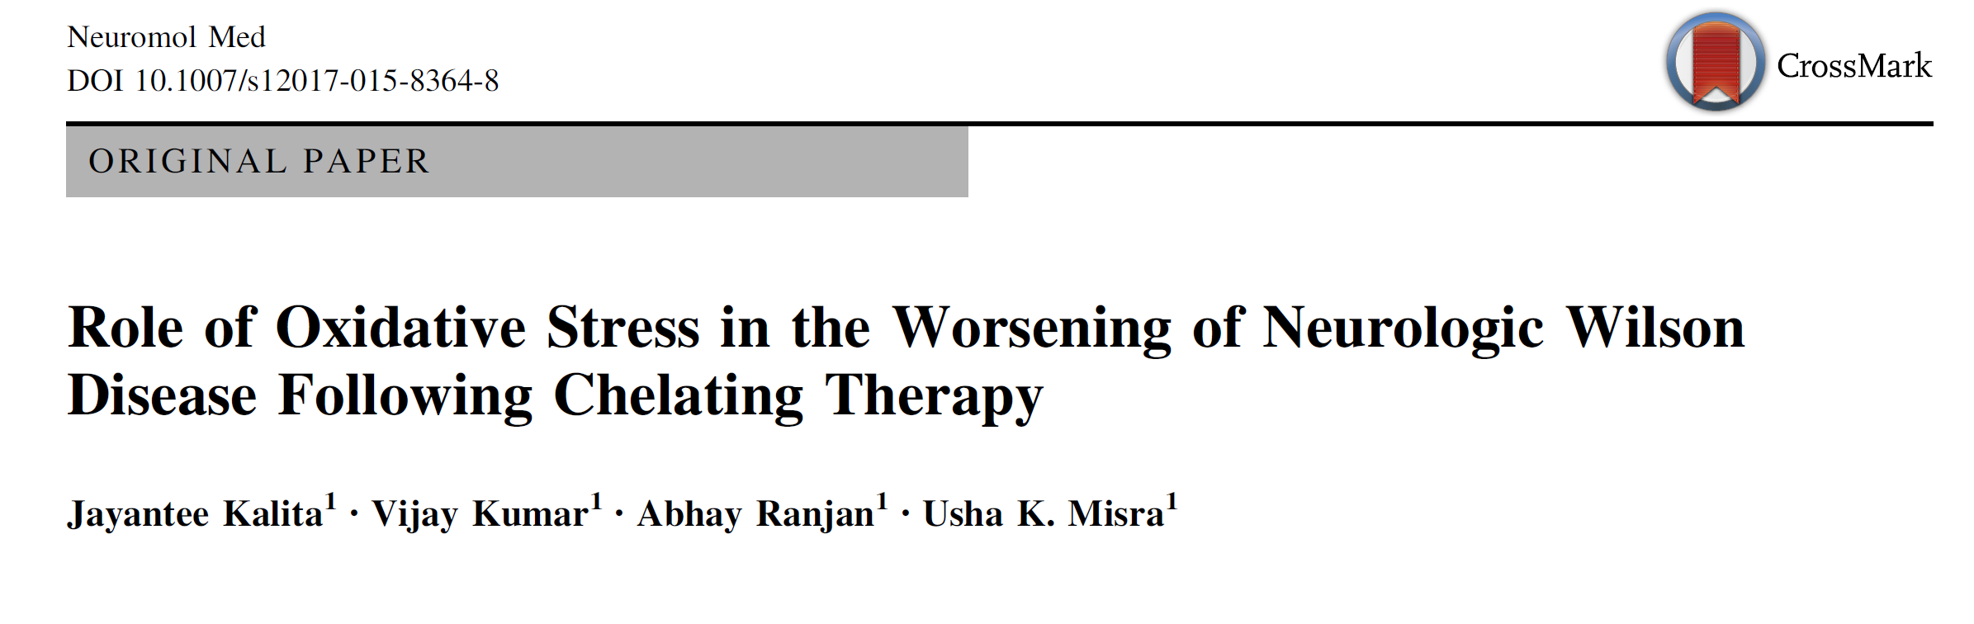
Prospectively evaluated
N=51 (40% hepatic)
15 D-Pen
27 D-pen +zinc
7 zinc
Follow-up at
1 mo, 3 mo, 6 mo or at neurological worsening
28% of those on
D-pen deteriorated
(8-24 weeks)
Neuromolecular Med 2015;17:364-72

Slide 27
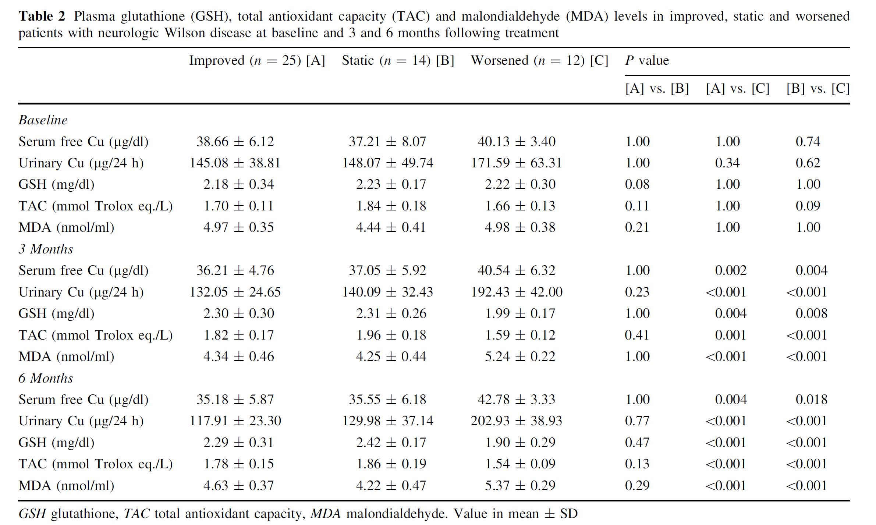
Conclusion: Increase in serum copper is associated with oxidative stress leading to neurological worsening

Slide 28
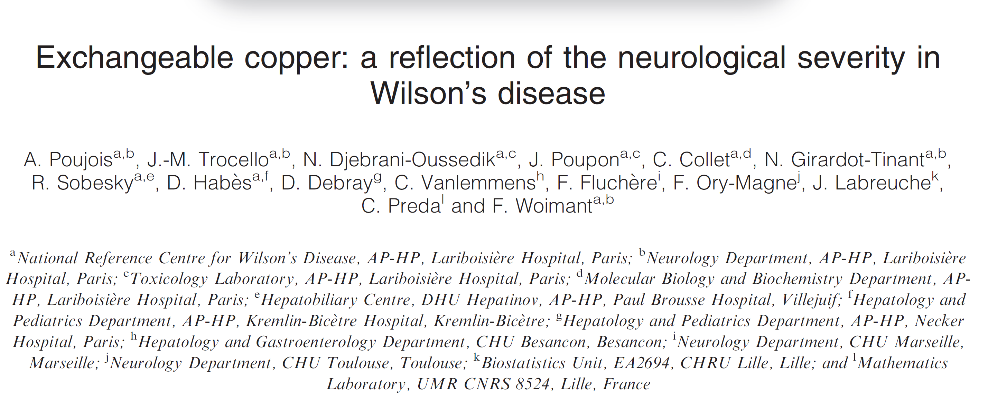
Eur J Neurol 2017;24:154-60

Slide 29
Non-ceruloplasmin bound copper (NCBC)
Fallacies
Negative values occasionally
Pitfalls: methodology in measurement of ceruloplasmin
Not a true reflection of toxic copper in body
NCBC does not correlate well extrahepatic copper toxicities
2009: Concept of exchangable copper (CuEXC) proposed (Balkhi, Anal Bioanal Chem 2009)
labile fraction of copper complexed to albumin
easily exchanged in the presence of high-copper-affinity
chelating agents eg: EDTA
Ultra filtration process for estimation

Slide 30
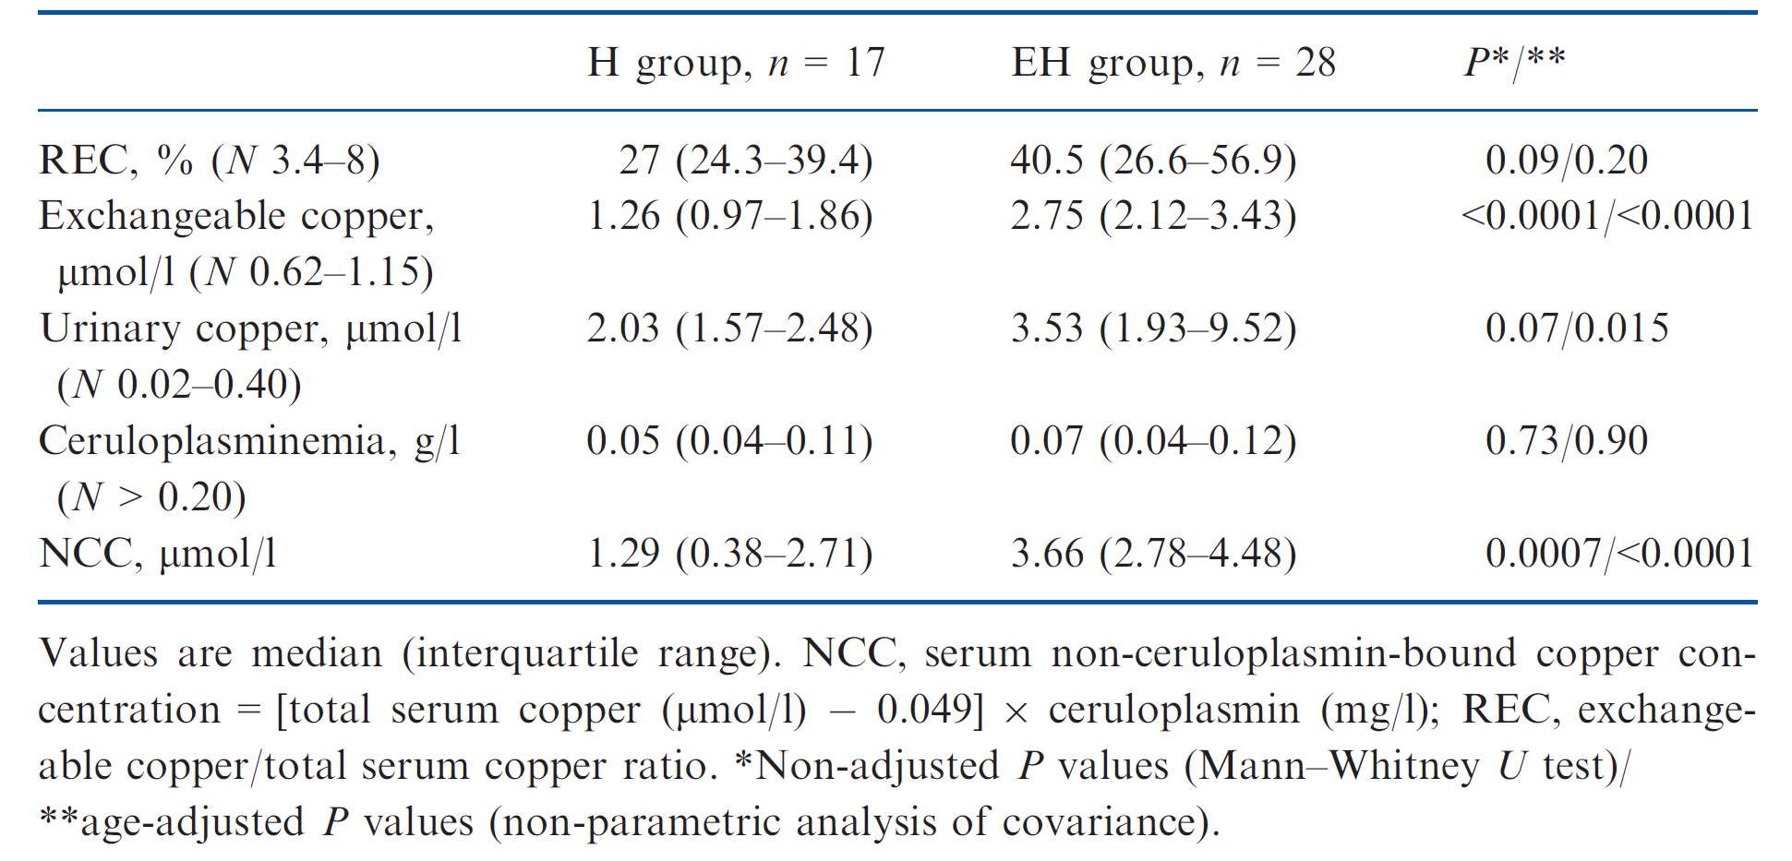
Results

Slide 31
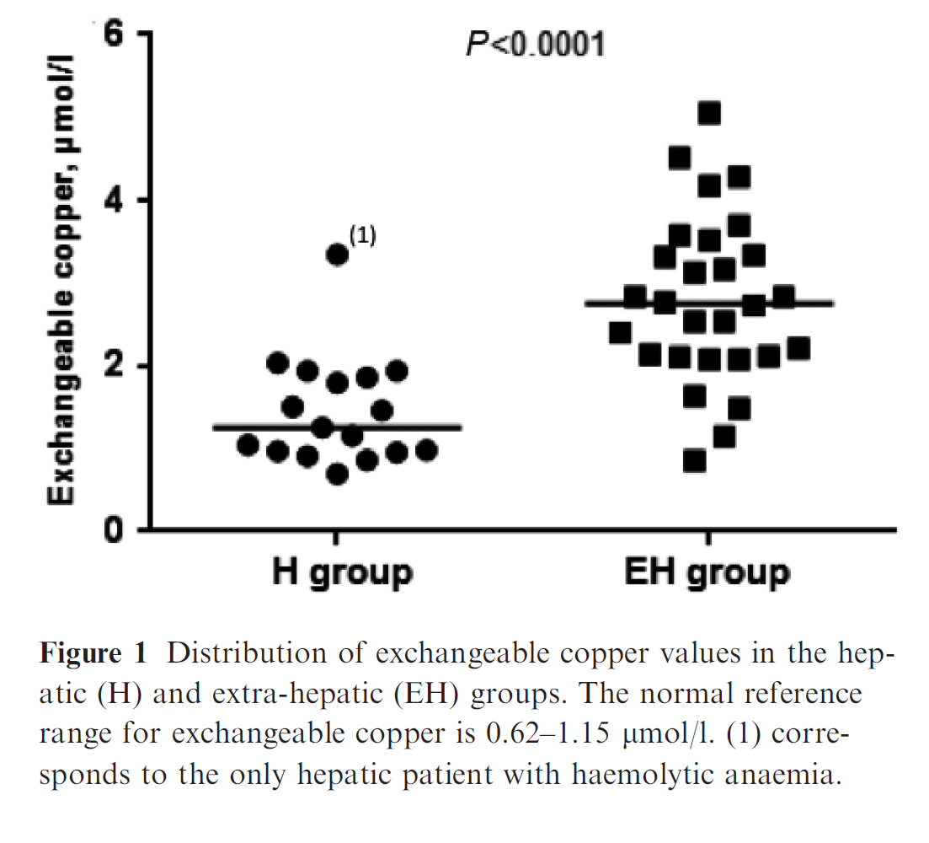
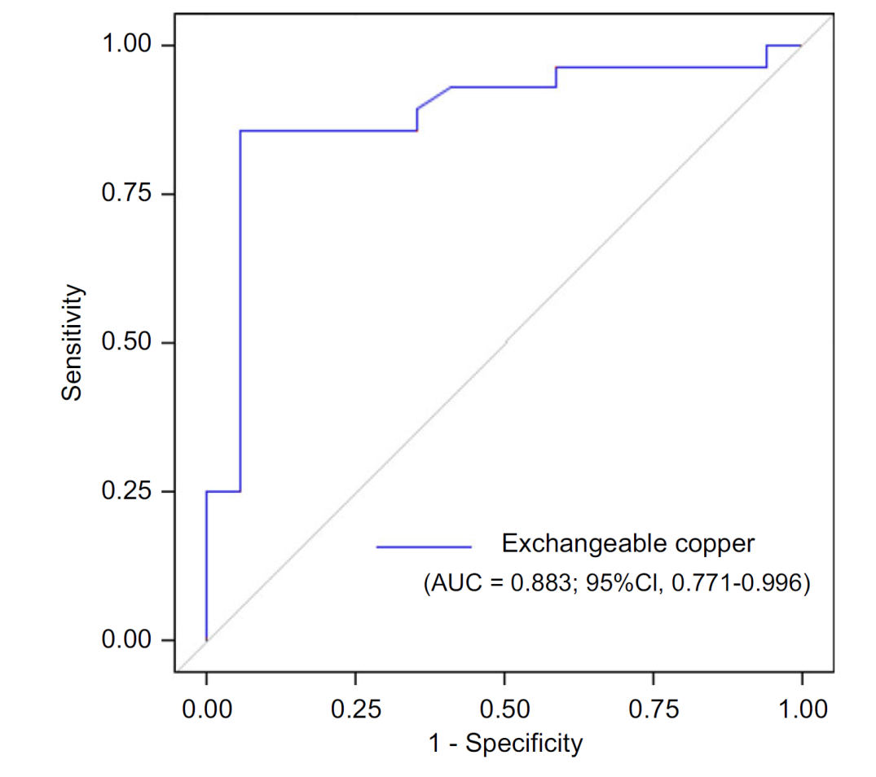
CuEXC correlated with
Unified Wilson Disease Rating Score (r = 0.45, P = 0.016)
Kayser Fleischer ring score (r = 0.46, P = 0.014)
Brain MRI score (r = 0.38, P = 0.048)
No correlation with the liver functions

Slide 32
Conclusions
Exchangeable copper value >2.08 μmol/l is
indicative of the severity of the extra-
hepatic involvement in WD
In the case of purely hepatic presentation,
atypical or mild neurological signs, it should
encourage physicians to search for lesions in
the brain and eyes.

Slide 37
Thank you

