Slide 1




When does one use Zinc alone?
Chairpersons: Aabha Nagral, Prashanth LK,SK Yachha
Talk: Vinay Goyal

Slide 2
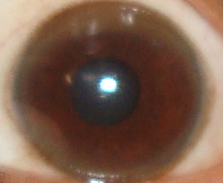


When does one use
Zinc alone in Wilson’s Disease?
Prof. Vinay Goyal
Department of Neurology
All India Institute of Medical Sciences
New Delhi. India
drvinaygoyal@gmail.com

Slide 3
Why Zinc in Wilson’s disease?
FDA, 1997: Zn Acetate developed by Gate pharma for WD
FDA 1997: Adults, Pead, Pregnancy, Pre symptomatic
zinc is essentially nontoxic
Induce Intestinal cell metallothionine, blocks absorption of Cu from intestine. (Intestinal cell life of 6 days)
Blockage of resorption of Cu from saliva, Gastric juice, Intestinal secretion
Zinc prevents the intestinal absorption of copper.
intestinal cells die and slough, the contained copper is eliminated in the stool.

Slide 4
Why Zinc in Wilson’s disease?
inducing intra-hepatic metallothionein, potentially providing further hepato-protection
inhibition of lipid peroxidation and the increase of available glutathione within hepatocytes, reducing oxidative damage
Maximum induction of intestinal metalloproteins occurs 3 weeks after the initiation of zinc.
Other Chelator: administered at least one hour before or after zinc.

Slide 5
Why Zinc in Wilson’s disease?
Adverse effects of zinc are not life- threatening,
  Gastric irritation 10 %
  Alcohol intolerance
  Headaches
  Hyperhydrosis
  Transient elevation of plasma
    lipase, Amylase, Alkaline phosphatase,
Sideroblastic anemia, the latter of which can indicate excessive copper removal, with copper deficiency

Slide 6
Zinc Acetate
25-50 mg, TDS, 60 min before meals
  Pyrates, fiber binds Zinc
  Effect complte in 2 weeks
  Deinduction half life of Zn: 10 days
Can: cause Cu deficiency
Avoid Liver, Shellfish: rich in Cu

Slide 7
Zinc in WD: Evidence
No RCT

Slide 8
When to use Zinc
As Initial treatment, when neuro/psy menifestation
Hepatic WD??
  Poor control
Maintenance therapy
Pregnancy: Safety of Zn
When complication with D-Pen
  Acute Neuro deterioration: 25%
  EPS
  Nephropathy due to penicillamine
  Drug reaction due to other drugs
When D-Pen NOT Available

Slide 9
Zinc + Penicillamine
How many of you use this combination?

Slide 10
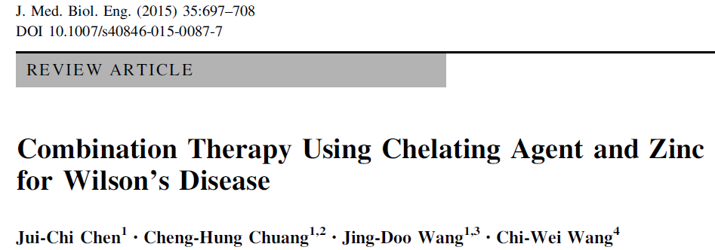
Zinc with Penicillamine
17 study, 1056 patients
data on effectiveness, adverse effects, and mortality.
Pooled analysis indicate that combination therapies for hepatic patients were significantly less effective than the same therapies for neurological manifestations (47.1 vs. 78.6 %; pooled relative risk ratio (RR): 0.63, 95 % confidence interval CI 0.43–0.94; p = 0.02).
Combination therapy of D-Pen & Zinc sulfate resulted in a significantly higher mortality rate compared to all other combination therapy types (16.3 vs. 4.7 %; RR: 3.51, 95 %CI 1.54–8.00; p\0.001).
Combination therapies involving zinc and a chelator should be carefully monitored

Slide 11
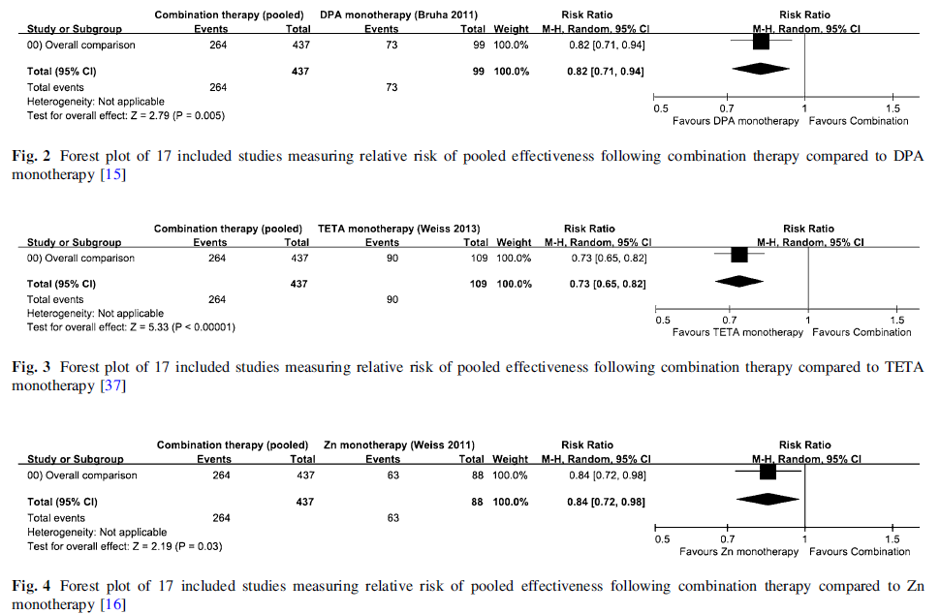
Zinc with Penicillamine
Efficacy

Slide 12
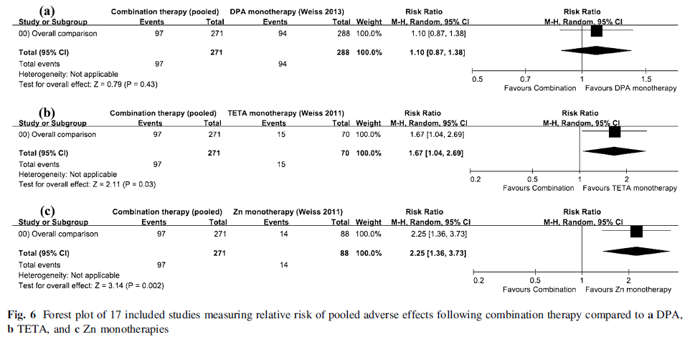
Zinc with Penicillamine
Adverse effect

Slide 13
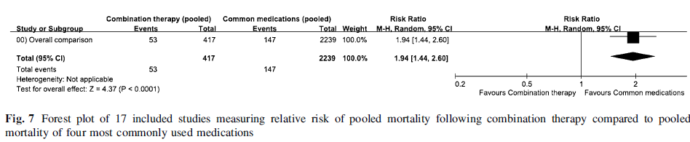
Zinc with Penicillamine

Slide 14
WD with Hepatic failure
Penicillamine

Slide 15
Zinc with Trientine

Slide 16
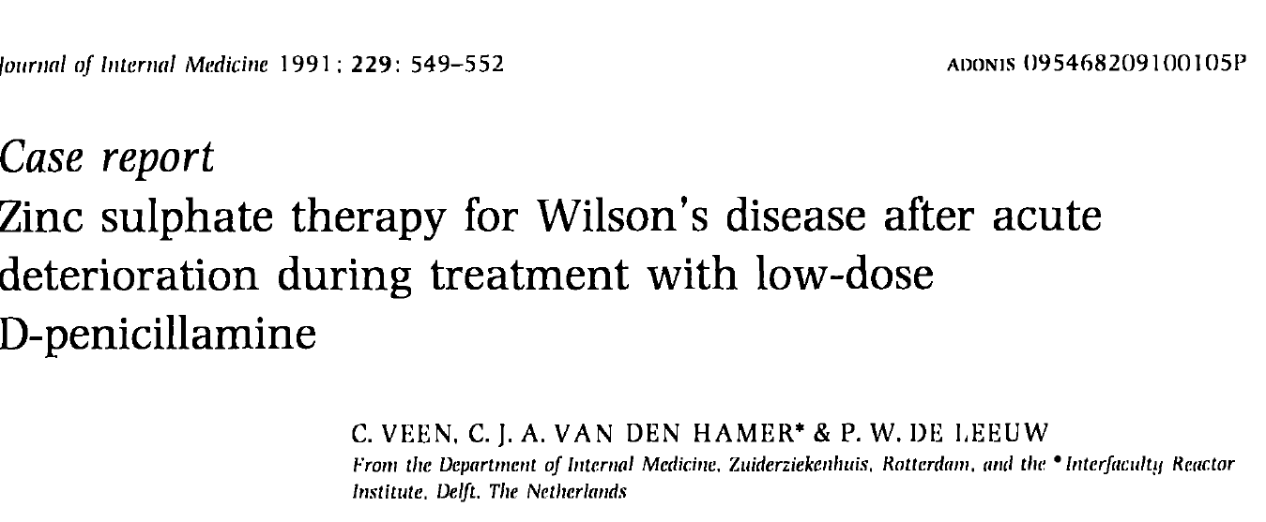
Zinc Sulphate

Slide 17
Effects of Zinc Supplementation on Serum Lipids
A Systematic Review and Meta-Analysis
Priyanga Ranasinghe; WS Wathurapatha; MH Ishara; R. Jayawardana; P. Galappatthy; P. Katulanda; GR Constantine
DisclosuresNutr Metab. 2015;12(26)
Print
Email
Abstract and Introduction
Methods
Results
Discussion
Conclusions
References
My Alerts
Click the topic below to receive emails when new articles are available.
Add "Lipids Management"
Abstract and Introduction
Abstract
Zinc is a mineral that plays a vital role in many biological processes and plays an important role in insulin action and carbohydrate metabolism. It may also have a protective role in the prevention of atherogenesis. Numerous studies have evaluated the effects of Zinc supplementation on serum lipids in humans and have demonstrated varying results. We systematically evaluated the literature and performed a meta-analysis on the effects of Zinc supplementation on serum lipids. A five staged comprehensive search of the literature was conducted in the following databases; PubMed, Web of Science and SciVerse Scopus for studies published before 31st December 2014. All controlled clinical trial in humans, that included a Zinc supplement intervention, either alone or in combination with other micronutrients and evaluated effects on serum lipids (total cholesterol [TC], triglycerides [TG], LDL cholesterol [LDL-c] and HDL cholesterol [HDL-c]). A meta-analysis of selected studies was performed using RevMan v5.3. The Jaded scale was used to assess the methodological quality of the trials included in the systematic review. A total of 24 studies were included in Meta analysis, which included a total of 33 Zinc interventions, in a total of 14,515 participants in the Zinc intervention or control group. The duration of Zinc supplementation ranged from 1 month to 7.5 years. The dose of elemental Zinc supplemented ranged from 15–240 mg/day. The pooled mean difference for TC between Zinc supplemented and placebo groups from random effects analysis was −10.92 mg/dl (95 % CI: −15.33, −6.52; p < 0.0001, I ²= 83 %), while for HDL cholesterol it was 2.12 mg/dl (95 % CI: −0.74, 4.98; p = 0.15, I ² = 83 %). The pooled mean difference for LDL-c between Zinc supplemented and placebo group from random effect analysis was −6.87 mg/dl (95 % CI: −11.16,-2.58; p < 0.001, I ² = 31) and for TG it was −10.92 mg/dl (95 % CI: −18.56, − 3.28; p < 0.01, I ² = 69 %). In conclusion, Zinc supplementation has favourable effects on plasma lipid parameters. Zinc supplementation significantly reduced total cholesterol, LDL cholesterol and triglycerides. Therefore it may have the potential to reduce the incidence of atherosclerosis related morbidity and mortality.
Introduction
Zinc is a mineral that plays a vital role in many biological processes, such as enzyme action, cell membrane stabilization, gene expression and cell signaling.^{[1]} It is required for structural and functional integrity of more than 2000 transcription factors and 300 enzymes; hence, almost all metabolic pathways are in some ways reliant on at least one Zinc requiring protein.^{[2,3]} Zinc also plays an important role in insulin action and carbohydrate metabolism.^{[4]} Studies have shown that diabetes is accompanied by hypozincemia and hyperzincuria.^{[5,6]} In addition Zinc is also an integral part of key anti-oxidant enzymes and Zinc deficiency impairs their synthesis, resulting in increased oxidative stress.^{[7]}
Zinc deficiency is known to affect 1/3 ^{rd} of the world's population.^{[8]} It is estimated that Zinc deficiency is a major factor contributing to 1.4 % of deaths worldwide.^{[8]} Zinc deficiency is more common in developing countries, and although severe deficiency is rare in developed countries, marginal deficiency is thought to be relatively common.^{[9,10]} Zinc deficiency is associated with many diseases, including malabsorption syndrome, chronic liver disease, chronic renal disease, sickle cell disease, diabetes and malignancy.^{[11]} Animal studies have shown that Zinc deficiency has profound effects on the cell structure of the aorta, fatty acid metabolism and carbohydrate metabolism, being disadvantageous for maintaining vascular health.^{[12]} Zinc deficiency renders vascular endothelial cells more susceptible to the effects of oxidative stress.^{[13,14]} Furthermore, in LDL receptor knock-out mice acute Zinc deficiency elicits changes in key transcription factors and adhesion molecules that are pro-atherogenic.^{[15]} In human studies a strong negative association was observed between the dietary intake of Zinc and the incidence of diabetes and heart disease, as well as several of their associated risk factors including hypertension and hyper-triglyceridemia.^{[16]} Hence Zinc may have a protective role in the prevention of atherogenesis.^{[12]}
Several human studies have demonstrated that Zinc supplementation reduces total cholesterol, LDL cholesterol and triglycerides, in addition to increasing the HDL cholesterol levels.^{[17–20]} However, these results have been contradicted by other studies.^{[21–23]} Even under the most rigorous study design conditions, a single well-planned study rarely provides definitive results.^{[24]} Hence, changing clinical practices relying on a single high-profile clinical trial can be harmful to patients' health. Systematic reviews and meta-analyses on the other hand often have increased power and decreased bias as compared with the individual studies they include, and the careful pooling of treatment effects can provide the most accurate overall assessment of an intervention.^{[24]} In 2008 Foster et al. performed a meta-analysis of controlled clinical trials to determine the effect of Zinc supplementation on serum lipids in humans.^{[25]} They did not observe any beneficial effect of Zinc supplementation on plasma lipoproteins in the overall analysis, whilst in sub group analysis of healthy subjects Zinc supplementation was associated with a reduction in HDL cholesterol concentrations.^{[25]} However, since then several recent studies have evaluated the effects of Zinc supplementation on serum lipids in humans and have demonstrated varying results.^{[17,21–23,25–28]} Hence the present study aims to re-explore the area under discussion, by systematically evaluating the literature and performing an up to date meta-analysis on the effects of Zinc supplementation on serum lipids: total cholesterol (TC); LDL cholesterol (LDL-c); HDL cholesterol (HDL-c); and triglycerides (TG) in humans.Continue Reading

Slide 18
Generic Zinc Options
Gluzin™ Pharmaceutical Grade Ainc's active ingredient is Zinc Gluconate (also called zincum gluconium) which is zinc salt that provides a good source of Zinc mineral. There are many types of zinc salt, but Zinc Gluconate is known to be more soluble than other zinc salts, and friendlier to the stomach.
NOW AVAILABLE: Gluzin™ easy-to-swallow zinc gluconate (25 mg and 50 mg) capsules that helps support and promote:
Blocking the absorption of axcess copper in the body
Healthy zinc levels
A healthy immune system
Balances interactions of essential trace elements in the body
Healthy DNA synthesis and metabolism
Gluzin™ has been formulated with minimum fillers to help reduce allergic reactions.
For more information on Gluzin™, please go to www.extremeV.com or email us at info@extremeV.com
To read the Zinc Digest, published in the Copper Connection, click here.

Slide 19
WD with Pregnancy
D-Pen and Trientine (TT): Teratogenic effects in animals
D-Pen: Teratogenic effects in humans.
Stopping D-Pen / TT has lead to severe worsening of WD during pregnancy, even Death¹²³
  Congenital connective tissue defect
  ^{Growth retardation,} Flat Facies, Broad Nasal bridge, Low set ears, short neck, loose skin, Simian crease
FDA 1974: Zinc Sulfate does not have teratogenicity in Humans⁴
Hepatology 2000: Zinc Acetate is safe in pregnancy
Zinc in pregnancy: Rate of birth defects: 7.7%, only slightly higher than the general population risk (4%).
1. Scheinberg IH, et al. NEJM 1997. 2. Deiss A, et al. Ann Intern Med 1970; 3. Maracek Z, et al. NEJM 1976
4. FDA. Teratologic evaluation of FDA 71-49 (zinc sulfate). FDA Ressearch Laboratories, Inc. Prepared for FDA, US Department of Commerce Publications PD-221 805, February 1973, and PB 267, June 1974

Slide 20
Zinc in WD with Pregnancy
26 pregnancies in 19 women who were on zinc therapy throughout their pregnancy.
The evidence is good that zinc protects the health of the mother during pregnancy.
Fetal outcomes were generally quite good, although one baby had a surgically correctable heart defect and one had microcephaly. (HEPATOLOGY 2000;31:364-370.)

Slide 21
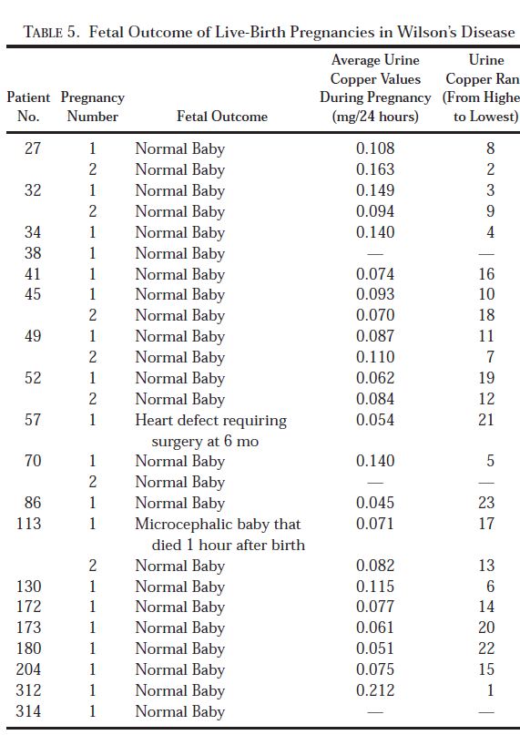
Zinc in WD with 26 Pregnancy: Hepatology 2000

Slide 22
Abstracts / Reproductive Toxicology, 2016 : Embryotox data, Germany
20 pregnancies with maternal chelator exposure at least during the first trimester.
14 were prospectively reported (13 penicillamine, 1 trientine) and 6 were retrospective (4 penicillamine, 2 trientine).
No major birth defects
3 / 14 prospective cases:
  One Spontaneous abortion
  One: elective termination

Slide 23
Abstracts / Reproductive Toxicology, 2016 : Embryotox data, Germany
Our observations do not support indications for teratogenicity based on earlier case reports on congenital anomalies associated with penicillamine
  cutis laxis syndrome,
  cleft lip/palate,
  congenital hypothyroidism.
Results: Should continue chelate treatment to maintain copper plasma levels within the normal range.
However, a detailed ultrasound examination of the fetus is recommended.

Slide 24
Trientine in Pregnancy with WD
Walshe, Q J Med, 1986; Total 13 pregnancy
7 patients, 11 pregnancies. : 8 healthy delivery
Other 3:
  One delivered prematurely with chromosomal defect (isochromosome X),
  One Each: Miscarriage at 14 weeks & Therapeutic abortion.
Infants’ ceruloplasmin levels:
  Averaged 9.9 mg/dL, not different than controls (mean, 10.0)
  2 infants from Wilson’s disease mothers had low values of 3.6 and 4.6.
Spain¹: Normal pregnancy & Healthy child
France²: Normal pregnancy & Healthy child
Summary: Trientine protect the mother’s health
  Limited data suggest safety except one major abnormality (isochromosome X)
has been reported.
Animals: Teratogenic3,4: Due to Copper deficiency
^{Animals: Zinc not teratogenic5}
1. Devesa R, et al. J Ped Gastroent Nutr 1995
2. Desbriere R, et al. La Presse Me´dicale 1998
3. Keen CL et al. PSEBM 1983
4. Tanaka H et al. J Nutr Sci Vitaminol 1992
5. FDA, 1974

Slide 25
Zn Dose in pregnancy in WD¹
Standard dose of 50 mg x 3 times daily
  24-hour urine copper values generally are over 0.1 mg.
24-hour urine copper values are generally under 0.1 mg
  25 mg x 3 times daily , or even lower doses
Monitor: Urine copper (and zinc) levels
If the copper values too high or too low:
  Check drug compliance
  Adjust Zn dose
1. Breweret al. Hepatology 2000

Slide 26
Zn Acetate or Sulphate
Same absorption
Better than Zn Carbonate ( in may MVI)
No proven difference in efficacy
Pre treatment with H2 blockers
  Reduced absorption of Zn Sufate
  Low Ph improves absorpton
Sulfate: more gastric upset
Zn Acetate: Readily available
  more used in Pharma industry: Vitamins, supplements

Slide 27
  (J Lab Clin Med 1998;132:264-78)
up to 10 years, Maintenance zinc, 141 patients
Results:
  Efficacy of zinc therapy in treating the presymptomatic patient
  from the beginning pf therapy
  pregnant patients and children
  . Median follow-up 4.8 years
  Presymptomatic 6.5 years
  Children it is 3.6 years.

Slide 28
  (J Lab Clin Med 1998;132:264-78)

Slide 29
Penicillamine AE
Zn compete with D-Pen, reducing decuppering
Acute decuppering stage:
  Inflammatory responses (fever, eosinophil, lymphadenopathy)
  Thrombocytopenia
  Leukopenia
Chronic maintenance Stage
  Zinc deficiency
  Taste and smell disorders
  Connective tissue disease & Polyarthritis;
  Lupus-like and myasthenia-like syndromes
  Aplastic anemia;
  Optic neuritis, retinal hemorrhages and conjunctivitis;
  Nephropathies.

Slide 30
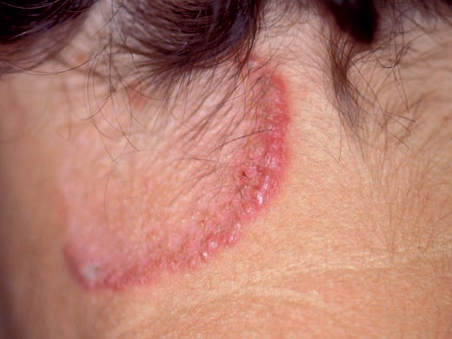
Elastosis perforans serpiginosa (EPS)

Slide 31
2012

Slide 33
Ferenci P. Wilson ́ s Disease. In: Bacon B, O ́ Grady JG, DiBisceglie A, Lake JR, editors. Comprehensive clinical hepatology. [Chapter 24]. Maryland Heights, Miss. USA: Elsevier Mosby; 2005. p. 351–367.

Slide 34
Question for audience

Slide 35
Penicillacmine Rx: Does it increase IRON deposition
Any answer?

Slide 36
My Proposal?

Slide 37
How about:
Initiate with Zinc
Then shift to D-Pen
When disease under control
  KF Ring
Maintain with Zinc or penicillamine
Where is such evidence??

Slide 38

drvinaygoyal@gmail.com
Notes:
38

