Slide 1
Complications of drug therapy
Chairpersons: Aabha Nagral, Prashanth LK,SK Yachha
Talk: Malathi Sathiysekaran

Slide 2
Complications of Drug therapy
Hepaticon 2017
“Wilson disease bench to bedside”
Malathi Sathiyasekaran

Slide 3
Drugs for Wilson Disease
D Pencillamine: 1956 : Walshe proposed penicillamine for WD and his seminal paper was published
Zinc:1961:Schouwink described the use of zinc salts in the treatment of WD
Trientene. 1969 : Walshe reported the use of trientine
Tetrathiomolybdate:1984: Walshe introduced it for WD

Slide 4
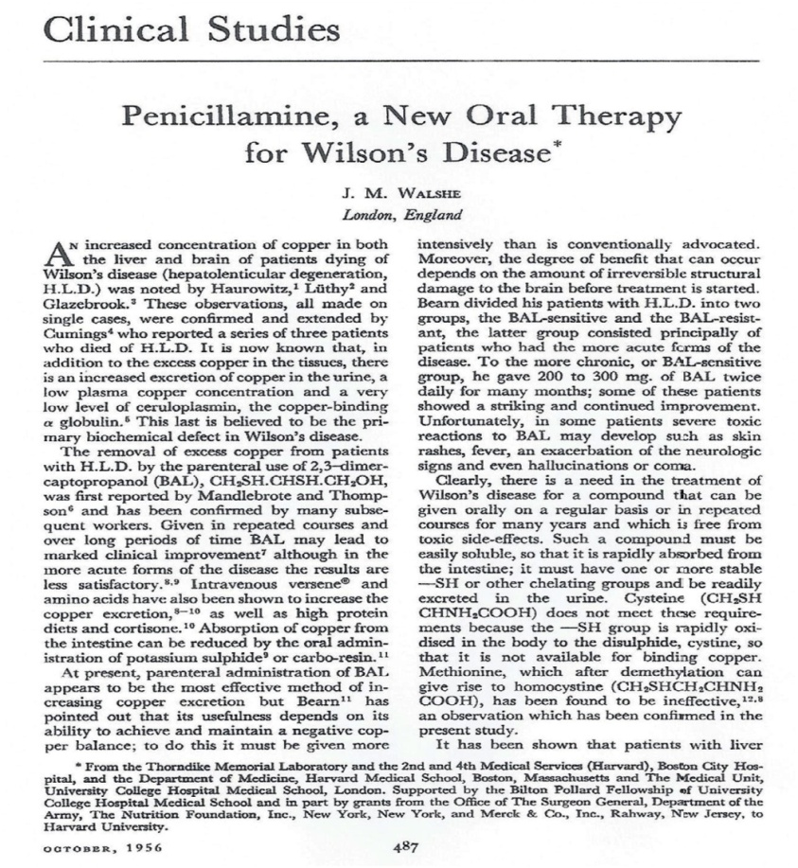
2017: the 60th anniversary of Walshe's article on treatment with penicillamine
1920
“JM Walshe 1954 ----It seemed right to act on one of Charles Dent's aphorisms: ‘never give an untried compound to a patient that you are not prepared to take yourself’.
Nothing untoward developed, 24 h after the ingestion of 1 g of penicillamine powder taken in solution.”

Slide 5
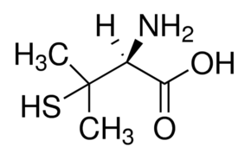
D-Penicillamine
Effects
Side effects
Penicillamine : dimethyl cysteine. (Sulphydryl bearing aminoacid cysteine doubly substituted with methyl groups)
General Chelator.
Also induces metallothionein in patients with WD.
Interferes with collagen cross linking.
Immunosuppresant action.
Severe side effects requiring drug to be discontinued 30 %
Chemical toxicity .Direct Dose dependent.
Immune mediated side effects

Slide 6
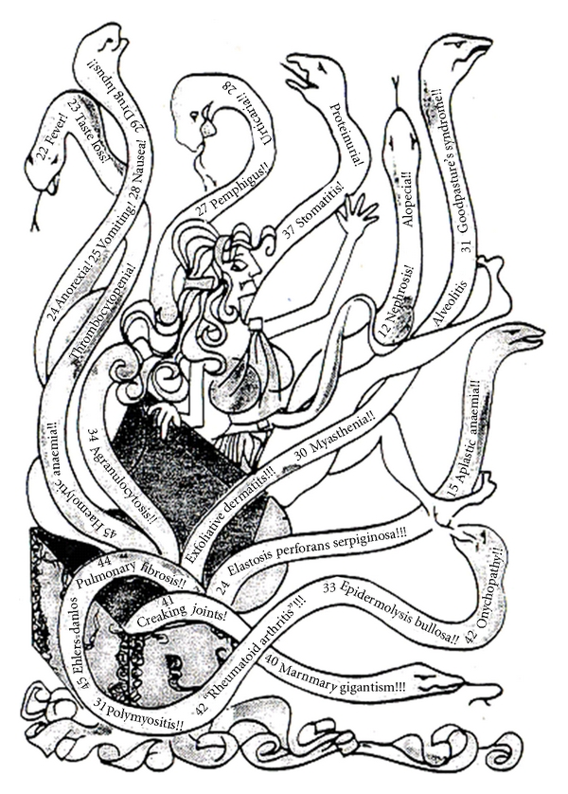
Penicillamine
OR
TREASURE TROVE?
PANDORA’S BOX/
Bockus 1985

Slide 7
Time of onset | General Complications range from 5-20% | Recommendation
Late Direct Dose Dependent and Immune Mediated(after 6 weeks) | Renal :Nephrotoxicity( Heralded by proteinuria ) Lupus Like sydrome (hematuria, proteinuria, positive ANA), Lung : Good pasture Syndrome Bone Marrow : Severe thromboctypenia,Total aplasia Skin :Progeria changes ,Elastosis Perforans serpingiosa,Pemphigus ,Pemphigoid lesions ,lichen planus, apthous stomatitis,hair loss (1-2%) Eye : optic neuritis. Mammary hypertrophy | Stop D Pen immediate
AASLD 2008

Slide 8
Time of onset | General Complications range from 5-20% | Recommendation
Early(1-3 weeks) Hypersensitivity | Fever, Cutaneous eruptions, lymphadenopathy Neutropenia, Thrombocytpenia and Proteinuria (2-10%) | Discontinue immnediately
Very Late ( after 1 year ) | Nephrotoxicity,severe allergy on restarting drug, myasthenia gravis, polymyositis ,(<1%) loss of taste, immunoglobulin A depression, serious retinitis, hepatotoxicity,hepatic siderosis
AASLD 2008

Slide 9
Neurological deterioration
Incidence ranges from 10-50% (Walshe 22%,Brewer 53%)
Occurs 2.3 ± 1.9 months after initiation of Dpen (Litwin 2015)
Some it is reversible others it is not.Less common with lower dosages
Can occur in all DP,Triene and Zinc therapy ( >Dpen 13.8%)Gut 2007
More when there is underlying neurological damage , thalamic ,brain stem involvement, MRI showing changes and those on dopamine antagonist receptors (Litwin J Neurol Sci.2015)
Probably due to increase mobilisation of hepatic copper and redistribution with increase copper exposure to the brain .

Slide 10
Zinc
Effects
Side effects
Intereferes with uptake of copper from GIT.
i) induces enterocyte metallothionein ,greater affinity for copper than Zinc
ii) inhibits entry into portal circulation .
iii) shed during enterocyte turn over and lost in faeces.
Induces Hepatocellular metallotheionein
Neurological deterioration is uncommon
Very few side effects
Gastric irritation more for zinc sulphate than acetate
Elevation of serum amylase and lipase without evidence of pancreatitis.

Slide 11
Triethylene tetramine hydrochloride Trientene:
Effects
Side Effects
General Chelator.
Polyamine like structure distinct fron pencillamine.Lacks sulfhydryl groups
Neurological worsening has been reported
Few side effects
No hypersensitivity.:fixed drug eruption reported in one patient.
Chelates Iron : should not be co-administered with Iron .
Sideroblastic anemia : reversible ( Iron and Copper Def )
Hemorrhagic gastritis, Loss of taste and Rashes .(Epstein O 1980)

Slide 12
Ammonium Tetrathiomolybdate
Effects
Side Effects
Strong decoppering agent
Interferes with intestinal uptake of copper (dose along with meals).
Binds copper from plasma ( dose between meals )
No neurological deterioration
Bone marrow depression .
Hepatotoxicity.
Aggressive copper removal : causes
i)neurological dysfunction
ii) Antiangiogenic effects

Slide 13
Place /Consultant (number) | D Penicillamine | Stopped DP | Zinc
Pune /A.Bavdekar | Bone marrow suppression : common Proteinuria : second common Skin rashes : less common EPS | No Yes Yes Yes | Gastritis after morning dose
Coimbatore/John Mathai(70) | Thrombocytopenia 3 |  | Nausea ,vomiting
Chennai : S.Srinivas(40) | acute neurological deterioration
Chennai B.Sumathi | Nephrotic syndrome 2 BM suppression 2 | Yes (Z) No
Chennai (40) M.Sathiyasekaran | Acute hypersensitivity 2 Thrombocytopenia 2 | Yes (T) No | Gastritis 2 ( stopped )
Chennai N.Shanmugam | SLE Arthritis | Yes(Z) Yes(Z)
Cochin GeethaM(48) | Rash 3 Proteinuria1 | Yes(T) Yes
TVM Prashanth (16) | Thrombocytopenia 1 Bone marrow suppression 1 | Yes(Z) Yes(Z) | None

Slide 14
Thank you

