Slide 1
How do we monitor neurological improvement?
Chairpersons: Aabha Nagral, Prashanth LK,SK Yachha
Talk: Rukmini Mridula

Slide 2
Monitoring Neurogical Improvement in Wilson’s disease
Dr K. Rukmini Mridula
Associate Professor
Dept of Neurology
Nizam’s Institute of Medical Sciences

Slide 3
Neurological manifestations in Wilson’s disease
Onset of neurological manifestations mostly occurs in the beginning of the second decade.
The manifestations vary based on the structures involved- putamen, globus pallidus, caudate nucleus, thalamus and brainstem.
Typical manifestations can be divided into 4 groups 1. dystonia 2. Parkinsonism 3. Tremor 4. Ataxic/choreic
Myoclonus, seizures, autonomic disturbances may occur rarely.

Slide 4
Neurological manifestations
It is important to evaluate for neurological signs in all patients with Wilsons disease
MRI Brain in all patients with Wilson’s disease before treatment
EASL guidelines 2012 (GRADE II-2, B), 1 AASLD Class I, Level C

Slide 5
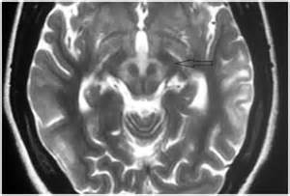
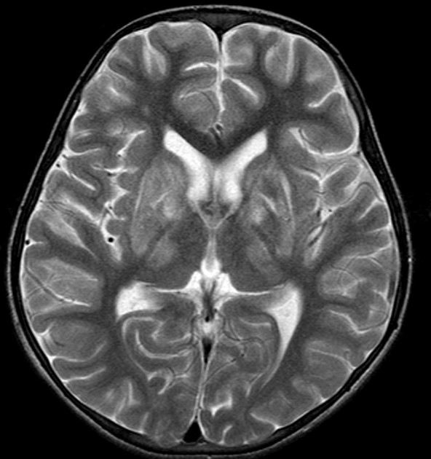

Slide 6
Chu staging
Stage I: Hand tremors, slurred speech, hoarseness or tendency to fall, with minimal or no functional impairment.
Stage II: Able to walk but show moderate rigidity or involuntary movements, unsteady gait, dysphagia, dysarthria, psychiatric symptoms, or any combination of these.
Stage III: Bedridden with severe generalized rigidity or spasticity; or unable to walk because of gross ataxia or marked involuntary movements.
Chu NS. Sensory evoked potentials in Wilson′s disease. Brain 1986;109:491-501.

Slide 7
Scales for Wilson’s disease
Global Assessment Scale for Wilson's Disease (GAS for WD) has 2 tiers.
Tier 1 scores the global disability in four domains: liver, cognition and behavior, motor, and osseomuscular. ). Each domain is scored on an ascending six-point scale (0–5).
Tier 2 assesses WD-related neurological dysfunction across 14 items. Each item is graded on an ascending five-point scale (0–4) and summed to obtain the total tier 2 score (0–56)
Aggarwal, A., Nagral, A., Jankharia, G., Aggarwal, N., & Bhatt, M. (2009). A novel global assessment scale for Wilson’s disease (GAS for WD). Movement Disorders, 24, 509–518.

Slide 8
Unified Wilson’s rating scale
Members of the EuroWilson consortium from Poland, Germany, and France prepared a new scale using clinical rating scales as the UPDRS, ICARS, and RSD.
The novel scale for WD consists of 3 parts, including: consciousness, a historical review based on the Barthel scale (2-11 items), and neurological examination (12-35, items).
The maximum score for the first part is 3, for the second 39 points, and for the last 143 points
Czlonkowska A, Tarnacka B, Moller JC, et al. Unified Wilson’s diseases rating scale - proposal for the neurological scoring of Wilson’s diseases patients. Neurol Neurochir Pol. 2007;41(1):1–12.

Slide 9
Monitoring therapy
Zinc may be initially started for first 3 months –followed by slow addition of pencillamine
Monitor for worsening on pencillamine weekly assessment –go slow and slowly titrate – in case of worsening (acute deterioration) reduce medication and reduce the rate of dose escalalation.
70% of neurological changes revert back after 2-3 years of therapy

Slide 10
Monitoring therapy
Role of investigations
24 hr urinary copper –In intial stages can be a sign of good compliance especially if symptoms are not improving
Serum copper, ceruloplasmin and non ceruloplasmin bound / free copper (Total serum copper (mcg/dL) - 3[ceruloplasmin (mg/dL)]) – are affected by various factors
CBC/ renal function tests/ liver function tests are required on a regular basis initially

Slide 11
Monitoring therapy
Presence of necrosis or cystic changes on MRI is a poor prognostic marker of recovery.
Dystonia and contractures can occur
Tremors can persist occasionally –thalamotomy/ VIM DBS can be performed.
Neuropsychiatric manifestations can persist

Slide 12
Thank you

