Slide 1
Dr. Banumathi Ramakrishna,
SIMS Hospital, Chennai

Slide 2
Role of liver biopsy
Stage of the disease
Aetiology

Slide 3
Aetiology
Autoimmune
Metabolic
Viral - rare for this age
*Correlation of clinical findings, investigations and histology.

Slide 4
Morphology ( Wilson’s)
Highly variable – depending on the stage of the disease
Early stage – minor changes (Mild steatosis- NASH like)
No stainable copper (cytosolic Cu bound to metalothionein – highly soluble & not detectable)
Chronic hepatitis & cirrhosis - Portal inflammation & interface hepatitis, steatosis, glycogenated nuclei, Mallory bodies and copper accumulation
Submassive or massive necrosis - in fulminant hepatic failure
Fresh tissue for Cu estimation*

Slide 5
Copper stain
Rhodanine – red orange granular deposits (Lysosomal copper complexes)
Orcein – Black brown deposits (sulfhydryl-rich CBP)
Zone 1 and can be pan lobular
Can be highly variable
Negative stain
Dry tissue weight estimation*- >250ug/gm dry weight (atleast1cm core). Sampling error
Notes:
The copper component of the protein complexes appears as red-orange flecks in rhodanine-stained tissue sections. The sulfhydryl-rich copper-binding proteins appear as black-brown flecks with the use of an orcein stain. Both the copper-binding proteins and the copper component of the protein complexes appear within periportal hepatocytes in the early stages of disease and then involve the entire lobule with time. Copper deposition can be highly variable within or between cirrhotic nodules

Slide 6
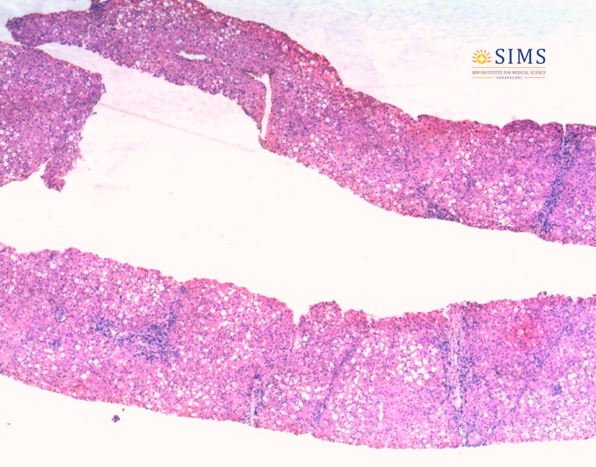
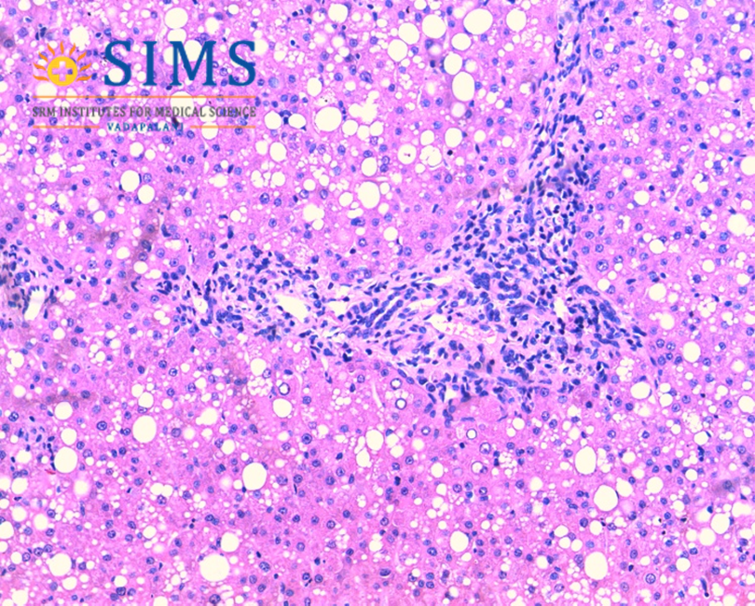
9 yrs, F, asymptomatic, persistent enzyme elevation, No KF ring, caeruloplasmin 371 u / l (n 200-1100) H/O sibling death
Portal inflammation, steatosis, glycogenated nuclei

Slide 7
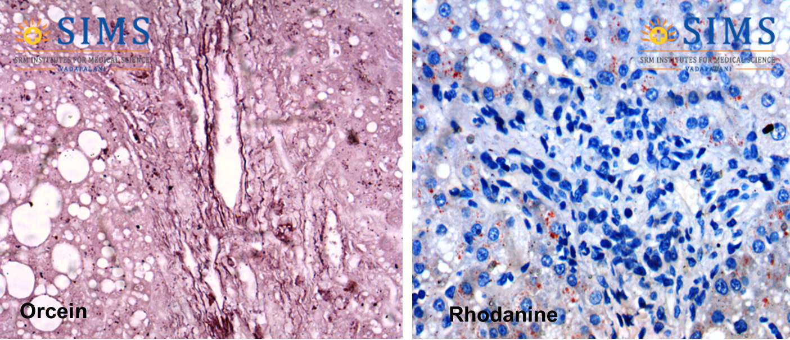
24 hr urine copper – 224ug , dry weight 1142ug

Slide 8
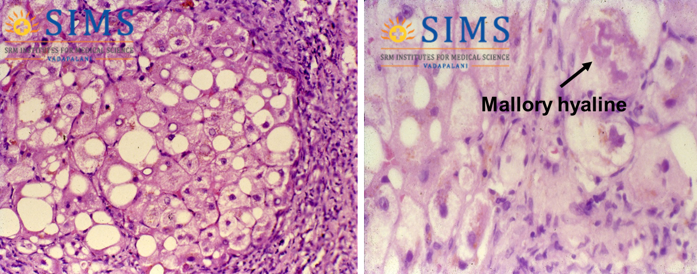
Wilson disease – Cirrhosis ( 8 yrs, M )

Slide 9
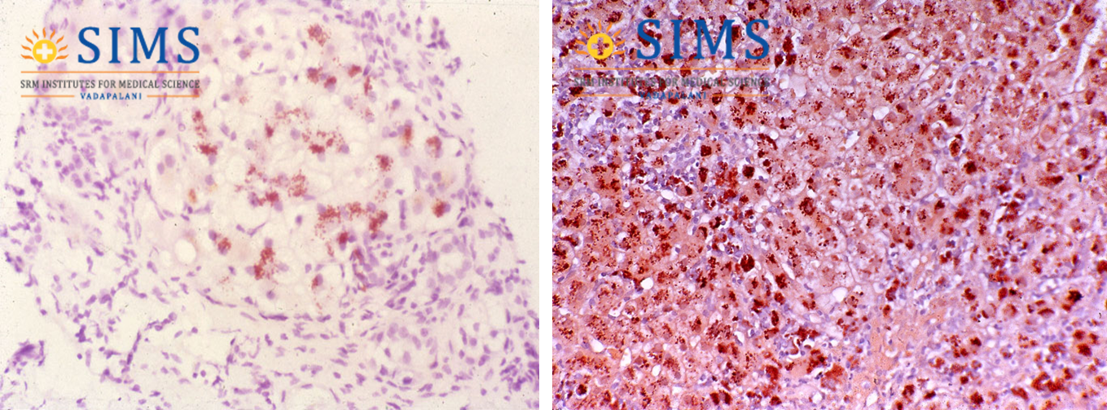
Rhodanine stain
6yrs M, cirrhosis with abundant copper deposits

Slide 10
Other conditions
Any chronic cholestasis
Biliary aetiology,ductopenia
Non Wilsonian

Slide 11
Thank you

