Slide 1
Case Discussion
Twelve year old child presents with jaundice, ascites and coagulopathy
Presenter : Durga Prasad
Moderator: SK Yachha
Panelists : Aabha Nagral, Ashish Bavdekar
Banumathi Ramakrishna, Prakash Vaidya

Slide 2
10 year old presenting with Jaundice, Ascites and Coagulopathy
Durga Prasad
Dept. of Pediatric Gastroenterology,
Sanjay Gandhi Postgraduate Institute of Medical Sciences, Lucknow

Slide 3
10 y Boy
SGPGI
No history of:
Encephalopathy
Variceal bleeding
No past history of:
Jaundice
Blood transfusion
Decrease in scholastic performance
Ascites
Jaundice
1 month duration 2010

Slide 4
Family history
Case of hepatic - neurological Wilson’s disease diagnosed at 9 year of age
Poorly compliant to therapy
Died at 12 year of age
Index case

Slide 5
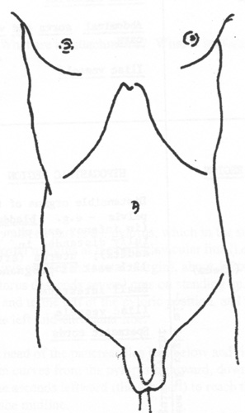
Examination
Weight: 26 kg (25th - 50th )
Height: 130 cm (25th - 50th )
Icterus +
No pallor
No stigmata of chronic liver disease
Liver – 3 cm , firm, irregular, span – 8 cm
Spleen- 3 cm
Ascites +

Slide 6
Clinical Possibilities
Chronic Liver Disease:
Cirrhosis with Portal Hypertension
Differential Diagnosis:
Wilson’s Disease
Autoimmune Liver Disease
Chronic Hepatitis B

Slide 7
Workup at SGPGI (2010)
Liver Function Test:
TB / DB: 7 / 3.8 mg/dL
AST / ALT: 277 / 100 u/L
Total Protein: 7.3 g/dL
Albumin: 2.8 g/dL
ALP: 674 u/L, GGT: 56 u/L
INR: 2.3 (uncorrectable)
Doppler Ultrasound:
Liver coarse echotexture:
10 cm enlarged, irregular margin
PV diameter: 6.6 mm
Hepatic veins and IVC patent
Ascitic Fluid:
High serum ascites albumin gradient
No spontaneous bacterial peritonitis
UGI Endoscopy:
Grade 1 esophageal varix

Slide 8
Workup at SGPGI
For Wilson’s Disease:
S. Ceruloplasmin: <8.3 mg/dL
Bilateral KF Ring: positive
24 hour urine copper: 623 µg/day
For Autoimmune Liver Disease:
ANA/SMA/LKM: negative
IgG: 3020 mg/dL
HBsAg: negative
Anti-HCV antibody: negative

Slide 9
Diagnosis
Jaundice
Firm hepatomegaly
Evidence of portal hypertension
High transaminases
Hypoalbuminemia
Coagulopathy
Positive family history
Low Ceruloplasmin
Bilateral KF ring positive
High 24 hour urine copper
Chronic Liver Disease
Wilson’s disease

Slide 10
Follow-up
AST: 277
ALT: 100
Alb: 2.8
INR: 2.4
AST: 123
ALT: 77
Alb: 3.2
INR: 1.3
AST: 64
ALT: 63
Alb: 4.5
INR: 1.0
AST: 74
ALT: 78
Alb: 4.8
INR: 1.0
AST: 46
ALT: 38
Alb: 4.8
INR: 0.9
Ascites
D-Pencillamine
Supplements: Pyridoxine, Calcium, water soluble and fat soluble vitamins
2010 2011 2012 2013 2014 2015 2016 2017

Slide 11
Follow-up
D-Pencillamine
274
AST
ALT
123
100
80
78
82
74
64
46
77
76
67
63
56
50
38
ALBUMIN
4.8
3.5
3.8
4.2
4.5
4.8
2.8
3.2
2.4
1.3
1.2
1.2
INR
1.1
1.0
1.0
0.9
2010 2011 2012 2013 2014 2015 2016 2017

Slide 12
Follow-up
AST: 277
ALT: 100
Alb: 2.8
INR: 2.4
AST: 123
ALT: 77
Alb: 3.2
INR: 1.3
AST: 64
ALT: 63
Alb: 4.5
INR: 1.0
AST: 74
ALT: 78
Alb: 4.8
INR: 1.0
AST: 46
ALT: 38
Alb: 4.8
INR: 0.9
LIVER BIOPSY
D-Pencillamine
Supplements: Pyridoxine, Calcium, water soluble and fat soluble vitamins
2010 2011 2012 2013 2014 2015 2016 2017

Slide 13
Liver Biopsy
Distorted lobular architecture
Portal fibrosis
Bridging fibrosis leading to nodules formation (Cirrhosis)
No evidence of any copper or copper binding protein deposition

Slide 14
Monitoring of therapy
Hb/TLC/Plt- normal
Urine protein- nil
24 hr urine copper: 623 µg
Hb/TLC/Plt- normal
Urine protein- nil
24 hr urine copper: 1236 µg
Hb/TLC/Plt- normal
Urine protein- nil
24 hr urine protein: 1056 µg
D-Pencillamine
2010 2011 2012 2013 2014 2016

Slide 15
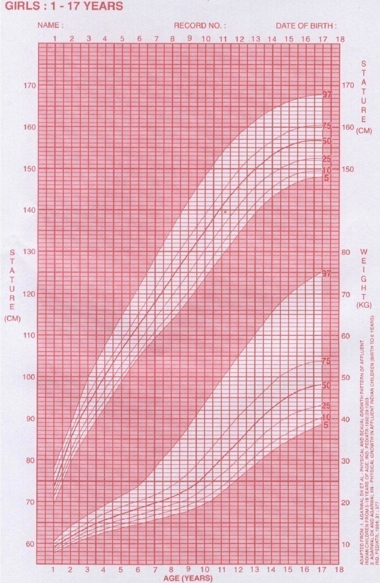
Outcome of the Case
Successful story of a case of Wilson's disease wherein full clinical and laboratory recovery is observed
No side effects of therapy were observed
Drug compliance has been excellent

Slide 16
Key messages
Wilson’s disease should be suspected in any case of chronic liver disease irrespective of duration of symptoms
Family screening should be done in all cases where there is family history of Wilson’s disease
This case highlights the effectiveness of specific therapy towards the complete recovery

Slide 17
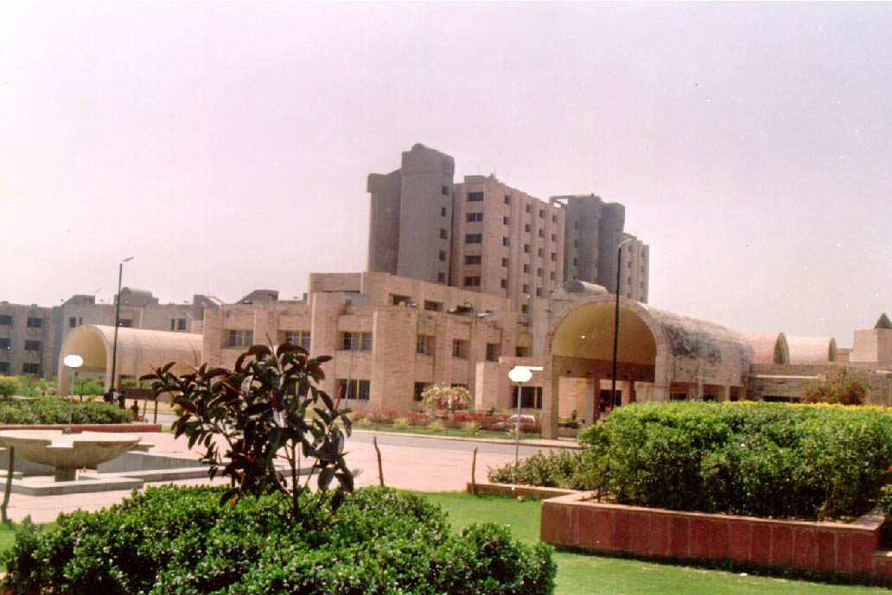
THANK YOU

