Slide 1
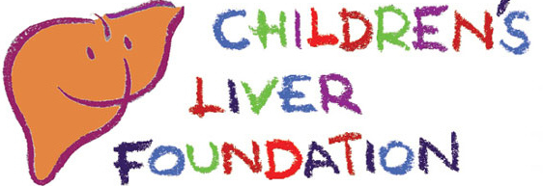

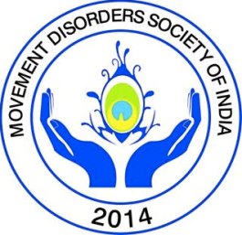

Wilson disease
Beyond the liver and brain…
Talk: Ujjal Poddar
Chairpersons: BR Thapa, A.S Puri

Slide 2
Non-hepatic, non-neurological manifestations of Wilson’s Disease
Ujjal Poddar, MD, DNB, DM
Professor
Dept. of Pediatric Gastroenterology
Sanjay Gandhi Postgraduate Institute of Medical Sciences, Lucknow

Slide 3
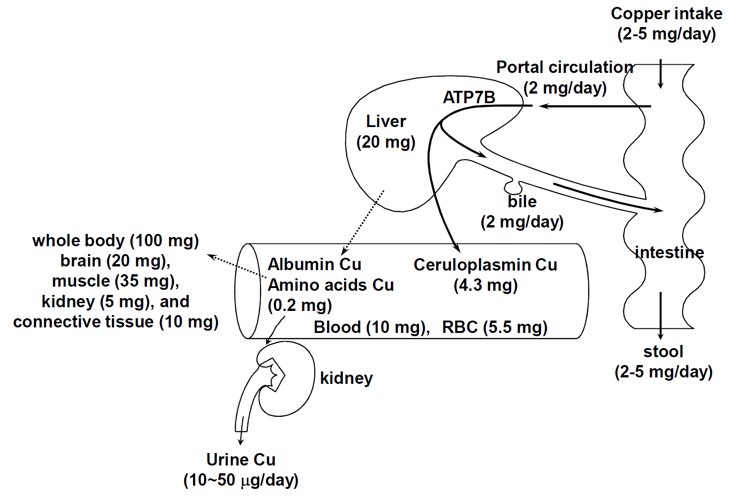
Copper metabolism

Slide 4
Non-hepatic, non-neurological manifestations of Wilson’s Disease
Organ | Manifestations
Eyes | Sunflower cataract, Kayser-Fleischer rings
Hematological | Hemolysis, anemia, thrombocytopenia
Kidneys | Tubular dysfunction, aminoaciduria, Fanconi syndrome
Musculoskeletal | Stiffness, back pain, osteoarthritis, osteoporosis
Heart | Cardiomyopathy, arrhythmias
Fertility | Amenorrhea, ovarian dysfunction, infertility, abortion
Others | Gallstones, pancreatitis, endocrine, skin

Slide 5
How common is non-hepatic, no-neurological manifestations?
Lee BH (S. Korea): n=245 [age: 14.8±9.9]
Hepatic: 134 (54.7%)
Neurological: 55 (22.4%)
Presymptomatic: 55 (22.5%: Incidental detection of raised ALT/AST:50, family screening 5)
Others (Joint): 1 (0.4%) [Arthralgia]
Pediatric Center. Liver Int 2011; 31(6):831-839

Slide 6
How common is non-hepatic, no-neurological manifestations?
Taly AB (India): n=282 [age: 15.9±8.1]
Hepatic: 42 (14.9%)
Neuropsychiatric: 212 (75.2%) [Hepato-neurologic 10, neurologic 195, psych.7]
Presymptomatic: 15 (5.3% on screening)
Osseomuscular: 6 (2.1%) [O/m features: arthralgia 37, arthritis 6, prox. weakness 22]
Others: 7 (2.4%) [?]
NIMHANS, Bangalore (Neurology center). Medicine 2007; 82:112-121

Slide 7
How common is non-hepatic, no-neurological manifestations?
Walshe JM et al: n=217
Hepatic: 94 (43.3%)
Neuropsychiatric: 96 (44.2%) [Hepato-neurologic 4, neurologic 90, psychiatric 2]
Presymptomatic: 24 (11%)
Osseomuscular: 2 (0.9%)
Not classifiable: 1 (0.4%) [?]
Handbook of Clinical Neurology, Vol 49, Elsevier, 1986: 223-238

Slide 8
How common is non-hepatic, no-neurological manifestations?
Liu XQ, et al (China): n=75 (<18y: 72)
Hepatic: 66 (88%)
Neurological: 24 (32%)
Psychiatric: 4 (5%)
Hemolysis, petechia : 6 (8%)
Hematuria, proteinuria: 6 (8%)
Amenorrhea, hairiness: 5 (7%)
Degenerative joint disease: 3 (4%)
Liu XQ, et al. World J Gastroenterol 2004; 10: 590-593

Slide 9
Osseomuscular manifestations
Bone and joint involvement: common
(May be presenting features or evolve later)
Asymptomatic radiological abnormalities
Fleeting joint pain
Painful mono/oligo arthropathy (large joints)
Spondylopathy
Non-traumatic fracture
Aggarwal A, Bhatt M. Int Rev Neurobiol 2013; 110: 313-48

Slide 10
Radiological bone abnormalities in WD
15 case series (n=7- 42 cases)
Bone loss: 24-88%
Osteomalacia: 14-35%
Fractures: 9-35%
Bone densitometry by DEXA
Adults (n=21): Osteoporosis in 9/21 (43%)
Pediatric (n=31): Osteoporosis 21/31 (67%)
[No change of BMD after 1y of treatment]
Quemeneur AS, et al. Best Practice & Research Clin Rheumatology 2011; 25: 627-36

Slide 11
Osseomuscular manifestations
Articular manifestations are usually mild
Affect large joints (mainly knee)
Precocious onset osteoarthritis (described)
No specific treatment other than chelators
D-penicillamine induced rheumatological disorders (SLE, Good-pasture, myasthenia, dermatomyocitis)
Reversal with OLT (one case report)
Pascart T, et al. Arthritis 2014; 2014: 375202

Slide 12
11y/boy with hepatic Wilson> developed joint symptoms
after 2y of diagnosis
Joint pain, swelling, restriction: Predominantly knee joints
Post-OLT: joint symptoms disappeared by day 4, (F/u 1.5y)

Slide 13
Osseomuscular manifestations
Recurrent or unexplained joint complaints
Early osteoarthritis (knee, hip and wrist joints) in young patients (25-30 years)
Chondrocalcinosis (calcium pyrophosphate deposit: common after 6th decade) in young
Wilson Disease should be ruled out
Quemeneur AS, et al. Best Practice & Research Clin Rheumatology 2011; 25: 627-36

Slide 14
Pathophysiology of joint symptoms
1st hypothesis: abnormal movements induced by CNS involvement (recurrent micro-trauma, falls, sprains, dystonia>>> post-traumatic pain/deformity)*
2nd hypothesis: copper deposition in cartilage and bone
* 6/8 children with osseomuscular presentation eventually developed neurological symptoms
Yu H, et al. BMC Neurology 2017; 17: 34 (8 children (12[3-17]y) with osseomuscular WD

Slide 15
Cardiac manifestations of Wilson Disease
Modes of cardiac manifestations:
Cardiomyopathy
Arrhythmia
Cardiac death
Autonomic dysfunction
Bajaj BK, et al. J Neuroscience Rural Practice 2016; 7: 587-589
[14F neuro WD with heart block and autonomic dysfunction>improved with RX]

Slide 16
Cardiac manifestations of Wilson Disease
Kuan et al. 53 cases of WD (mean age: 21.4y)
ECG abnormalities: 34%
Asymptomatic orthostatic hypotension: 19%
Abnormal response to Valsalva: 33%
Cardiac deaths: 2 (3.8%) [ventricular fibrillation 1, dilated cardiomyopathy 1]
Kuan P. Cardiac Wilson’s disease. Chest 1987; 91: 579-83

Slide 17
Cardiac manifestations of Wilson Disease
N=42 cases of WD (mean age: 34±10y) with 42 age/sex matched healthy volunteers
(Echo and 24-h ECG Holter in 23 WD)
Increased thickening of interventricular septum and LV posterior wall
ECG: 42% (supraventricular tachycardia and ectopic beats)
Hlubocka Z, et al (Czech Republic). J Inherit Metab Dis 2002; 25: 269-77

Slide 18
Cardiac manifestations of Wilson Disease
Meenakshi-Sundaram et al. n=50 WD, ECG
At least one abnormality on ECG: 15 (30%)
[Sinus bradycardia, tachycardia, bifid P wave, ST elevation/depression, T inversion, ventricular premature contraction, prominent U wave]
Meenakshi-Sundaram S, et al (NIMHANS). JAPI 2004; 52: 294-6

Slide 19
Cardiac manifestations of Wilson Disease
Cardiac evaluation (echo and Holter): of patients with Wilson’s disease should be a part of routine evaluation
Cardiac arrhythmia and dysfunction may have therapeutic and prognostic implications
Bajaj BK, et al. J Neuroscience Rural Practice 2016; 7: 587-589

Slide 20
Hematological manifestations of Wilson Disease
Coombs-negative hemolytic anemia with or without hepatic dysfunction (10-15% of cases)
Hemolytic anemia: may be mild and transient
Hemolytic anemia: may be severe and herald the development of Fulminant WD
Thrombocytopenia: with/without hemolysis
Pfeiffer RF. Handbook of Clinical Neurology, Vol. 100. Elsevier 2011:687-709

Slide 21
Hematological manifestations of Wilson Disease
Excess free copper released from liver (hepatocyte necrosis) oxidative stress to RBC hemolysis
Liver disease may be silent: presentation with severe hemolytic anemia*
Hemolytic anemia of unknow etiology in adolescents/young adults: Wilson disease
Santra G, et al. J Assoc Physic India 2014; 62: 55-57 [Two cases]

Slide 22
Renal manifestations of Wilson Disease
Copper deposition in renal tubular epithelium
Renal tubular dysfunction: hypercalciuria, hyperphosphaturia, aminoaciduria, glucosuria [Nephrocalcinosis, nephrolithiasis]
Glomerular injury: d-penicillamine induced (rarely as manifestation of WD, glomerular mesangial deposition of copper), IgA nephrop.
Pfeiffer RF. Handbook of Clinical Neurology, Vol. 100. Elsevier 2011:687-709

Slide 23
Renal manifestations of Wilson Disease
N=85 cases of Pediatric Wilson disease
Renal impairment as initial symptom: 7 (8%)
Other manifestation of WD, found to have renal impairment: 18 (21%)
On follow-up (on penicillamine), detected to have renal impairment: 9 (10.5%)
Zhuang XH, et al. World J Pediatr 2008; 4: 102-105 [n=85 pediatric WD]

Slide 24
Renal manifestations of Wilson Disease
Presentations:
Nephrocalcinosis: Hematuria (mainly microscopic)
Nephrolithiasis: Renal colic
Investigations:
Renal tubular function: low molecular weight proteinuria, urine NAG* [at presentation]
Glomerular injury: high molecular weight proteins (albumin) [while on therapy]
*N-acetyl-ß-d-glucosaminidase. Sozeri E, et al. Pediatr Nephrol 1997; 11: 307-11

Slide 25
Renal manifestations of Wilson Disease
Management:
Renal tubular dysfunction: only chelator is not enough. Treatment of RTA (bicarbonate)
D-penicillamine induced glomerular injury: discontinue d-penicillamine
Sinha R, et al. Pediatr Nephrol 2012; 27: 919-920

Slide 26
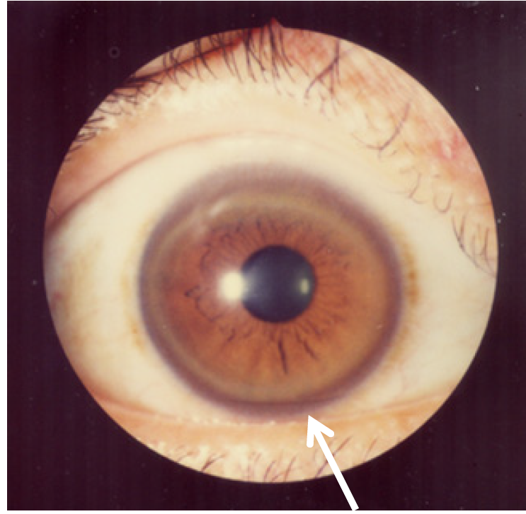
Ocular manifestations: Kayser-Fleischer rings:

Slide 27
Ocular manifestations of WD
Kayser-Fleischer rings:
Always bilateral
Easy to identify in persons with blue-eyes
Appear sequentially, disappear in reverse direction (upper>lower>medial>lateral)
Neuro WD: 95-100%, hepatic 50-60%
KF rings in cholestatic liver disease (PBC, AIH,
chronic cholestatic jaundice)
Pfeiffer RF. Handbook of Clinical Neurology, Vol. 100. Elsevier 2011:687-709

Slide 28
KF like rings or bile pigment rings
N=40 cases of prolonged acute hepatitis with cholestasis (TSB>20mg/dl for >6 weeks)
Bile pigment rings: 37 (92%), disappeared in all when TSB<10mg/dl
 | KF rings | Bili pigment rings
Naked eye appearance | May be seen | Not seen
Site of ring | May be sectorial | Always circumferential
Color | Golden brown | Yellowish green
Texture | Granular | Homogenous
Layer of cornea involved | Descemet’s membrane | Peripheral stoma
Relation of bilirubin level | No | Yes
Nagral A, et al. Indian J Gastroenterol 2015; 34: 410-412

Slide 29
Ocular manifestations of WD
Sunflower cataract:
Rare: 2-17% with untreated WD
Anterior capsular deposition of copper
Always associated with KF ring
Do not interfere with vision
Disappears with chelation therapy
Abnormal oculo-motor functions (EOG): vertical and
horizontal smooth pursuit, vertical nystagmus etc.
Pfeiffer RF. Handbook of Clinical Neurology, Vol. 100. Elsevier 2011:687-709

Slide 30
Other manifestations of WD
Skin: hyperpigmentation of the legs, blue lunulae of nails, acanthosis nigricans
Endocrine: Hypoparathyroidism, pituitary dysfunction, hypogonadotrophic hypogonadism
Gallstones: due to frequent bouts of hemolysis
Krysiak R, et al. Yale J Biol Med 2012; 85: 249-54
Lee HW, et al. J Korean Med Sci 2016; 31: 1345-48

Slide 31
Conclusions
Nonhepatic-non-neurological manifestations are uncommon and often with hepatic/neurological disease
Young patient with premature osteoarthritis>>>WD
Unexplained I/V hemolysis in young adults>>>WD
Unexplained hematuria/renal stone>>WD
All WD: cardiac evaluation (echo+ Holter)

Slide 32
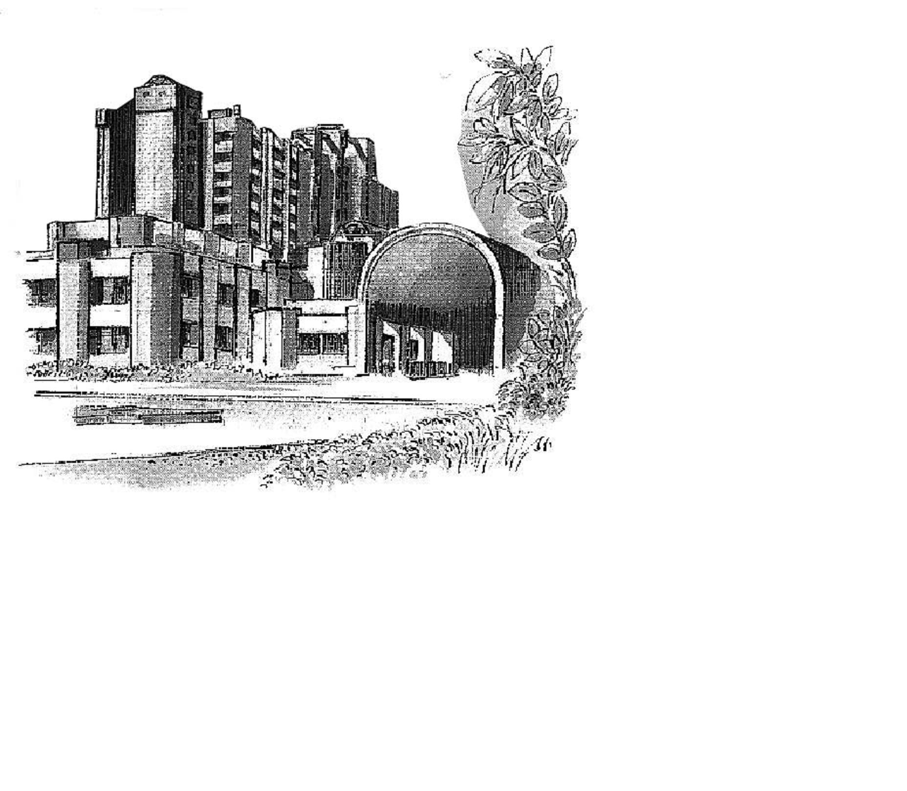
Thank You

