Slide 1




Diagnostic challenges in Wilson disease: do scoring systems help?
Talk: Harshad Devarbhavi
Chairpersons: Banumathi Ramakrishna,
Rukmini Mridula, Ujjal Poddar

Slide 2
Diagnostic Challenges: Do Scoring systems help?
Prof. Harshad Devarbhavi, MD,DM
St. Johns Medical College Hospital
Bangalore

Slide 3
Experts in neuropsychiatric WD and hepatic WD view diseases differently; Global Assessment Scale /Liver scores
Obtain grants from different sources
Go to different meetings
Write to different journals
In all disputes and discussions the first rule is clarify your terms (Mikes G. The land of the rising yen: Japan)

Slide 4
Scoring Systems
Early diagnosis of WD
Challenges in ALF
Prognostic scoring systems
  Childs Pugh criteria
  MELD score
  Nazer Score
  Revised King’s College Criteria

Slide 5
N=2070
Wilson disease 1.3% (n=26)

Slide 6
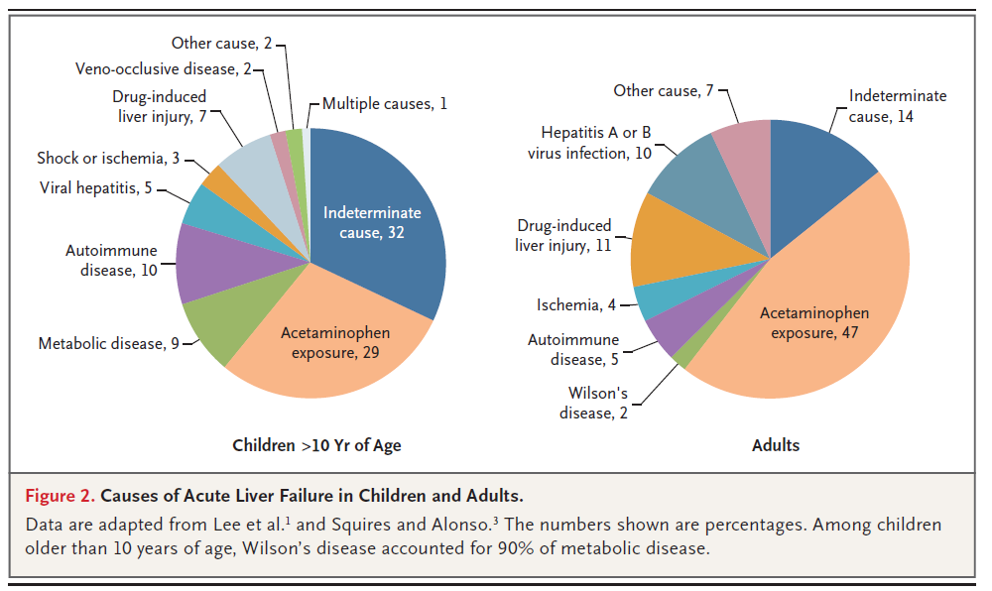
Olson KR et al. NEJM Jan 2017

Slide 7
Etiology of ALF (N=1441, 30 Y)
514
(35.7%)
415 (28.8%)
No of patients
126
138
(9.6%)
103
60
23
Courtesy Dr. Shalimar and Dr. Acharya, AIIMS

Slide 8
Adult ALF from 2011-15 onwards (SJMC, N=65)

Slide 9
Paediatric ALF -2012- 2015 (N=59)

Slide 10
Paediatric ALF -2011-15 onwards (N=59)

Slide 11
Acute on Chronic Liver Failure (ACLF)
Compensated cirrhosis
Precipitants
No factors
Type B
ACLF
Hepatic and extrahepatic organ failures
Gastroenterology 2014;147:4-10

Slide 12
ACLF Wilson disease (N=61)
1997-2016: 264 patients
Patients fulfilled APASL criteria
  Bilirubin >5 mg/dl and INR>1.5 + ascites ± encephalopathy
  36 males, 25 females
Ascites 55/61 (90%)
Encephalopathy 29/61 (47.5%)
44/61 died (2 LTx) (72%)
Devarbhavi H. Hepatology 2016;64: 282A

Slide 13
Nazer H. Gut 1986;27:1377(N=34 (6-33y) pediatric and chronic cases; score>7 )
 | 1* | 2* | 3* | 4*
Serum bilirubin [µmol/L] [mg/dL) | 100-150 (5.8-8.7) | 15-200 (8.7-11.6) | 201-300 (11.7-17.5) | >300 (17.55)
AST [U/L] | 100-150 | 151-300 | 301-400 | >400
INR | 1.3-1.6 | 1.7-1.9 | 2.0-2.4 | >2.4
Dhawan et al. Liver Tx 2005;11:441 (Score >11 death/LTx, Age 12-13.2y)
WBC [10⁹/L] | 6.8-8.3 | 8.4-10.3 | 10.4-15.3 | >15.3
Albumin [g/L] | 34-44 | 25-33 | 21-24 | <21

Slide 14
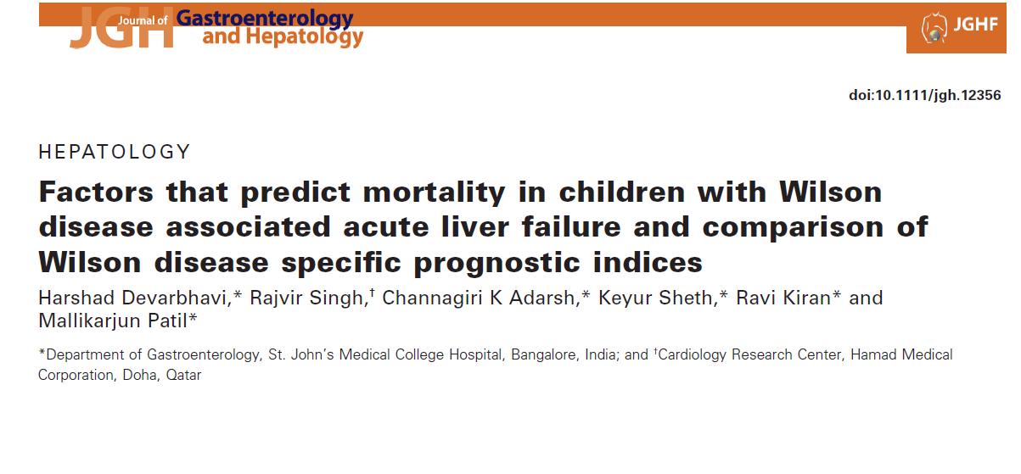
Total number: 230
Children accounted for 70% of all WD
Children with WD & ALF = 64% of liver presentation
44% w HE 56% wo HE
Mean age 9.7 years (ALFSG 24 years)
J Gastro Hepatol 2014;29:380-

Slide 15
WD: N=3+6 vs Control =5
Findings: younger, KF+(7/9), high: S. Cr, U Cu, L Cu.
Less pronounced AST, ALT elevation, high T. Bilirubin, low HB
McCullough AJ et al. GE 1983;84:161
WD: N=6 (Mean age 18.5y) vs Control n=43 Non WD FHF
ALP/TB <2 (100% sensitivity/specificity)
AST/ALT >4
                Berman DH et al. GE 1991;100:1129-34
Nazer H. Gut 1986;27:1377(N=34 (6-33y) pediatric and chronic cases; score>7 )
 | 1 | 2 | 3 | 4
Serum bilirubin [µmol/L] [mg/dL) | 100-150 (5.8-8.7) | 15-200 (8.7-11.6) | 201-300 (11.7-17.5) | >300 (17.55)
AST [U/L] | 100-150 | 151-300 | 301-400 | >400
INR | 1.3-1.6 | 1.7-1.9 | 2.0-2.4 | >2.4
Dhawan et al. Liver Tx 2005;11:441 (Score >11 death/LTx, Age 12-13.2y)
WBC [10⁹/L] | 6.8-8.3 | 8.4-10.3 | 10.4-15.3 | >15.3
Albumin [g/L] | 34-44 | 25-33 | 21-24 | <21

Slide 16
Failure of simple biochemical indices to reliably differentiate Fulminant WD from other causes of FHF.
21 cases ( 15 < 16 years)
30-44% of non-Wilsonian FHF erroneously assigned a diagnosis of
fulminant WD
S. bilirubin, ALP, AST
            Sallie R et al. Hepatology 1992;16:1206
7 WD (6/7 <18 y) vs 8 non-WD
4 Gr 1 HE, 3 Gr2 HE
ALP/TB AND AST/ALT ratio did not differ between two groups
MELD 28
ALT and Hb (<.001)
              Eisenbach C et al. WJG 2007;13:1711
WD 7 (14 y) vs 12 non WD FHF (Low HB, Inc Bili, KF ring in all 7 WD)
ALP/TB <1 (ROC 0.83); AST/ALT (ROC 0.16)
ALP/TB: 86% sensitivity and 50% specificity (Note: AP=IU;TB Umol)
Tissieres P et al. Ped Crit Care Med 2003;4:338

Slide 17
Schilsky M. Hepatology 19924;19:583

Slide 18
N=16 (11/16 KF not checked)
ALP/TB <4: sensitivity/specificity 94/96%
AST/ALT >2.2: sensitivity/specificity: 96/86%
Combining sensitivity/specificity 100%
Mean age: 25.5 y
Median MELD: 40
All admitted for LTx
Korman J …Schlisky ML. Hepatology 2008;48:1167-1174

Slide 19
WD ALF: Comparison of Scores
SJMCH data
Variable Sensitivity
ALP/TB 27%
AST/ALT 47.5%
Both 49%
Mean age: 9 y
MELD: 37-40
Devarbhavi H. J Gastro Hepatol 2014;29:380-386

Slide 20
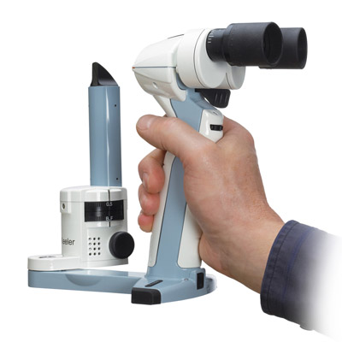

Slide 23
Nicastro E. Hepatology 2010;52:1948

Slide 24
Nicastro E. Hepatology 2010;52:1948

Slide 25
Nicastro E. Hepatology 2010;52:1948

Slide 26
Signs that should alert a physician to the diagnosis of WD
Splenomegaly
Hepatomegaly
Hemolysis
Anemia
O’Brien and Williams Hepatology 2008;48:30

Slide 27
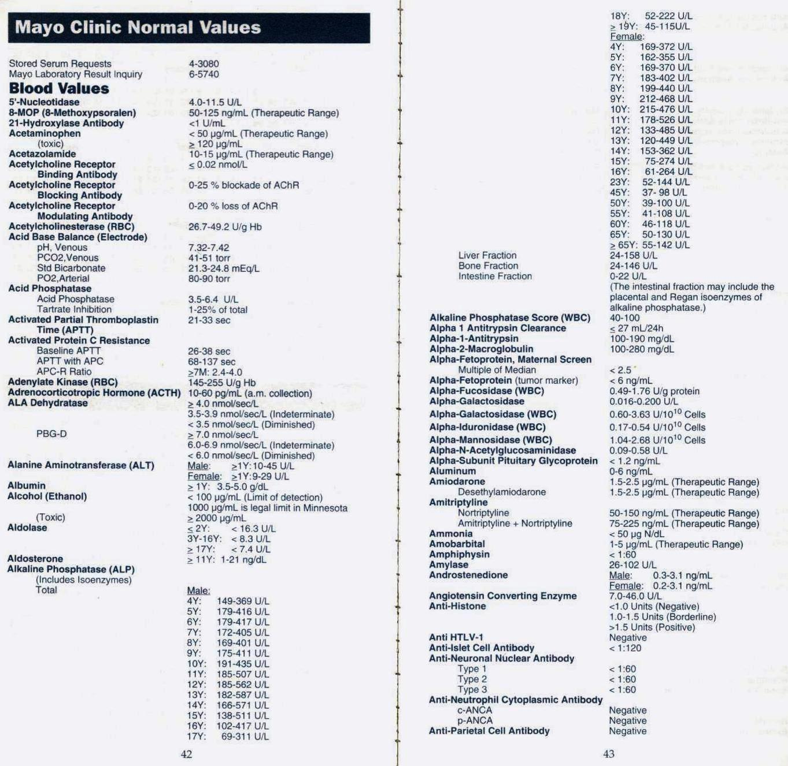

Slide 28
Penicillamine Challenge Test (PCT)
PCT 88% sensitive and 98% specific (Hep 1992;15:609)
“Although helpful, the test is cumbersone and difficult to perform in severely ill children”(Dhawan Ltx 2005)
  “we were unable to do it in any of the children who died or required urgent Ltx. In addition, the PCT gave normal results in 9/29 tested children who presented with less severe disease”
Schilsky “Therefore, along with the data data collected by Dhawan et al, Nicastro et al.’s data imply that we should lay the PCT to rest and rely on basal urine Cu excretion with lower cut off values” (Hep 2010;52:1872)

Slide 29
Any 2 of the following
Positive family history
Low serum ceruplasmin (<0.2g/L)
Elevated liver copper (>250 mg/g dry weight)
Presence of Kayser-Fleischer rings
Elevated baseline 24-hour urinary copper excretion (>1µmol/24 hours)
Elevated 24-hour urinary copper excretion following administration of 2,500-mg doses of penicillamine (>25µmol/24 hours)⁴
Coombs’ negative hemolytic anemia
Dhawan A. LTx 2005;11:441-448

Slide 30
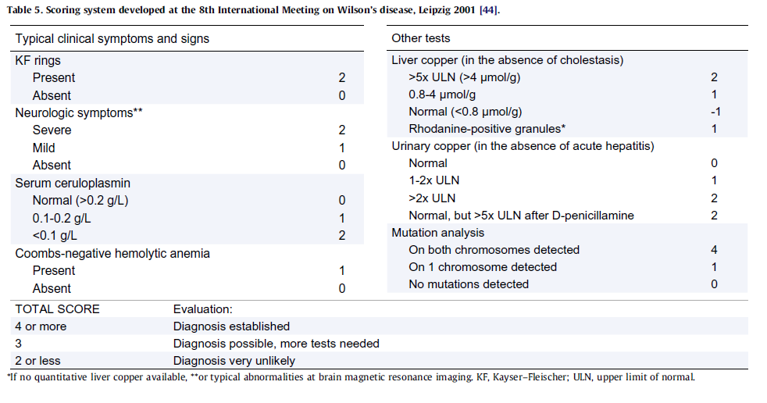

Slide 31
Scoring system for diagnosis of WD ( 8th International Meeting on Wilson’s disease, Leipzig 2001)
KF rings Present Absent | 2 0
Liver copper (in absence of cholestasis) > 5XULN (>4 mcmol/g) > 0.8-4mcmol/g Rhodanine-positive granules 1 | 2 1
Serum ceruloplasmin Normal (>0.2 g/L) 0.1-0.2 g/L < 0.1 g/L | 0 1 2
Neurologic symptoms severe Neurological symptoms mild Absent | 2 1 0
Urinary copper (in the absence of acute hepatitis) 1-2 ULN >2 ULN N but > 5x ULN after D-pencillamine Normal, or < 40 mcg | 1 2 2 0
Mutation analysis On both chromosomes detected On 1 chromosome detected No mutation detected | 4 1 0
Coombs-negative hemolytic anemia Present Absent | 1 0
TOTAL SCORE Evaluation:
4 or more Diagnosis established
2-3 Diagnosis possible, more tests needed
<2 Diagnosis very unlikely

Slide 32
Naples Study in mild liver disease
WD scoring system
Positive predictive value 93%
Negative predictive value 92%
Nicastro E. Hepatology 2010;52:1948

Slide 33
Typical clinical symptoms
(extra pyramidal symptoms, KFR, CPL)
Score 0-1
Score 2-3
Score ≥ 4
Diagnosis established
Urinary copper >1.6µmol/d*
Urinary copper >1.6µmol/d*
Mutation analysis
>4 µmol/g
Hepatic copper
2 mutations
Score ≤3
1 mutation
Normal or <4 µmol/g
0 mutation
Fig. 1. Diagnostic algorithms for Wilson’s disease based on the Leipzig Score [44]. *In children the cut off can be lowered to 0.64 µmol/d.

Slide 34
Take Home Message: Scoring Systems
Appropriate constellation of symptoms, signs together with positive screening tests are adequate for diagnosis.
The burden of proof is on the clinician.
The real challenge is not in tests but to consider the diagnosis in the first place (Schilsky 2007)
Combination of KF ring, ceruloplasmin, urinary copper and some others are adequate for diagnosis
Simple biochemical ratios are helpful if present; often misleading
Leipzig criteria with scores of above 2-3 are often achievable

