Slide 1




Case Discussion
Acute liver failure with hemolysis
– needing a transplant
Presenter : Ravi Bhardwaj
Moderator: Anupam Sibal
Panelists : BR Thapa, Harshad Devarbhavi,
RK Dhiman, Srinivas Sankaranarayanan

Slide 2
Dr Ravi Bharadwaj
FNB Pediatric Gastroenterology
Apollo Center For Advanced Pediatrics
Indraprastha Apollo Hospital

Slide 3
Presenting complaints
10 year old
Female
Presented in June 2016 with c/o:
Poor appetite with nausea
Fatigability
Progressive abdominal distension
Symptoms for 4 weeks
Took medicines from nearby practitioner

Slide 4
5th week of illness
Two episode of cola colored urine
painless
A day later parents noticed yellowish discoloration
of eyes
Decreased urine output

Slide 5
No documented fever
No diarrhea/abdominal pain/vomiting
No skin lesions/joint pain/joint swelling/chest pain
No dysuria/edema/pustules
No significant drug history
No bleeding from any site (skin, GI)
No seizures/alteration in sensorium/abnormal
movements/behavioural changes

Slide 6
Question?
Differential diagnosis?

Slide 7
Past History
No history of blood transfusion
No similar history in past
No history of prior admission for any illness

Slide 8
Developmentally normal
Vaccinated for age
Family history
One younger male sibling – 7 years, well
no history of similar illness in family
No h/o consanguinity
Dietary history: Calories 90 Cal/kg/day
Protein 1.5 g/kg/day

Slide 9
Admitted in nearby hospital
Evaluated and referred for further evaluation

Slide 10
On examination
RR: 26/min
Pulse: 96/min
Temp: 98.3 F
BP: 116/70mm Hg
SPO₂: 96%
Weight: 25 kg (-1 to -2 SD)
Height: 128 cms ( -1 to -2 SD )

Slide 11
Pallor +, Icterus +
No clubbing/spider nevi/palmar erythema
Periorbital puffiness +
P/A: distended, soft
Liver 2 cms BCM/span 10 cms, firm with sharp
margins
Spleen 2 cms BCM, firm
FF+
CVS – WNL
Chest – no added sounds
CNS – WNL

Slide 12
Question?
Differential diagnosis?

Slide 13
Question?
How should this child be investigated further?

Slide 14
Investigations |  | Investigations
Hb | 8.3 | Bil T/D | 19.6/10.2
TLC | 13100 P32L63 | AST/ALT | 670/214
Platelet count | 113000 | GGT | 42
Peripheral smear | normocytes, few schistocytes Fragmented RBC’s | ALP | 47
ESR | 21 mm/hr | Prot/Albumin | 7.3/3.5
Retic count | 7% (corrected) | PT/INR | 3.7
DCT | negative | BU/Cr | 54/1.1
Urine R/M | Positive for Hb Protein 1 + | Uric acid | 1.1
 |  | LDH | 886
Cultures | sterile | USG abdomen | Coarse liver, spleen enlarged, mild ascites

Slide 15
Investigations
Anti-HAV IgM and total | NR
HBsAg | NR
Anti-HCV | NR
Ceruloplasmin | 8 mg/dl
24 Hr Urinary Copper (without challenge) | 413 mcg/day
KF ring | positive
ANA | negative

Slide 16
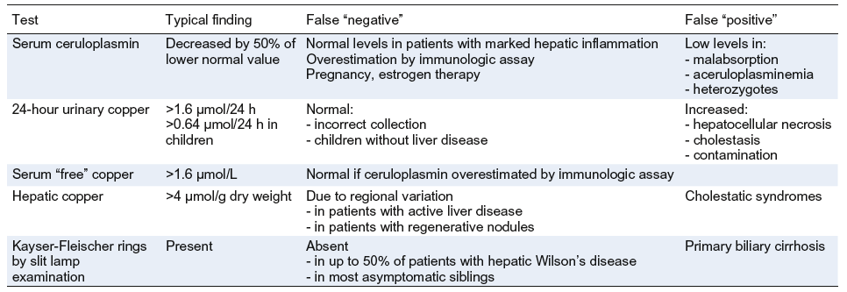

Slide 17
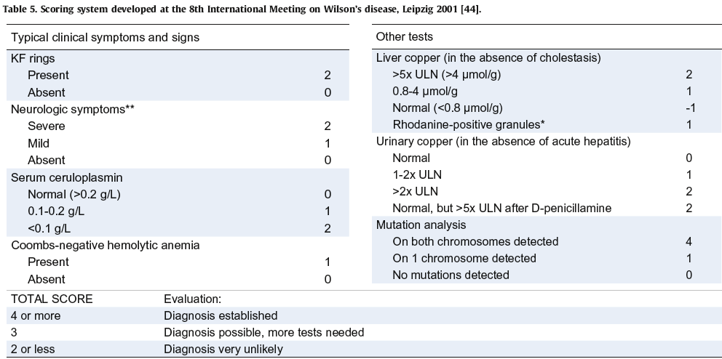

Slide 18
Score 7 on WD criteria (Leipzig score) by Ferenci et al
    Serum Cp <10 mg/dl +2
    Urine Cu > 2 ULN +2
    KF ring +2
    Coomb’s negative hemolytic anemia +1
    Wilson's disease ( score > 4)

Slide 19
Acute Liver Failure in WD
Modest rises in serum aminotransferases (<< 2000 IU/L)
Normal or markedly subnormal SAP
AST/ALT >2.2 and ALP/Bil <4
Coombs (–) hemolytic anemia and hemolysis
Rapid progression to renal failure
Korman J et al. Hepatology 2008
Ferenci et al. Aliment Pharmacol Ther 2004
Roberts et al. AASLD. Hepatology 2008
EASL. J Hepatol 2012

Slide 20
D3 of admission
developed altered sensorium
drowsy
hyperreflexia

Slide 21
Question?
Is the diagnosis of Wilson’s disease confirmed?

Slide 22
Acute liver failure with grade 2 encephalopathy with
coombs negative hemolysis with AKI
Wilson’s disease

Slide 23
Prognostication

Slide 24
ALF without encephalopathy
Modified Nazer score
New wilson’s index
? PELD/MELD
Devarbhavi H et al. J Gastro Hepatol 2014

Slide 25
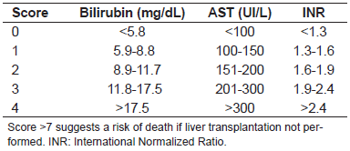
Nazer score
Nazer et al. Gut 1986

Slide 26
Modified King’s score (New Wilson Index)
Score | Bilirubin ɥmol/L | INR | AST IU/L | WCC x 10⁹/L | Albumin g/L
0 | 0-100 | 0-1.29 | 0-100 | 0-6.7 | >45
1 | 101-150 | 1.3-1.6 | 101-150 | 6.8-8.3 | 34-44
2 | 151-200 | 1.7-1.9 | 151-300 | 8.4-10.3 | 25-33
3 | 201-300 | 2.0-2.4 | 301-400 | 10.4-15.3 | 21-24
4 | >301 | >2.5 | >401 | >15.4 | <20
A score ≥ 11 urgent need for transplantation
Our patient had a score of 16
Dhawan et al. Liver Transpl 2005

Slide 28
Multivariate analysis
Unadjusted hazard 95% Confidence P
Ratio Interval Value
Enc 2.88 1.11 – 7.45 .03
T Bil 1.05 1.02 – 1.09 .002
Only encepaholopaty and total bilirubin emerged as independent predictors of mortality

Slide 29
Score = 2.87 x encephalopathy + 1.07 x t bilirubin
Devarbhavi H. J Gastro Hepatol 2014

Slide 30
ALF with encephalopathy
High mortality 80% (90% to 100% in some series)
Liver transplantation is lifesaving
Berman et al. Gastroenterology 1991
Roberts et al. AASLD. Hepatology 2008
EASL. J Hepatol 2012
Devarbhavi H et al. J Gastro Hepatol 2014

Slide 31
Question?
Treatment options in Wilsonian acute liver failure?

Slide 32
Child was taken for LRLT
Mother was donor

Slide 33
Question?
Donor evaluation/parents as donor in such cases

Slide 34
Sibling evaluation
First-degree relatives of any patient newly diagnosed
with WD must be screened
Chance of a sibling being a homozygote and therefore
developing clinical disease – is 25%
Analysis of the ATP7B gene for mutations in the children
Roberts et al. AASLD. Hepatology 2008
EASL. J Hepatol 2012

Slide 35
POD # 1
post LT on POD#1
sensorium improved over the next 72 hours

Slide 36
POD#4
Investigations
Hb | 7.9
TLC | 8100 P52L43
Platelet count | 87000
Bil T/D | 5.6/3.2
AST/ALT | 220/114
ALP | 83
Prot/Albumin | 6.1/2.9
PT/INR | 1.3
BU/Cr | 21/0.6

Slide 37
Child discharged on POD #19
On tacrolimus, MMF and prednisolone
No acute post-LT complications
Steroids tapered and stopped by 3 months

Slide 38
Question?
Role of supportive therapy, plasmapheresis,
hemodialysis and MARS

Slide 39
Neuro Wilson
Less common in children
< 10 years old: neuro-psychiatric disorders 17%
Average age of neurological dysfunction is 18.9 years
In adults neurological dysfunction constitutes initial
clinical manifestation in 40–60%
Pfeiffer et al. Semin Neurol. 2007

Slide 40
LT in treatment of progressive neurological
deterioration is controversial
Pfeiffer et al. Semin Neurol. 2007

Slide 41
Question
Role of LT in neuro Wilson?

Slide 42
Post LT outcome
Indication | N/% | Survival @1 year | 5 year | 10 year | 15 year
EHBA | 66.1% | 91.3 | 89.5 | 86.9 | 84.8
ALF |  | 72.6 | 69 | 67 | 67
WD: Japan | 2.6% | 98.3 | 96.5 | 94.4 | 73.4
UNOS |  | 90 | 89
SPLIT |  | 96 | 91.4
France |  | 89% | 87% | 87% | 87%
Arnon et al. Clin Transplant. 2011
Kasahara et al. Am J of Transpl 2013
Guillaud et al. J Hepatol. 2014

Slide 43
LT experience
Pediatric 220
BA | 81
Metabolic liver diseases | 54
Cryptogenic | 34
ALF | 19
BCS | 08
NNH | 06
AIH | 03
Hep B | 03
Hyper oxaluria | 02*
Poisoning | 02
Hepatoblastoma | 02
PVT | 01**
Hep C | 01
HCC | 01
Chronic rejection | 01
* combined LK ** re transplant
Notes:
Update figures

Slide 44
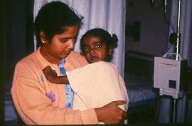

Slide 45
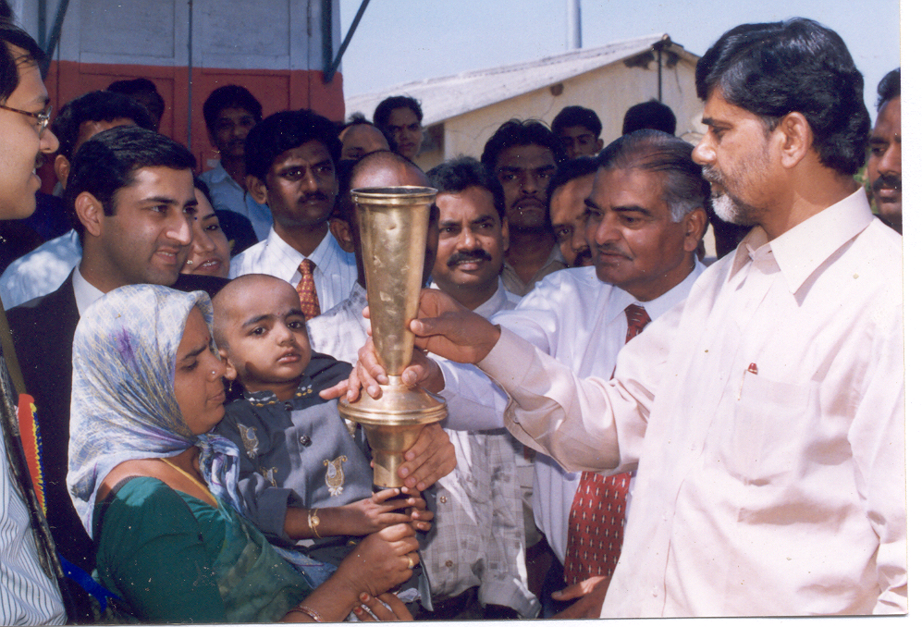

Slide 46
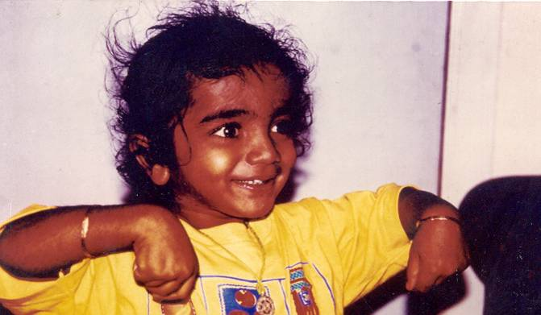

Slide 47


Slide 48
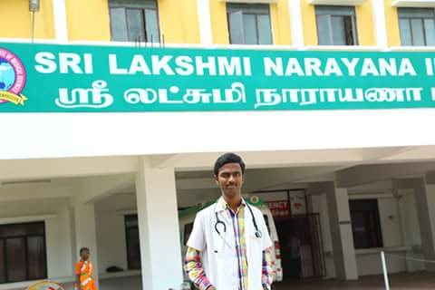

Slide 49
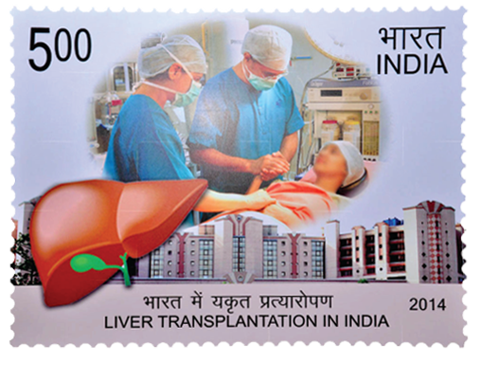
Notes:
49

Slide 50
Thank you!

