Slide 1
Wilsonian crisis
Chairpersons: Aabha Nagral, Prashanth LK,SK Yachha
Talk: Seema Alam

Slide 2
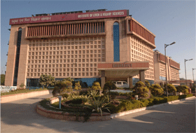
Wilsonian Crisis
Department of Pediatric Hepatology
Institute of Liver and Biliary Sciences

Slide 3
What is Wilsonian Crisis/ Fulminant WD ?
Pathogenesis of FWD?
Diagnostic criteria of FWD
Prognostic indicies: ILBS data
Treatment Modalities available
ILBS data on HVPE

Slide 4
What is Fulminant WD?
Neurological
Liver
CLD
ACLF/ALF
Wilsonian Crisis
Hemolysis
Renal Damage
Most common presentation of WD : chronic liver disease or neurological
Wilsonian Crisis
ALF /ACLF associated with haemolytic anaemia and acute renal failure

Slide 5
Children constituted 65.5% of all patients with FWD
Pediatric Critical CareMedicine. 2003; 4: 338–43.
3% of PALFSG Cohort were FWD
J. Pediatr. 2006; 148: 652–658.e2..
6–12% of patients with ALF referred for emergent orthotopic liver transplantation
World J Gastroenterol. 2007
Wilson’s disease D/D in any young patient presenting with ALF
initial presenting symptoms of the disease,
previously treated but stop their medications.
J Hepatol. 2012; 56:671–685.

Slide 6
Wilsons disease - KEM Hospital, Pune
Type | n | x age at diagnosis (yrs) | x duration of illness (mths) | Survival (%)
Neurological | (34) | 11.5 | 16.5 | 82
CLD | (49) | 8.2 | 8.2 | 61
Acute hepatitis | (19) | 7.1 | 1.1 | 36
FHF | (18) | 5.9 | 0.7 | 11
Others | (10) | 10.8 | 14.1 | 90
Asymp. Sibs | (24) | 7.3 | - | 87
Indian J Pediatr 2002

Slide 7
Fulminant Wilson
Rapid onset
Severe coagulopathy
Coomb’s negative hemolysis – severe intravascular hemolysis (cola-coloured urine)
Rapid progression to Renal failure
ALP (IU/L):Bilirubin (mg/dL) <2.2
AST:ALT >4
Encephalopathy
High mortality without LTV

Slide 8
16 WD ALF + 124 Non-WD ALF
Sens Spec LR+
Cp <20 mg/dL: Enzymatic 21% 84%
Immunoassay 56% 63%
SAP: Bil <4 94% 96% 23
AST/ALT >2.2 94% 86% 7
Accuracy 100%

Slide 9
Failure of biochemical indices to diagnose WD in fulminant setting
21 WD & 193 non-WD ALF
SAP:Bil ratio <2: False + in 31%
AST:ALT ratio >4: False + in 43%
Sallie R et al. Hepatology 1992; 16: 1206-1211

Slide 10
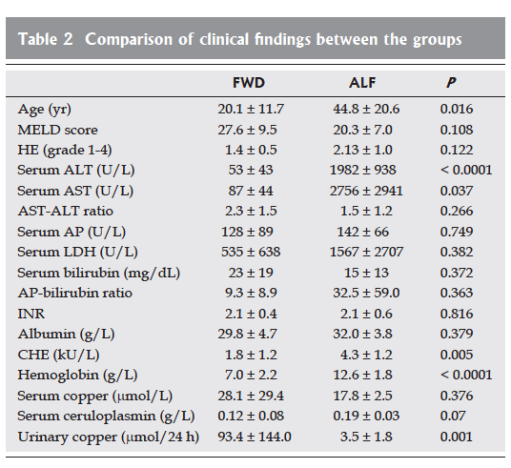
–Johnny Appleseed

Slide 11
Time tested signs and tests such as KF ring, serum ceruloplasmin and urinary copper levels may still have a place including such important clinical clues as splenomegaly, ascites, and hepatomegaly.
Ratios of simple biochemical variables as pointers to an early diagnosis in patients with FWD have their limitations in children.

Slide 12
Hemolysis
Coombs negative hemolytic anemia
Marked hemolysis usually with severe liver disease
1-12% had hemolysis as presenting feature
Single acute episode / Recurrent / Chronic
25% of jaundiced patients have hemolysis

Slide 13
Pathogenesis of FWD
Hemolytic process: sudden release of ionic Cu from necrotic hepatocytes into circulation.
Scheinberg IH, Sternlieb I. WB Saunders Company, 1984
Inhibition of Na pump by Cu: as in neurone: inhibits sodium potassium ATPase.
Proc Roy Soc Lond (Biol) 1966;106:285–94.
Cu induces reduction of RBC glutathione or presence of superoxide radicals: cause hemolysis.
Hoogenraad T. WB Saunders Company, 1966

Slide 15
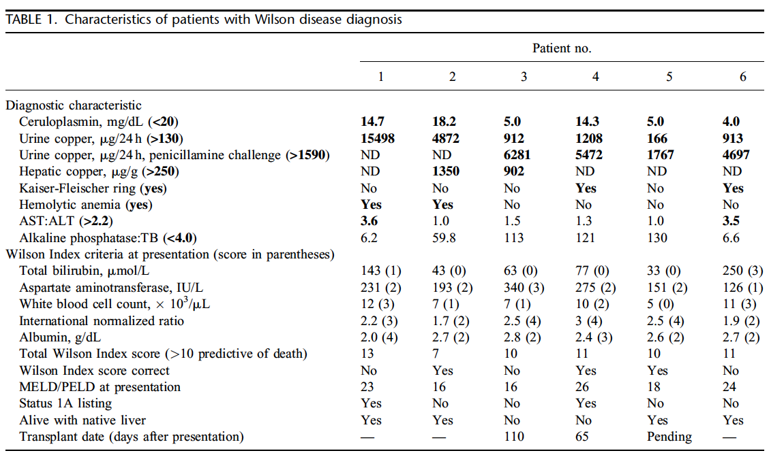

Slide 16
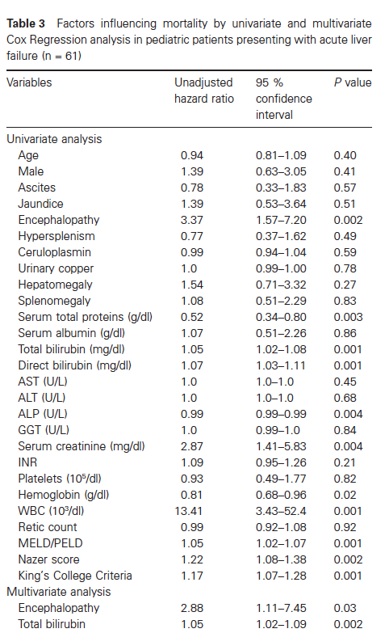
Regression formula developed to predict
mortality in our series of pediatric ALF secondary to WD
was as follows: Score = 2.87 °ø encephalopathy + 1.07 °ø total
bilirubin.
Children FWD: overall 54% mortality;
HE gr 3/4 poor survival
ALF without encephalopathy 32.4% mortality.
NWI and PELD/MELD modest accuracy in predicting outcome.

Slide 17
“Type a quote here.”
Some of the patients with fulminant WD have possibility to avoid LT

Slide 18
ILBS data

Slide 19
Outcome
82 WD….73 patients: 39 DCLD + 34 ACLF
N = 34
Death: 14 (41.1%)
LT: 4 (11.8%)
Survival with native liver: 16 (47.1%)
23 had NWI ≥ 11…….8 SNL
10 had NWI 6 - 10…3 poor outcome
HE grade 3/4 19….2 SNL
No to grade 2 HE 15….1 poor outcome
Bili >17.5 13/34, 2 SNL

Slide 20
Management of FWD
Supportive management for stabilising the patient
Chelating agents
Low Cu Diet
Rapid removal of free Cu: MARS/TPE
LT Option

Slide 21
Normally 90–95% of Cu bound to ceruloplasmin
Excess Cu binds to albumin
TPE efficiently removes both ceruloplasmin-bound and albumin-bound copper.
FFP used helpful in treating the coagulopathy
TPE is more readily available

Slide 22
MARS removed copper without detoxifying albumin dialysate from copper.
cationic resin to allow the regeneration of albumin dialysate
Improve the renal function
Clinical improvement in HE and decrease in ammonia level
Remove significant bilirubin
Stabilise patients until a liver transplant was available.

Slide 23
Total 52 sessions HVPE
24 patients
ALF- 11 (HAV, HEV)
AIH- 3
HLH-2
Wilson Ds- 8 patients (M:F= 5 :3)
19 sessions HVPE
NWI >=11
Diagnosis
Ceruloplasmin : 8 (3 – 12)
KF ring : All
U.Cu >100mcg/d: All
Hemolysis: 7 patients
Median Age: 85 mo (74 –148)
Outcomes
Median Improvement
Median Improvement
HVPE volume: 2 times the plasma volume
Complications:
Nil
Survival at Day 7 :
n=6
Survival at Day 30:
n=3
Median no of days
with native liver :
16 (3-56)
PELD - Pre HVPE 31- 48
Post HVPE 17-34
NWI Pre HVPE 15-18
Post HVPE 6-13

Slide 24
J Hepatol. 2014 Mar;60(3):579-89. Long term results of liver transplantation for Wilson's disease: experience in France.
Transplant Proc. 2012 Mar;44(2):478-80.
Liver transplantation for Wilson's disease in pediatric patients: decision making and timing.
Transplantation. 2009 Jan 27;87(2):261-7. Long-term outcomes for 32 cases of Wilson's disease after living-donor liver transplantation.

Slide 25
Conclusions
FWD/Wilsonian Crisis/ACLF/ALF high mortality almost upto 50% especially those HE grade 3 and 4
Diagnosis of this syndrome is better with conventional diagnostic criteria: Ratios limited value in children
NWI as a prognostic marker could have doubtful efficacy…..New prognostic model with HE grade 3/4
MARS and TPE are newer modalities of bridging therapy to LT
TPE/ MARS in a percentage (albiet very small) of cases may help in avoiding LT
Graft and Recipient survival after LT is good.

Slide 26
THANK YOU

Slide 27
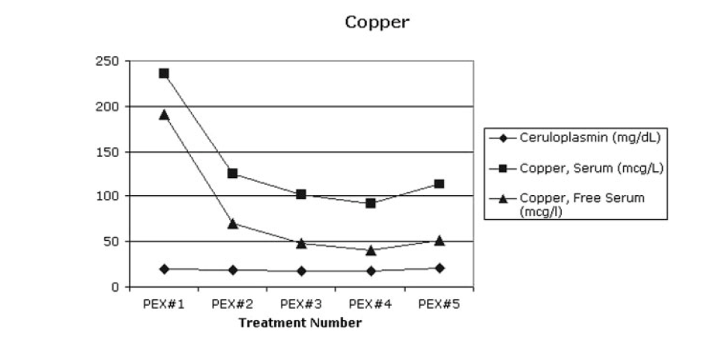
“Type a quote here.”
–Johnny Appleseed

Slide 29
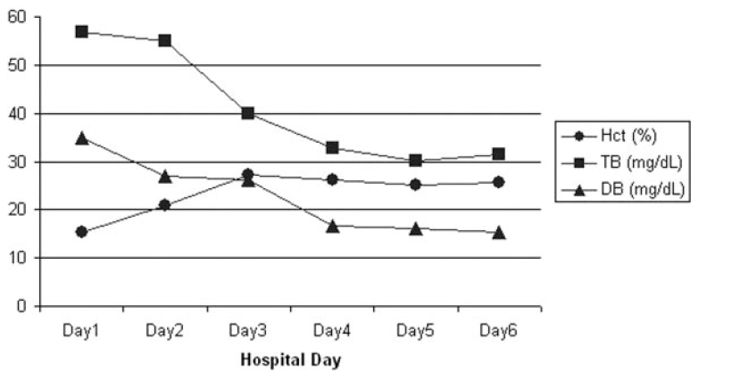
“Type a quote here.”
–Johnny Appleseed

Slide 30
HVPE in children - ILBS
Children >10 kg with ALF Static or Worsening INR / HE
INR > 4
or INR >3 with HE
with constraints for Liver transplantation

Slide 31
Blood is dialysed against a human serum albumin (HSA) dialysate solution that allows blood detoxification of both water-soluble and protein-bound toxins, by means of the presence of albumin in the dialysate (albumin dialysis). The albumin dialysate is then regenerated in a close loop in the MARS circuit

